Slide 1
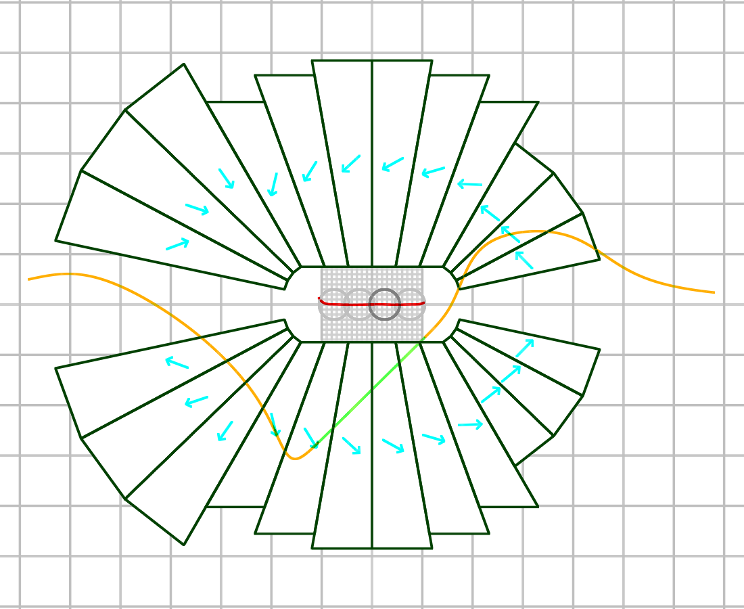
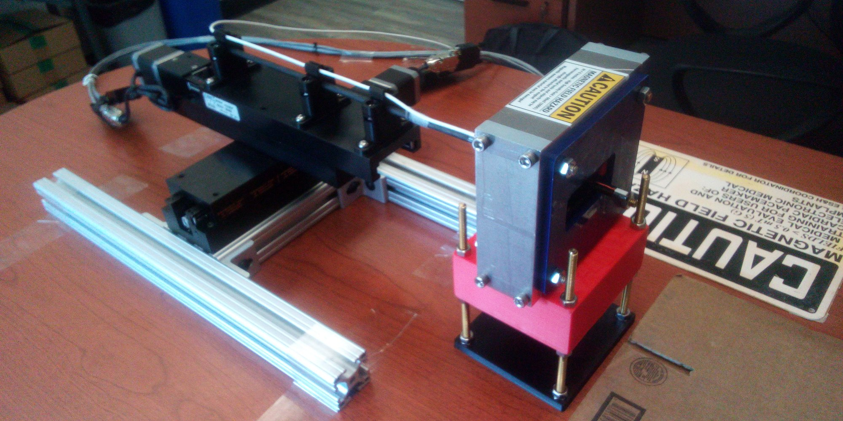
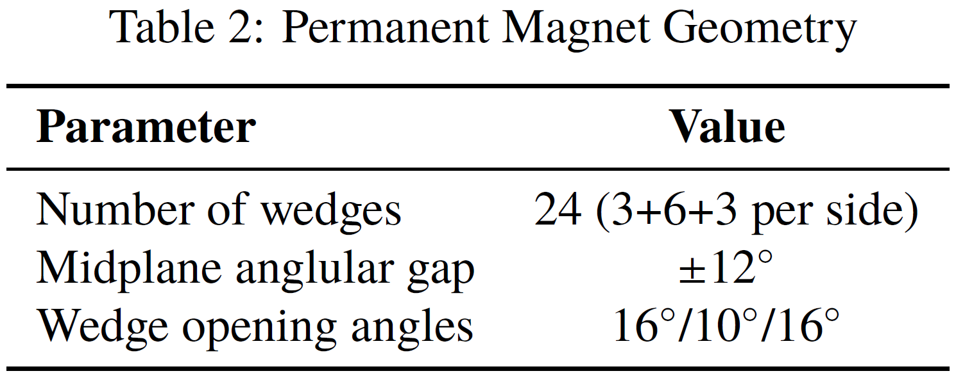
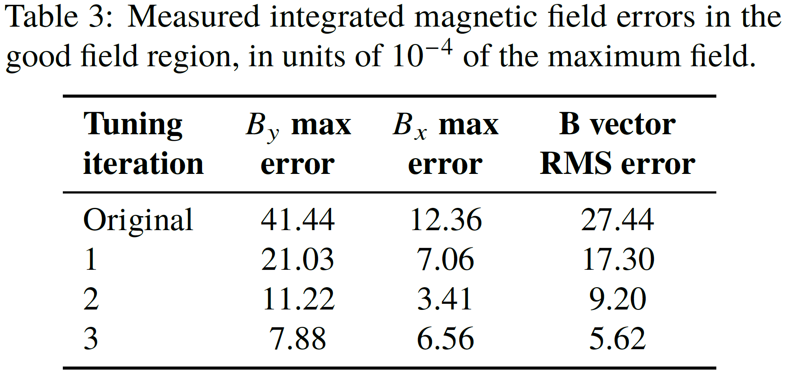
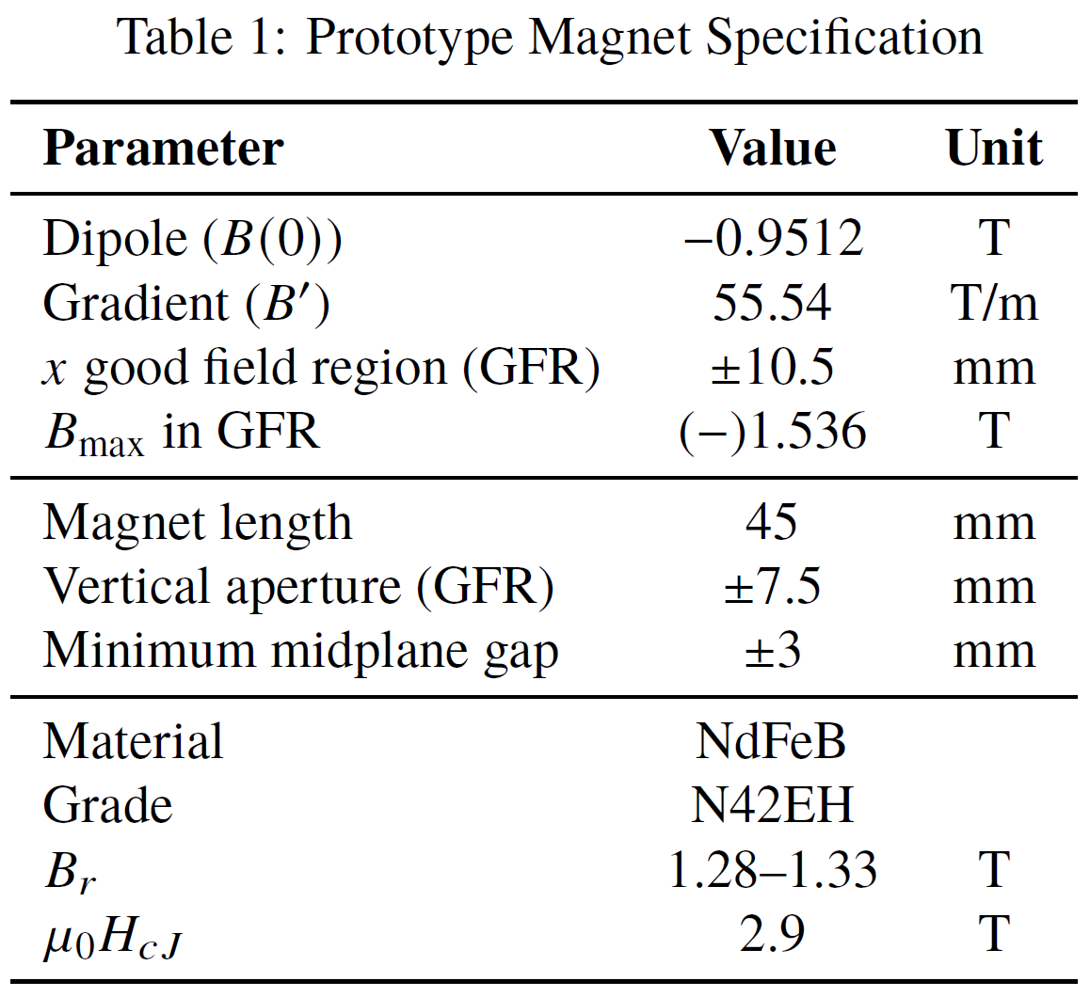
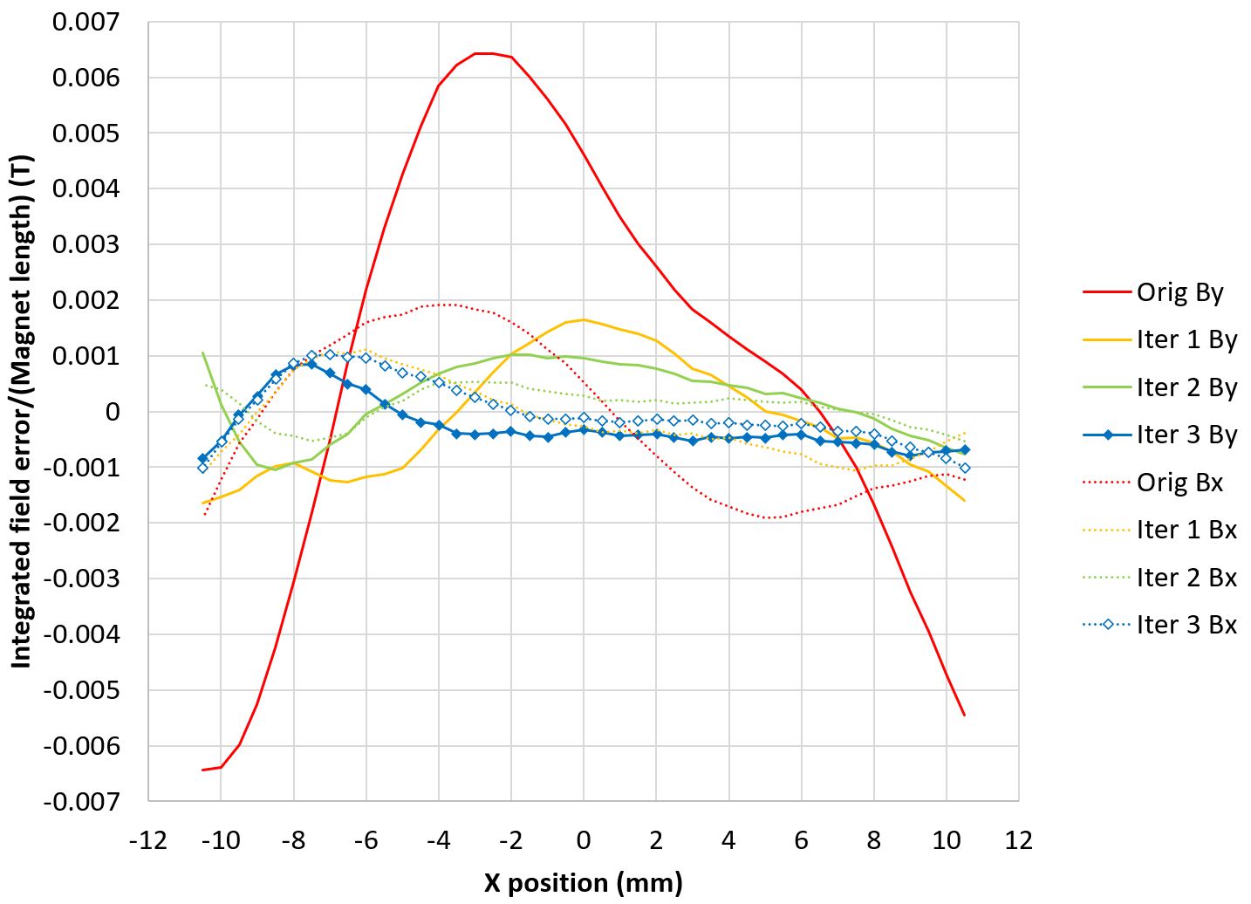
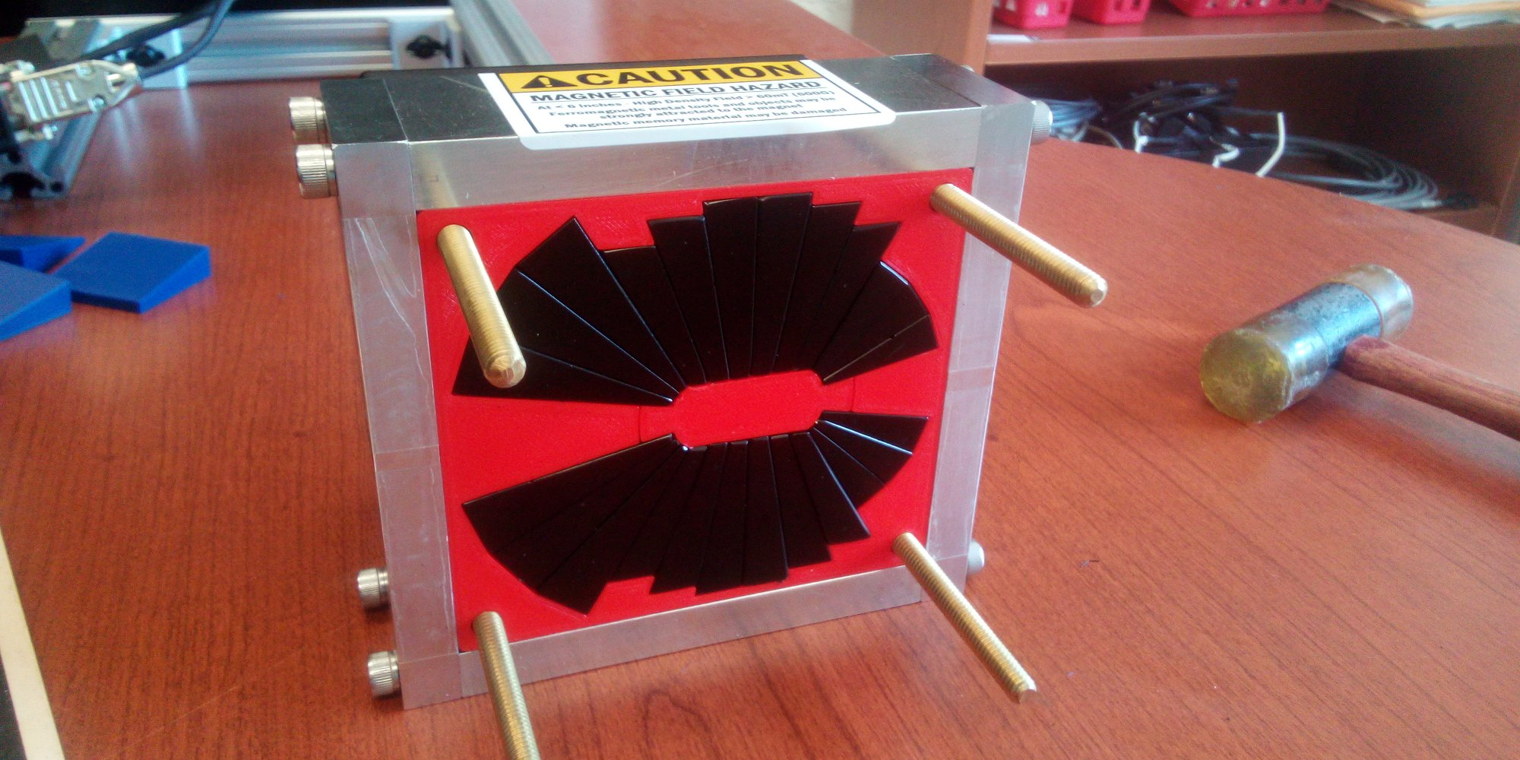

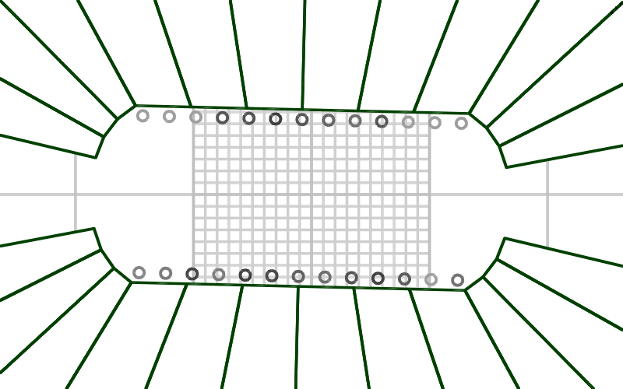
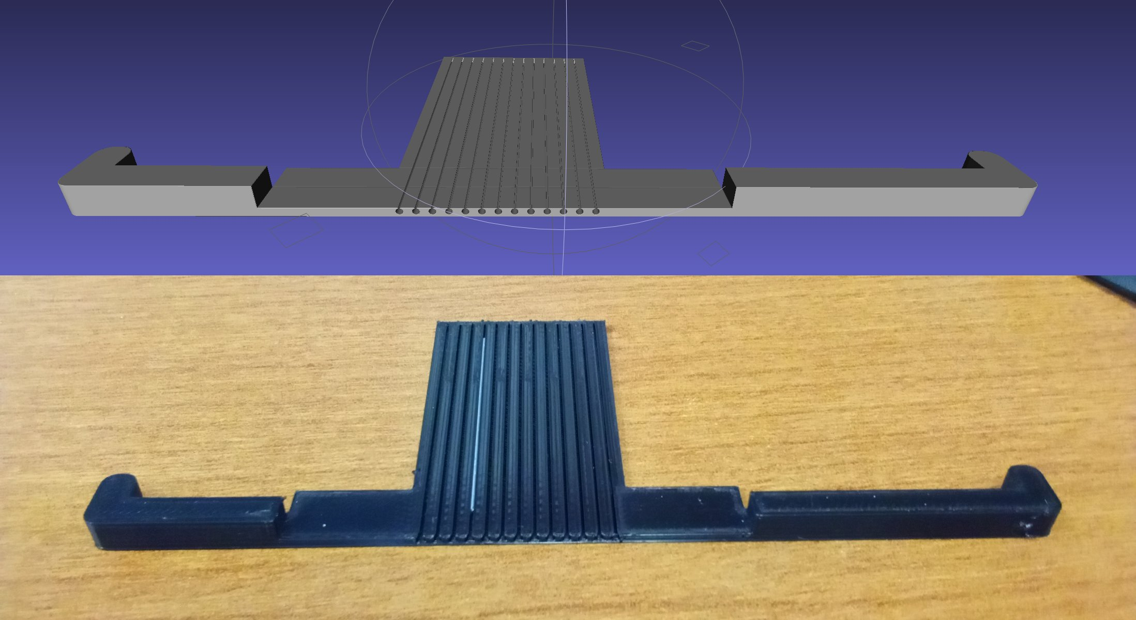
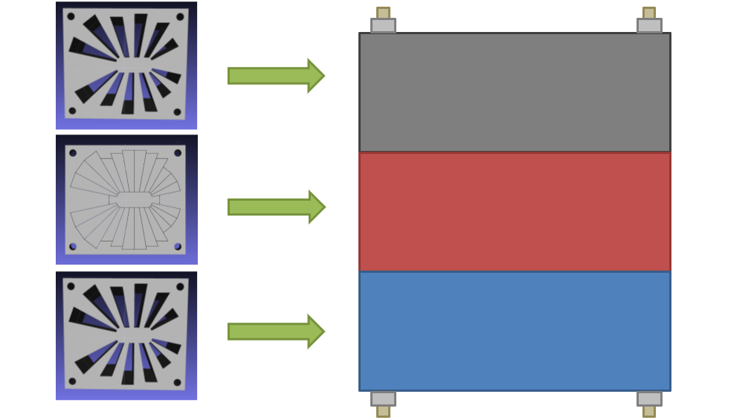
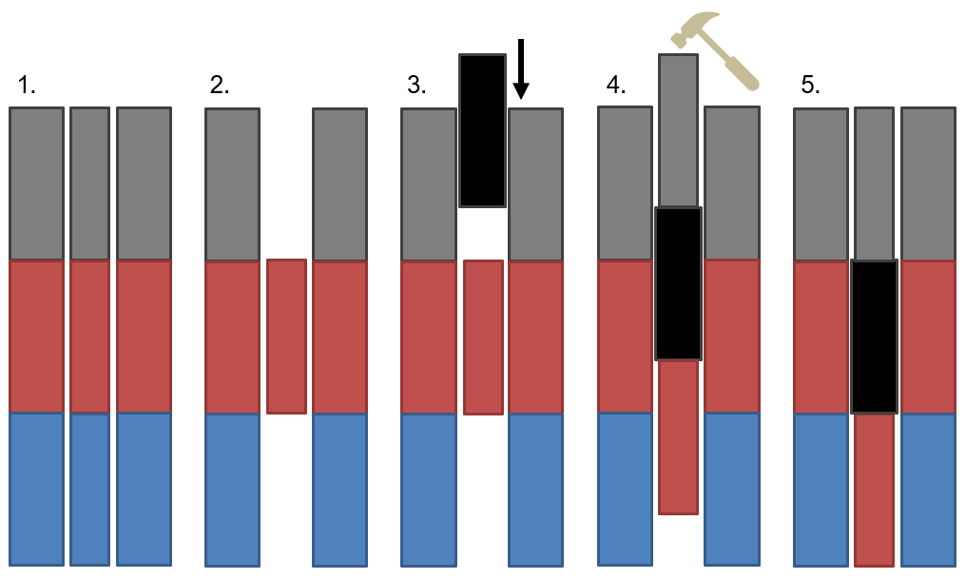
Open-Midplane Gradient Permanent Magnet with 1.53T Peak Field
S.J. Brooks {sbrooks@bnl.gov}, Brookhaven National Laboratory, Upton, NY, USA
Abstract
The CEBAF energy upgrade will require magnets with high fields to bend electron beams of up to 22 GeV in the 80.6 m radius tunnel. A peak field in excess of 1.5 T, together with a large gradient of 40 T/m or more, are used in its fixed-field arc lattice to bend multiple recirculation energies in a single pipe. Additionally, the magnet must have an open midplane to allow synchrotron radiation to be absorbed by a cooling channel.
A short 45 mm section of NdFeB prototype has been designed and built as part of permanent magnet R&D at BNL. This satisfies all the above requirements and has had its integrated field tuned to better than 1 part in 10³. This tuning process uses a technique with iron rods adapted from CBETA and miniaturised here, together with measurements at a new compact field-mapping stand that is accurate to 1 part in 10⁴.
Specification
Field Tuning Method
Given an initial measurement of the magnet’s field, small iron rods can be placed just inside the aperture to cancel field errors.
This was initially used at CBETA but adapted for a smaller aperture magnet by using rods of 0.89mm diameter instead of 2.03mm.
(left) The rods are placed in the positions shown, above and below the aperture.
(right) 3D printed holders with 13 channels for the rods on each side were manufactured.
Design
Construction
The prototype magnet was made by placing the NdFeB wedges within a 3D printed PLA mould, contained by an aluminium frame.
Magnet before central plug is removed.
Aperture of magnet after plug removed.
The forces and torques between permanent magnet wedges are too large for assembly purely by hand, so channels to guide the magnets were 3D printed and attached to the mould, as shown below (left). The mould was initially filled with plastic dummy wedges, which were replaced one-at-a-time by magnets using the channels (below right).
Field Measurements
The magnet mid-plane was field mapped with a three-axis Hall probe moving transversely and longitudinally on two stacked linear stages (shown below). A Senis 3MH6 Teslameter with ±0.01% accuracy was used.
Integrated field error as a function of transverse position in the magnet, for three successive field tuning iterations.
Conclusion
The prototype permanent magnet demonstrates:
High combined-function field levels up to 1.536 T;
Zero energy consumption;
Good linearity with relative errors <10⁻³;
An open midplane for synchrotron radiation emission, with opening angle for a stronger vacuum chamber;
An oval aperture for lower material use and cost.
These features are key for the 20 GeV CEBAF energy upgrade, as well as advanced light source lattices that use high-gradient magnets and compact fixed-field hadron therapy gantries using permanent magnets.
cm grid

