Slide 1
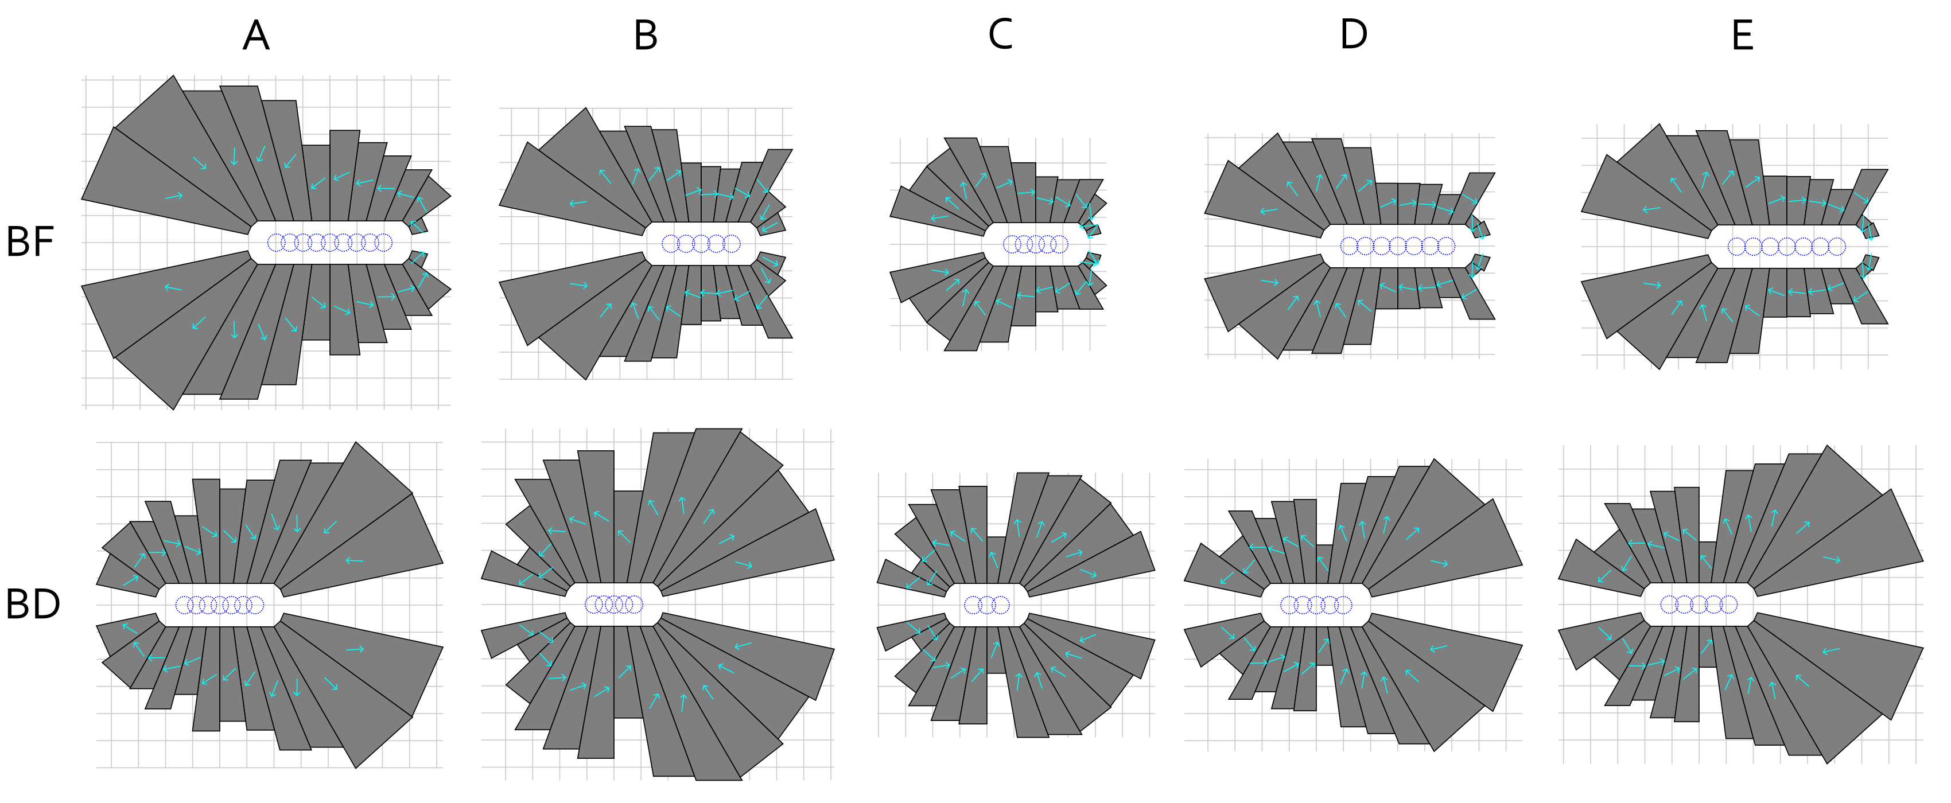
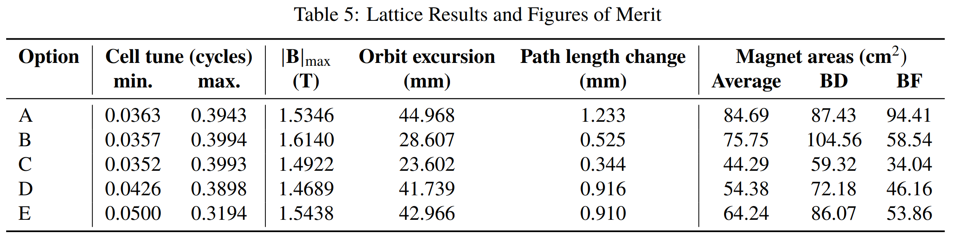
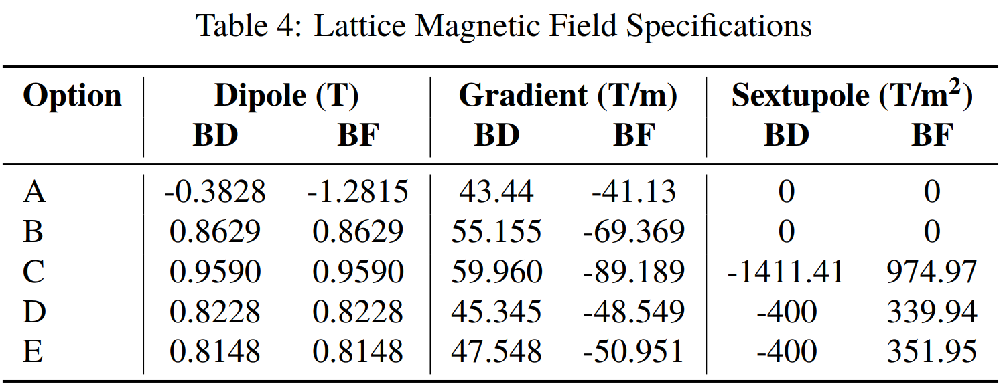
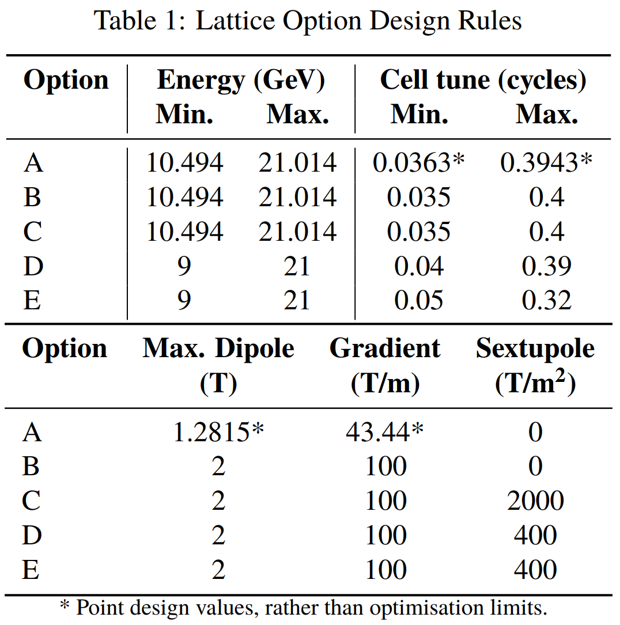
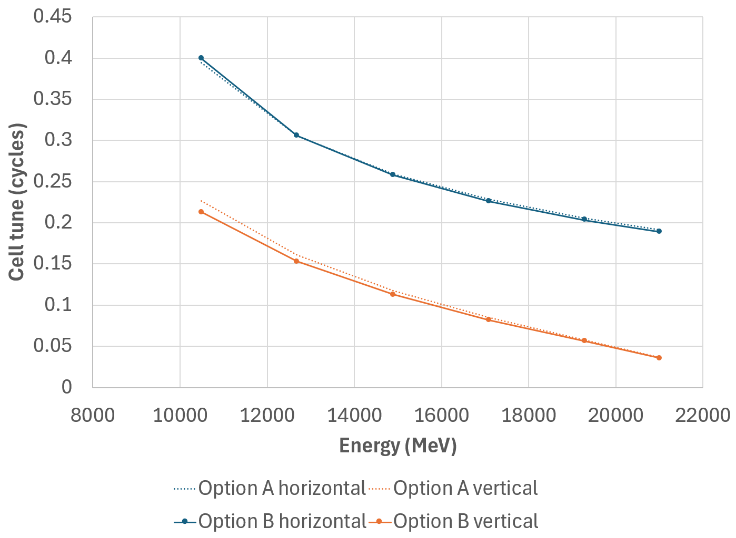
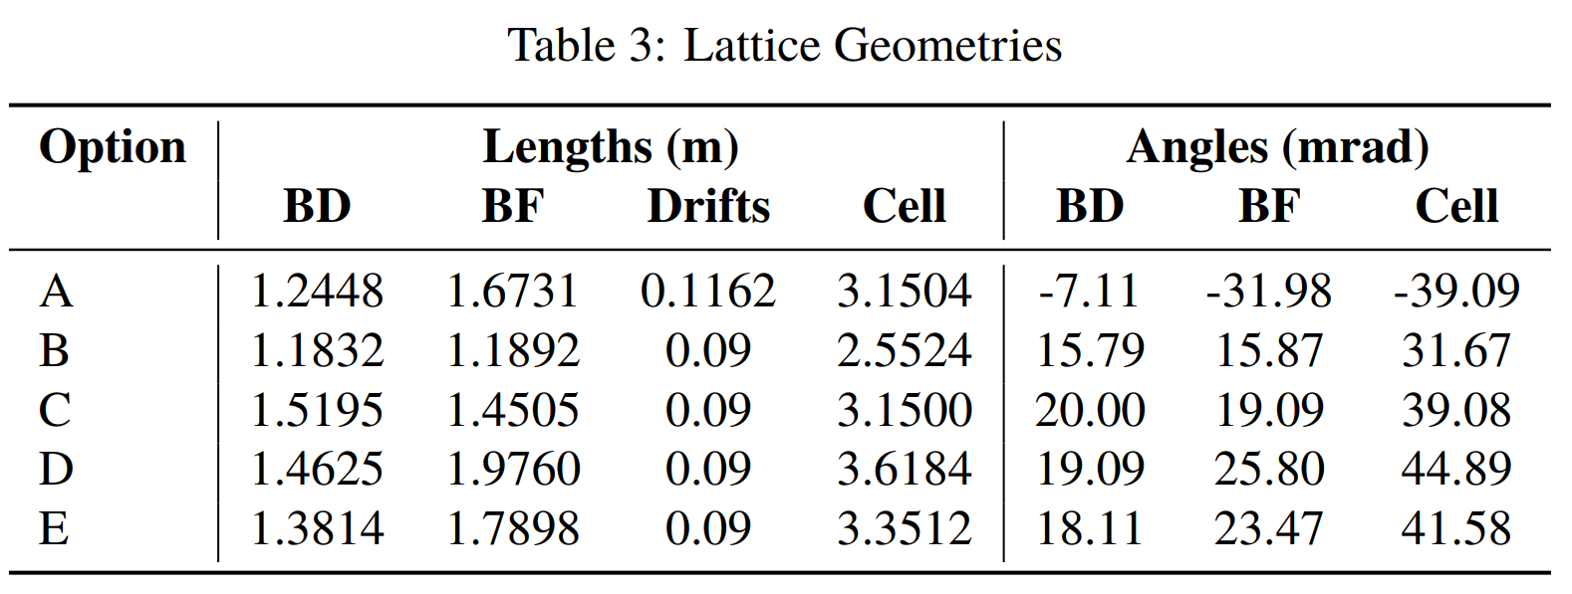
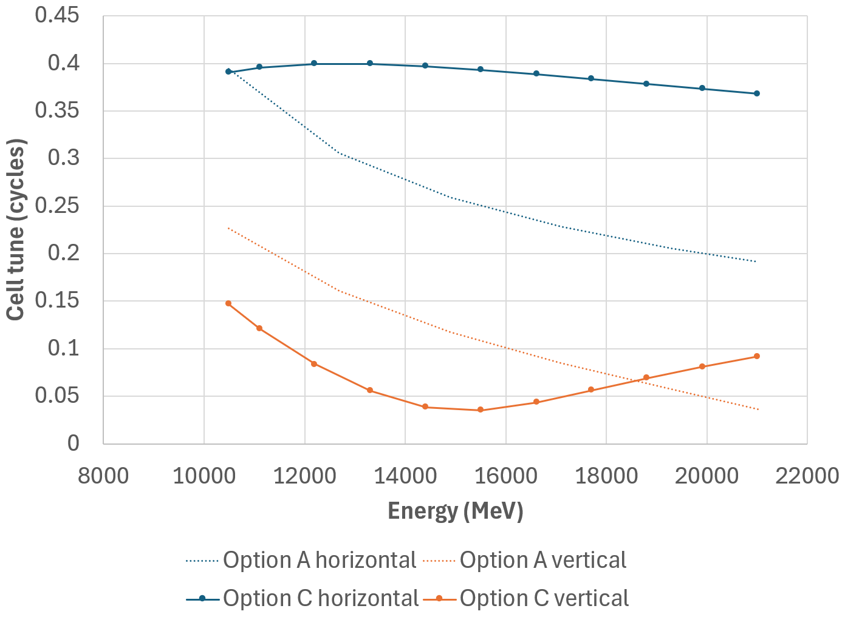
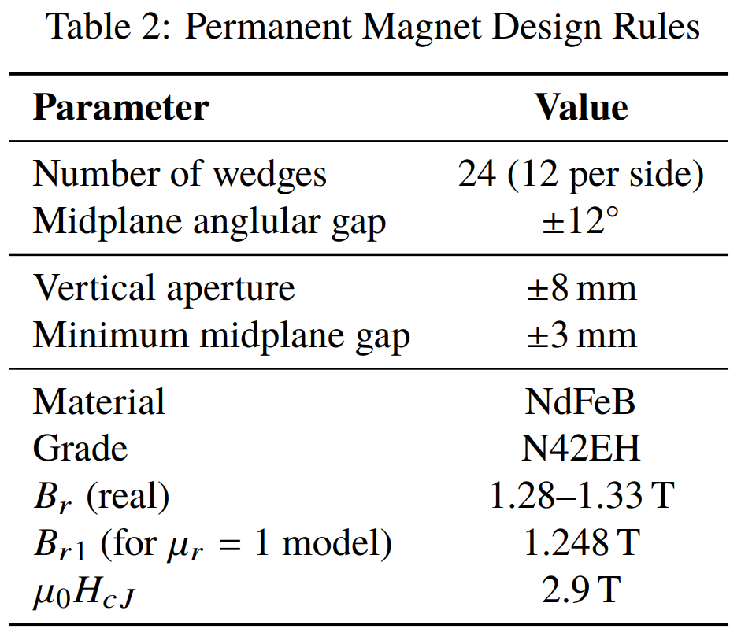
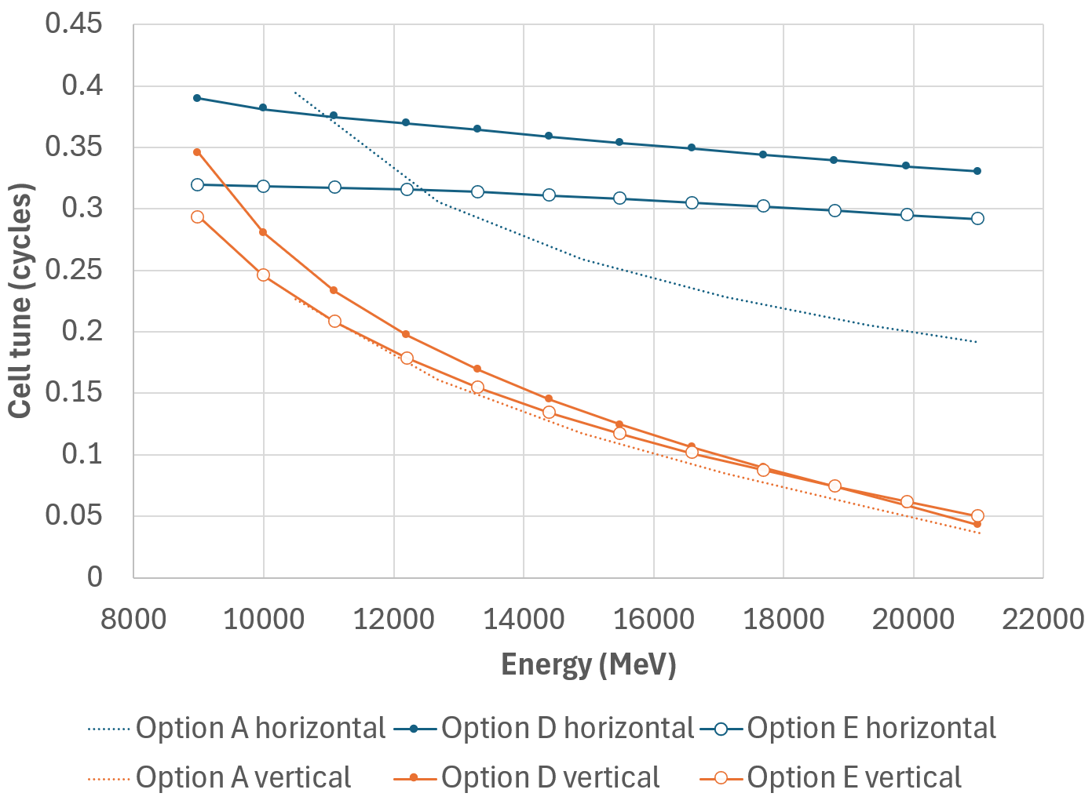
Optimisation of a Permanent Magnet Multi-Energy FFA Arc for the CEBAF Energy Upgrade
S.J. Brooks {sbrooks@bnl.gov}, Brookhaven National Laboratory, Upton, NY, USA
Abstract
It is currently planned to increase the energy of the CEBAF recirculating linear accelerator to 20GeV or more by adding two new recirculating arcs that contain multiple new energy passes. The beam is continuous (CW), so no field ramping is desired, making this a fixed-field accelerator (FFA). The wide energy range requires a low dispersion lattice that can be created with high-gradient permanent magnets. One constraint is the existing tunnel radius in relation to the fields achievable by practically-sized permanent magnets. Thus, searching for the most efficient implementation in terms of magnet material volume is important. In this paper, a lattice cell search and optimisation is conducted that evaluates cells by the magnet volume per unit length, with the permanent magnet designs also produced via an automated code. The new lattice cells are compared to the previous manually designed cell.
Lattice Constraints
Option A is the baseline lattice with linear fields. Constant radius of curvature 80.6m was used to fit the CEBAF tunnel.
Magnet Constraints
Permanent Magnets
Lattice Results
Optimisation Method
Candidate lattice cells were tracked with the Muon1 code and optimised with its built-in genetic algorithm. The optimiser started from random designs with no manually-set starting point, so the following scoring ranges were used to guide it towards viable designs.
If the first energy is unstable or has an unacceptable tune, the cell is scored by how far cos φ (calculated from the trace of the transfer matrix) deviates from the desired tune range limits, where φ is the phase advance.
If the first energy has correct tunes but later ones do not, the cell is scored by the percentage of the FFA energy range that is acceptable.
If all energies have correct tunes, the HalbachArea code is called to attempt magnet designs. If the magnet design fails, the cell is scored by peak field in the bore of the accelerator, with lower being better.
If all energies have correct tunes and magnets exist, the cell is scored by the average magnet area (Σ_{Elements e} A_{e} L_{e}) / Σ_{e} L_{e} weighted by length through the cell, with lower being better.
Cell Tunes vs. Energy
Grid is 1cm, arrows indicate magnetisation direction.
cm grid
BF
o
BD
o
A,B
C
D,E

