Slide 1
Benchmarking and Simulating the CBETA FFAG Arc Cell
Page Headline
Lattice Design Scott Berg
Muon1 Simulations Stephen Brooks
JSBFMD Simulations Scott Berg
BMAD Simulations Chris Mayes

Slide 2
Tracking Codes for CBETA
BMAD
Used for end-to-end lattice, layout, tracking, some collective effects. Needed some tweaking to track fieldmaps.
PTC
Used for Cornell injector, good space charge model.
Muon1
FFAG optimisation with fieldmap tracking or soft-edged magnet models.
JSBFMD
FFAG design with fieldmaps, optimisation of fieldmap placement.
JSBISD
FFAG design with hard-edged equivalent optics.
Zgoubi (work in progress)
Will do nonlinear fieldmap tracking, spin tracking, end-to-end.

Slide 3
Code Comparison
JSBFMD (developed recently for CBETA by Scott Berg)
Uses cylindrical polar coordinates (r,theta,y)
Tracks in theta
Also Runge-Kutta 4th order
Fieldmaps are fitted with smooth splines and particles are tracked through the spline fit
BMAD
Hard-edged fit to CBETA cell
Muon1 (by Stephen Brooks)
Uses Cartesian global-frame coordinates
Tracks in t
Runge-Kutta 4th order
Fixed timestep of 10ps (I sometimes lower this to 5ps for CBETA, very little difference)
Fieldmaps are interpolated trilinearly (occasionally leads to rough edges when finding tunes)
NB: previous work for eRHIC got good agreement on an FFAG lattice between Muon1, Zgoubi, MAD-X+PTC and SYNCH

Slide 4
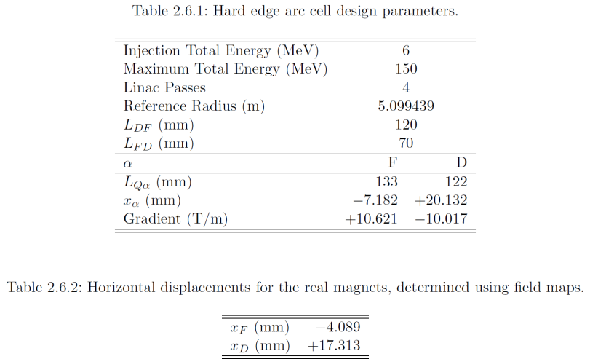
CBETA FFAG Arc Cell Lattice

Slide 5
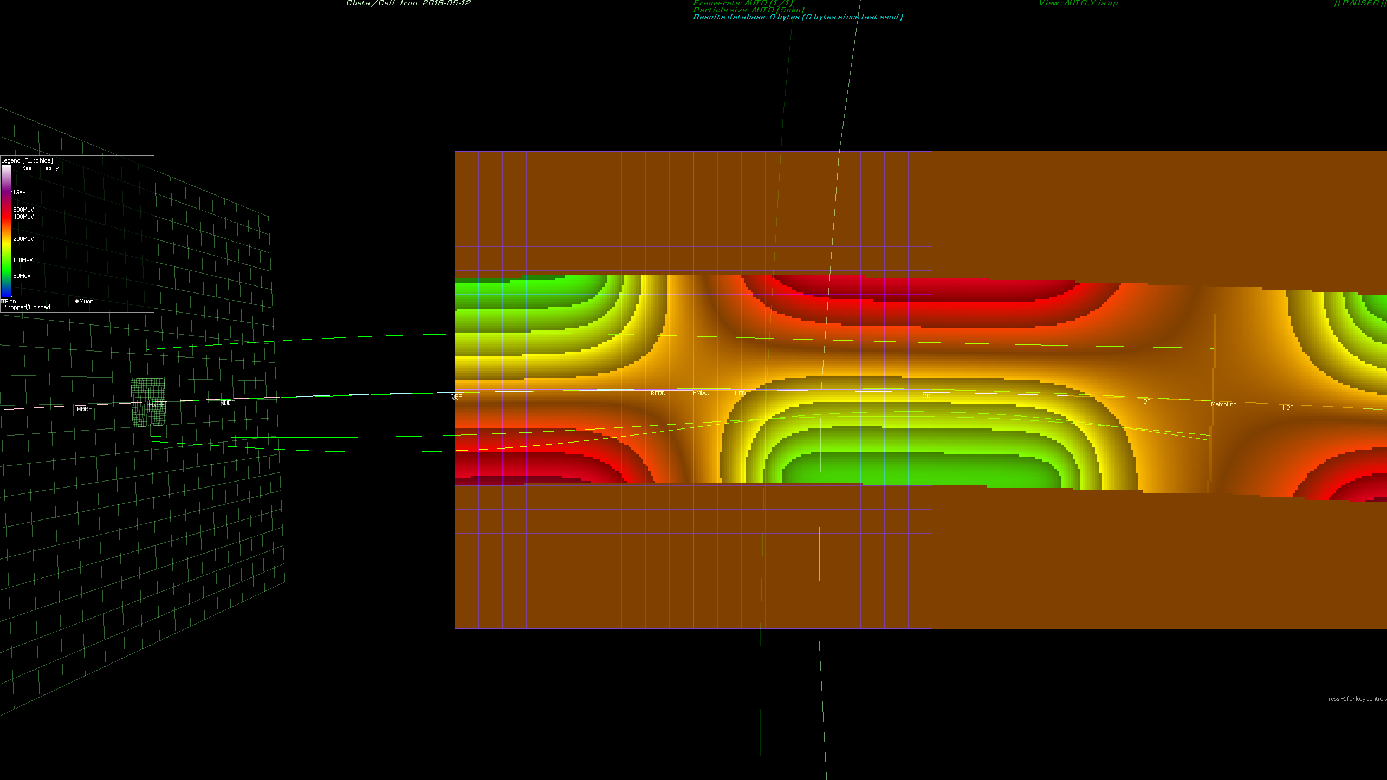
Page Headline
Muon1 Simulation
Colours are B_y component of fieldmap, bands are 0.1T intervals, dark orange band = 0

Slide 6
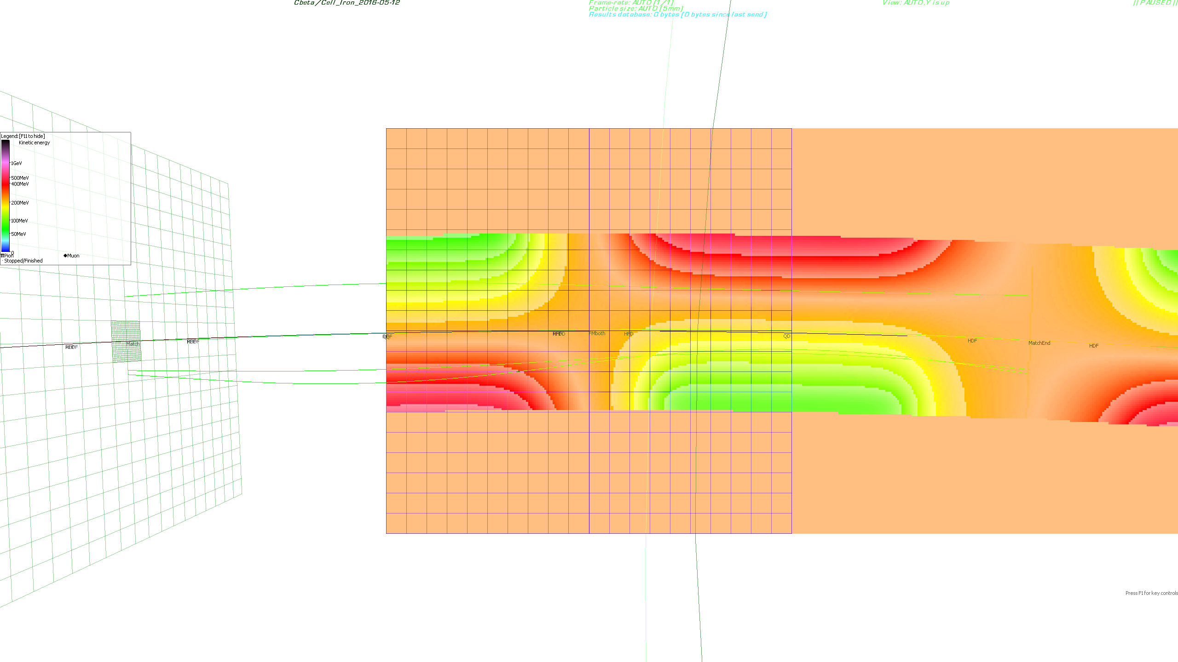
Page Headline
Muon1 Simulation
Colours are B_y component of fieldmap, bands are 0.1T intervals, dark orange band = 0

Slide 7
Cell Tunes from Muon1

Slide 8
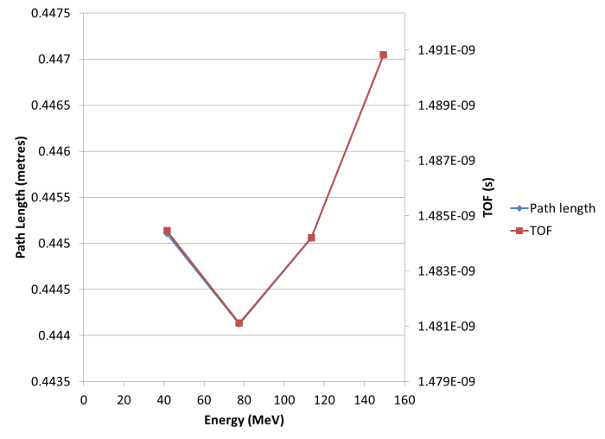
Cell Path Length and TOF

Slide 9
Cell Tunes from Both Codes
Total Energy (MeV) | Muon1 Cell Tune X | JSBFMD Cell Tune X | BMAD Cell Tune X | Muon1 Cell Tune Y | JSBFMD Cell Tune Y | BMAD Cell Tune Y
42 | 0.360041 | 0.363443 | 0.361953 | 0.286975 | 0.289387 | 0.290147
78 | 0.177298 | 0.178187 | 0.177897 | 0.119886 | 0.120718 | 0.121138
114 | 0.125858 | 0.126546 | 0.124989 | 0.063870 | 0.064455 | 0.063132
150 | 0.104551 | 0.105049 | 0.103141 | 0.039038 | 0.039960 | 0.039837
Only the first turn (42MeV) is in the region susceptible to strong resonances. The rest of the turns are in the pseudo-continuous phase advance regime.
The low tune is always the Y tune at the highest energy. Going higher makes it difficult to find a lattice with practical field strengths. Going lower makes optics sensitive to focussing errors and not enough phase advance for “adiabatic” transition from FFAG arc to straight.

Slide 10
CBETA FFAG Arc Cell (and Holger’s Fieldmaps) Imported Into Muon1
File “Cbeta/Cell_Iron_2016-05-12”
{Scott's 150MeV lattice from "160507-JSBerg" folder, using Holger's fieldmaps from "160512-FieldMap" subfolder}
#h = +1.9610000439244032e-01;
#R=1.0/h;
#lqf = +1.3300000000000001e-01;
#lqd = +1.2200000000000000e-01;
#lfd = +7.0000000000000007e-02;
#ldf = +1.2000000000000000e-01;
#thqf=2*asin(0.5*lqf/R);
#thqd=2*asin(0.5*lqd/R);
#thfd=2*asin(0.5*lfd/R);
#thdf=2*asin(0.5*ldf/R);
{Drift Length Angle}
DF #R*thdf# #thdf*-1#
QF #R*thqf# #thqf*-1#
FD #R*thfd# #thfd*-1#
QD #R*thqd# #thqd*-1#
HDF #DF.Length/2# #DF.Angle/2#
HFD #FD.Length/2# #FD.Angle/2#
No scaling or displacement for final fieldmap version
#scalboth = 1; dispboth = 0;
#scalF = 1; scalD = 1;
#dispF = 0; dispD = 0;
{TrilinearFieldMap File Strength Xrel MirrorY=1}
FMboth Cbeta\Iron_2016-05-12\160308a-38-48_5deg150MeVCombQdOnQfOn_polar.txt #scalboth*-1# #dispboth-R#
FMF Cbeta\Iron_2016-05-12\160308a-38-48_5deg150MeVSepQfOn_polar.txt #scalF*-1# #dispF-R#
FMD Cbeta\Iron_2016-05-12\160308a-38-48_5deg150MeVSepQdOn_polar.txt #scalD*-1# #dispD-R#
CellFM: HDF,QF,HFD,FMboth,HFD,QD,HDF;
CellFMsep: HDF,QF,HFD,FMF,FMD,HFD,QD,HDF;
#Emin = +4.2000000000000000e+07;
#Emax = +1.5000000000000000e+08;
#n = 4;
#EmasseV=510998.928;
{MatchScan Estart Egoal Estep Species=Electron AllowUnstable=1}
Match #Emax-EmasseV#eV #Emin-EmasseV#eV #(Emax-Emin)/(n-1)#eV
MatchFine #Match.Estart# #Match.Egoal# 1MeV
{Match-Aperture}
MatchEnd
CellFM,Match,CellFM,MatchEnd,CellFM;
Fieldmaps
Scott’s parameters
h is inverse radius
Convert chord lengths to arc lengths
Cell definitions
Scott’s energy range
Number of passes
Units, total E. -> k.e.
Define empty circular arc elements (radius R) for layout reference
Half-elements
Place 3 cells to allow fringe field overlaps

Slide 11
Focus: Aligning the Fieldmaps
{TrilinearFieldMap File Strength Xrel MirrorY=1}
FMboth Cbeta\Iron_2016-05-12\160308a-38-48_5deg150MeVCombQdOnQfOn_polar.txt #scalboth*-1# #dispboth-R#
FMF Cbeta\Iron_2016-05-12\160308a-38-48_5deg150MeVSepQfOn_polar.txt #scalF*-1# #dispF-R#
FMD Cbeta\Iron_2016-05-12\160308a-38-48_5deg150MeVSepQdOn_polar.txt #scalD*-1# #dispD-R#
CellFM: HDF,QF,HFD,FMboth,HFD,QD,HDF;
CellFMsep: HDF,QF,HFD,FMF,FMD,HFD,QD,HDF;
3 fieldmaps with long file names
Field magnitude is inverted due to difference in curvature direction (JSBFMD vs. reality)
Relative position in local X is “-R”, i.e. origin is centre of radius R circle
Mirrored in Y to give both positive and negative Y
For each version of the cell (combined or separate fieldmaps), the maps are placed at the centre of the F-to-D (short) drift
The cell entrance/exit is the centre of the D-to-F (long) drift

Slide 12
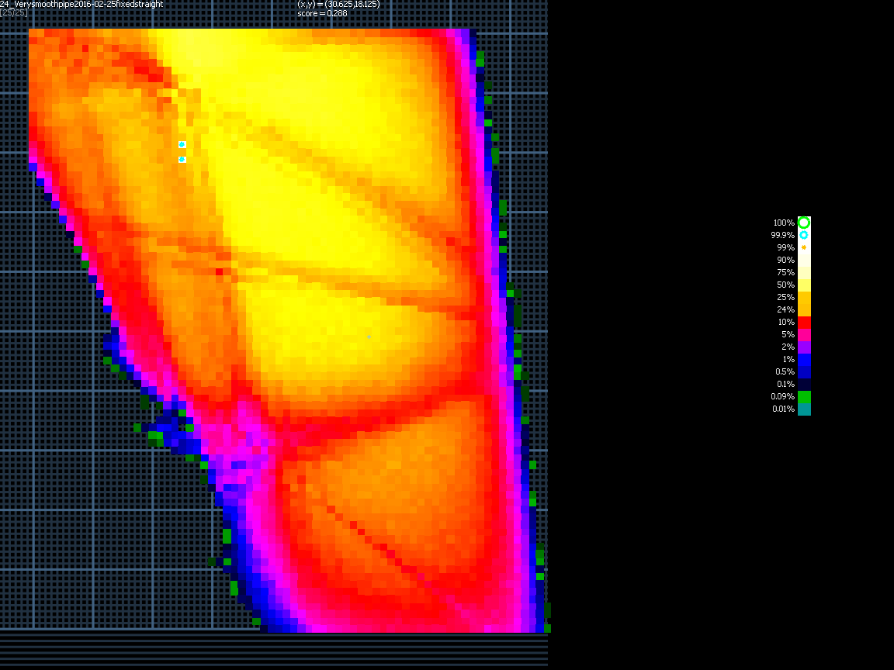
Resonance Plot
QF strength
Plot of aperture (transmission of v.large 1cm-radius beam) as a function of two focussing strengths
Qy=1/4
Qy=1/3
For lowest-energy pass, highest tunes.
Working point circled:
(Qx,Qy) = (0.360,0.287)
Qx=1/3
Qx=1/2
QD strength

Slide 13
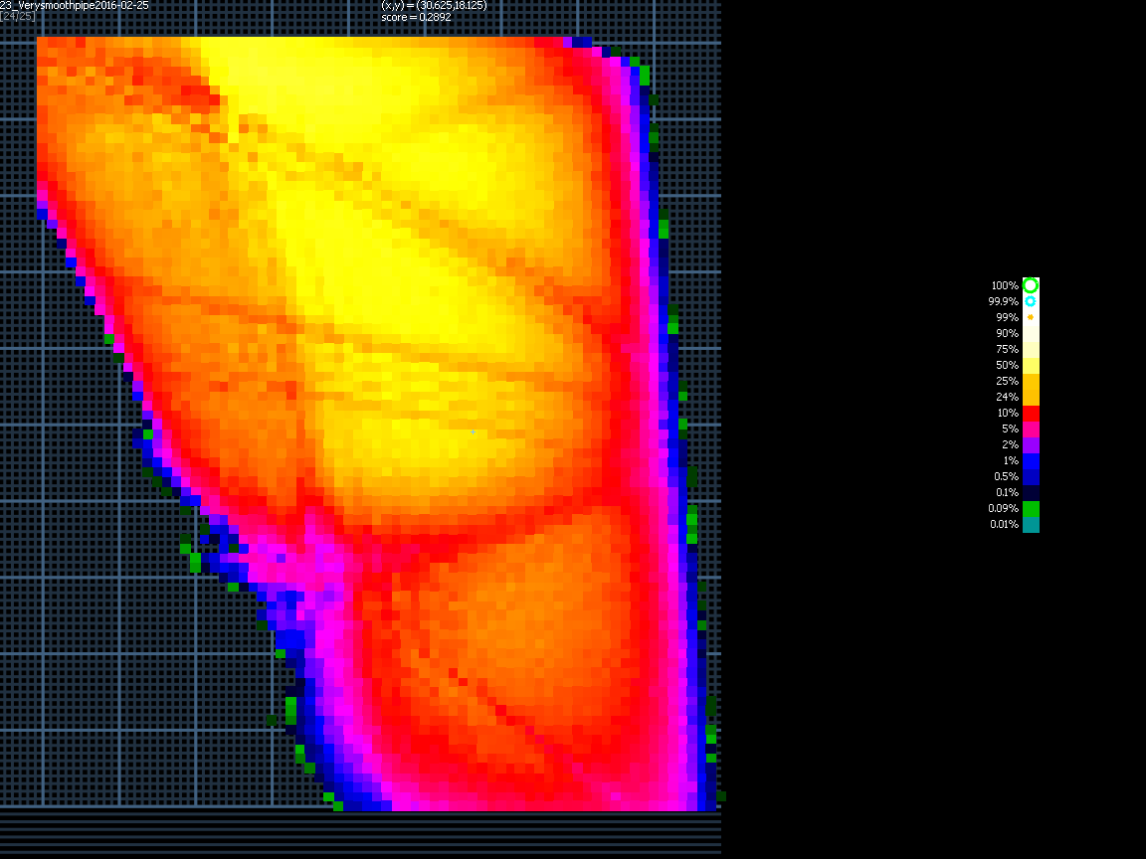
Resonance Plot
before adjustment to straight drift lengths
Resonance band features broadened because straight section has different tunes to arcs. Can fix by adjusting straight section drift lengths.

Slide 14
Conclusions
The CBETA FFAG has been simulated in JSBFMD, Muon1 and BMAD
These codes have very different internal operation yet we get consistent results
Arc-to-straight match has been optimised for an old lattice, currently being optimised for the newest version

