Slide 1
CBETA Production Magnets
QD 2421, 2424-26
QF 2527, 2531-33, 2538-40, 2543, 2544, 2547, 2548, 2553-56, 2567

Slide 2
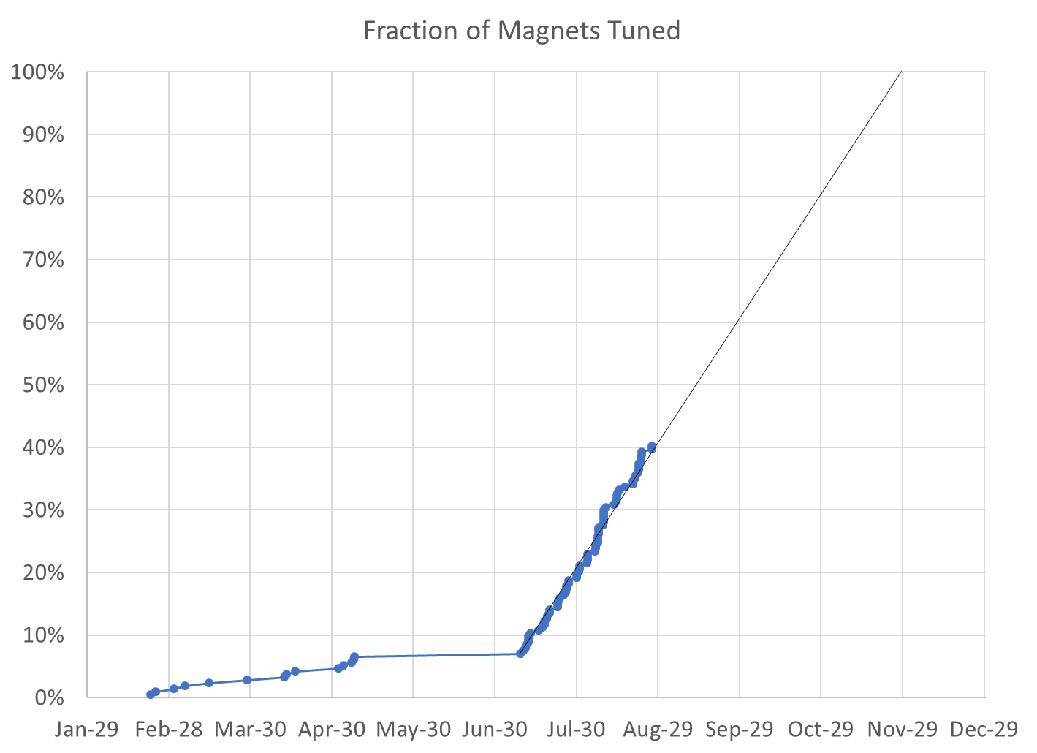
40% complete
86 / 214 magnets (128 remaining)

Slide 3
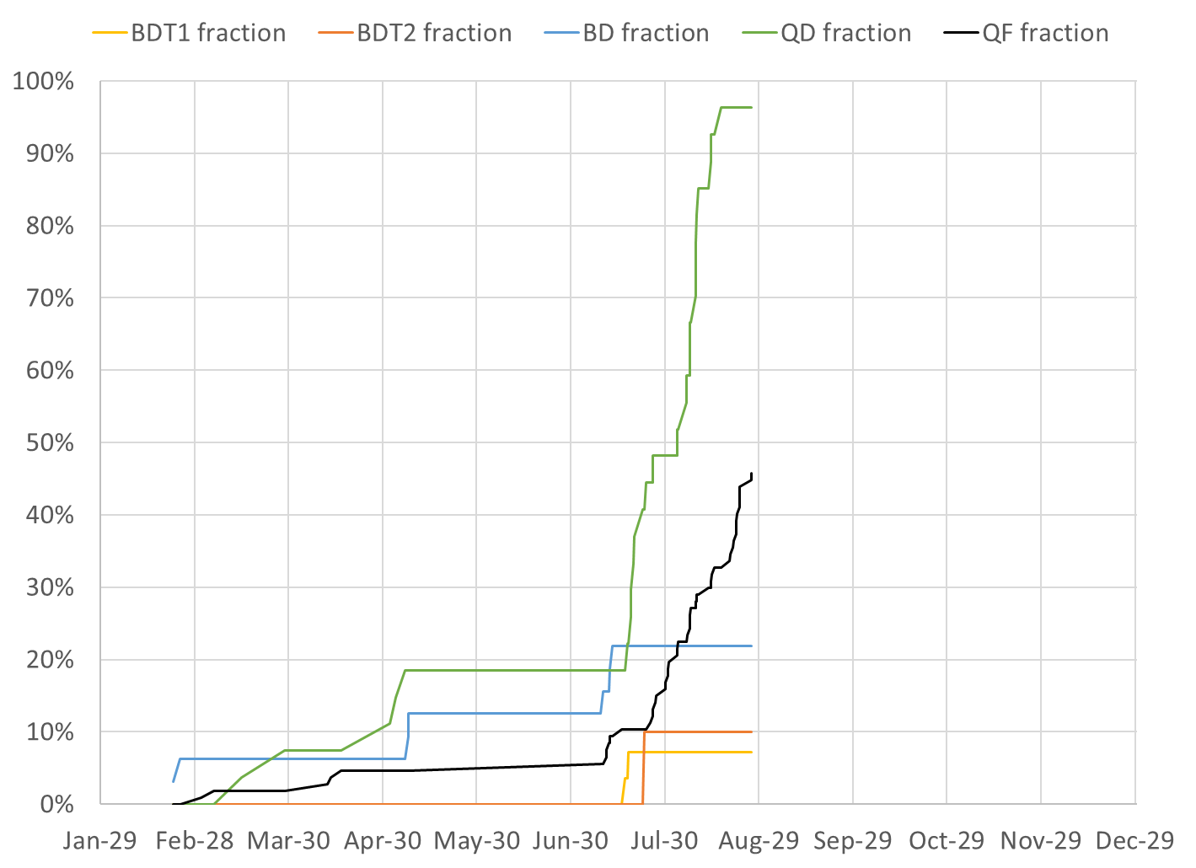
BDT1 2 / 28 magnets (26 remaining)
BDT2 2 / 20 magnets (18 remaining)
BD 7 / 32 magnets (25 remaining)
QD 26 / 27 magnets (1 remaining)
QF 49 / 107 magnets (58 remaining)

Slide 4
Projections
Method | Rotating Coil Measurements per Week | Magnets Tuned per Week | Projected Finish Date | Speed-up Required to Finish Nov-30
Magnets rate since main production start |  | 10.16 | Nov-23 | 7 calendar days spare
Rotating coil rate last 3 weeks plus model | 34.6 | 12.38 | Nov-08 | 22 calendar days spare
Rotating coil rate since start | 26.2 | 9.21 | Dec-03 | +4.0%
Required to hit deadline | 27.2 | 9.58 | Nov-30 | 0%

Slide 5
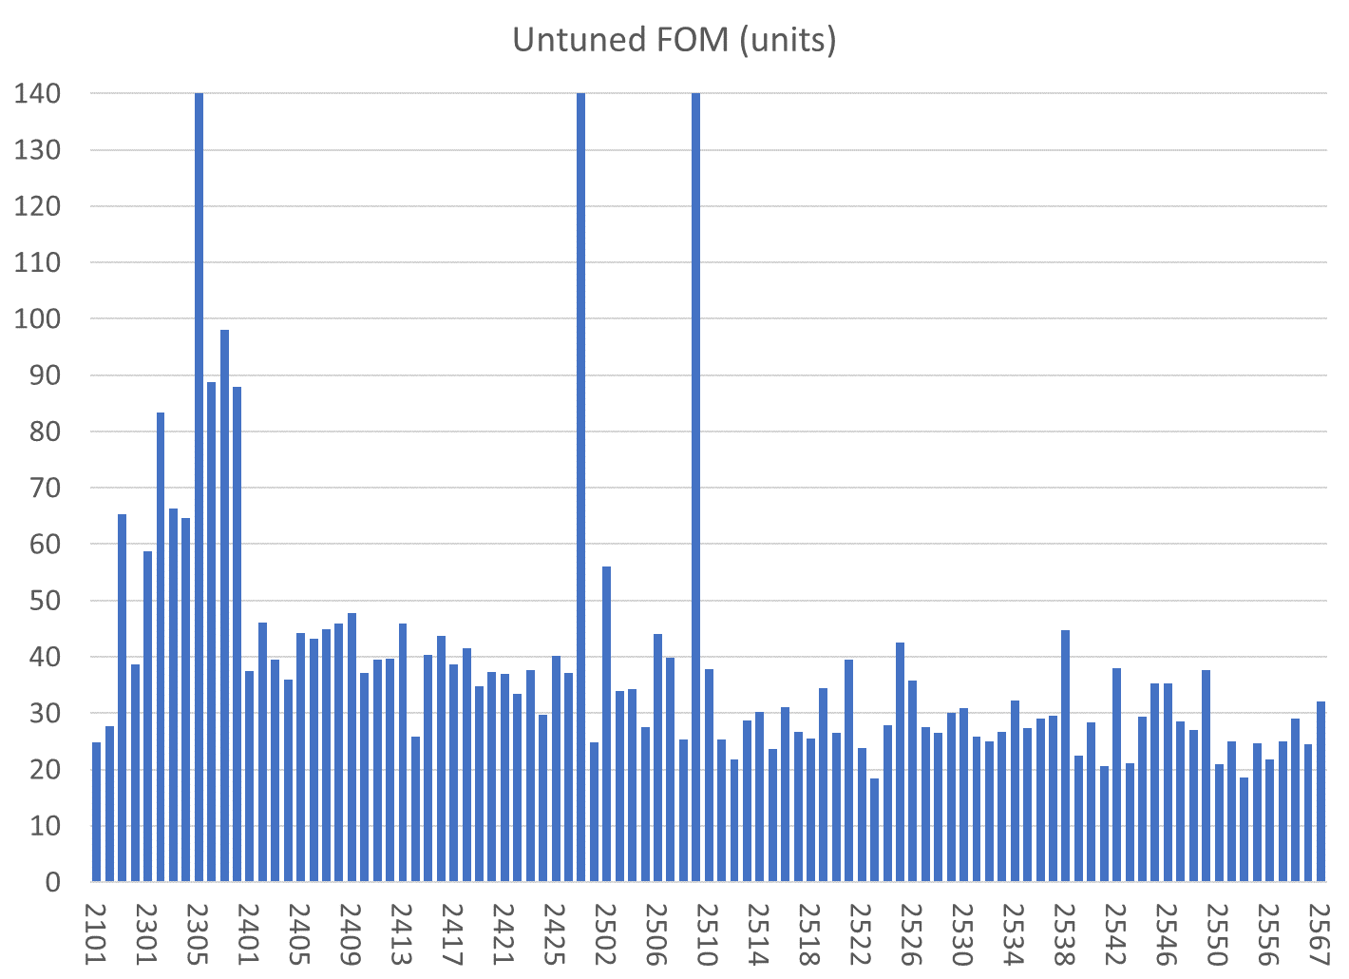
All magnets are shown, those under consideration this week are under light blue bars
Reject
Reject
BD
BDT1
QD
QF
BDT2
Reject

Slide 6
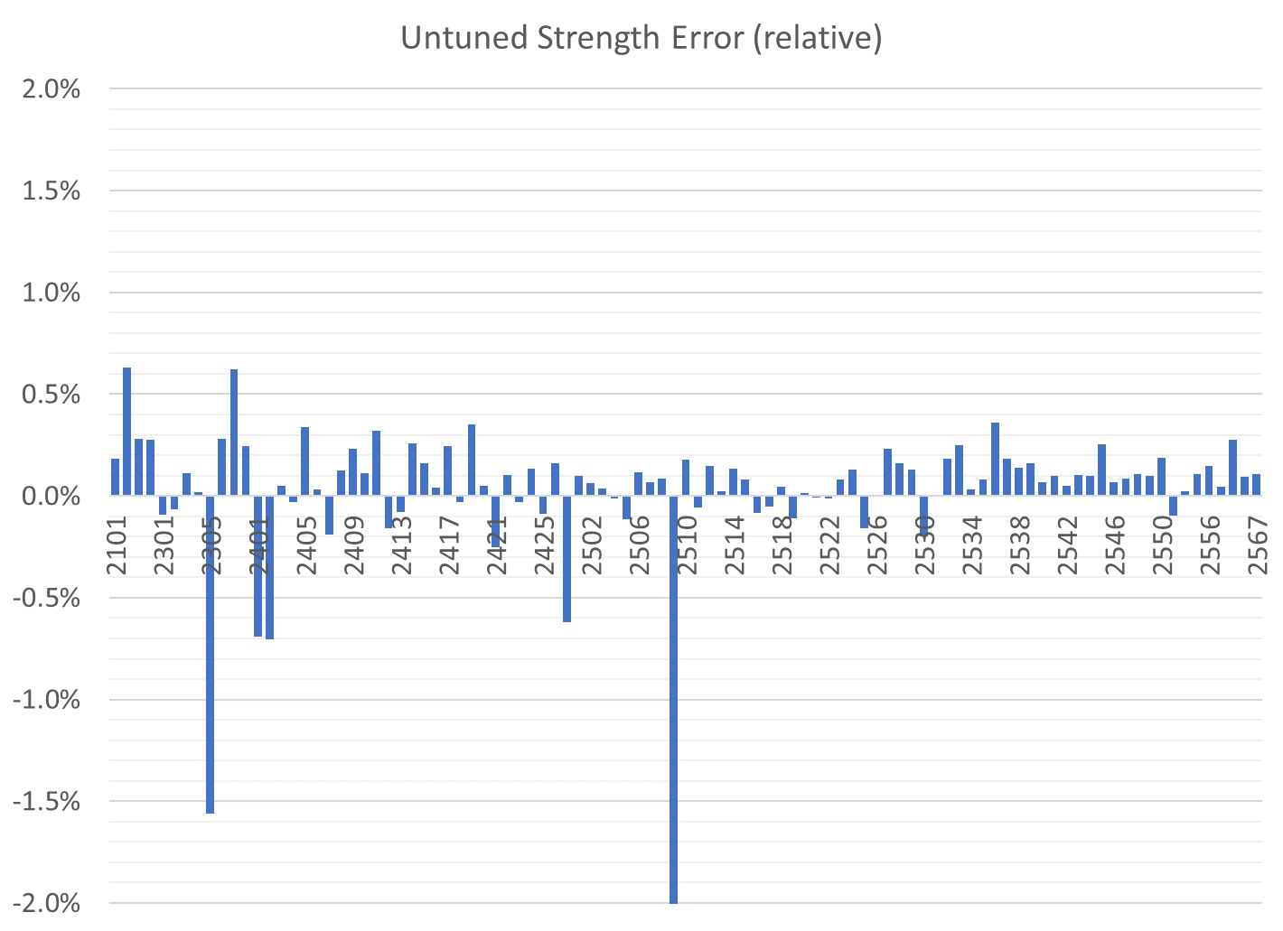
All magnets are shown
BDT1
BD
QD
QF
BDT2
Reject
Correcteed in aluminium
Reject
Reject

Slide 7
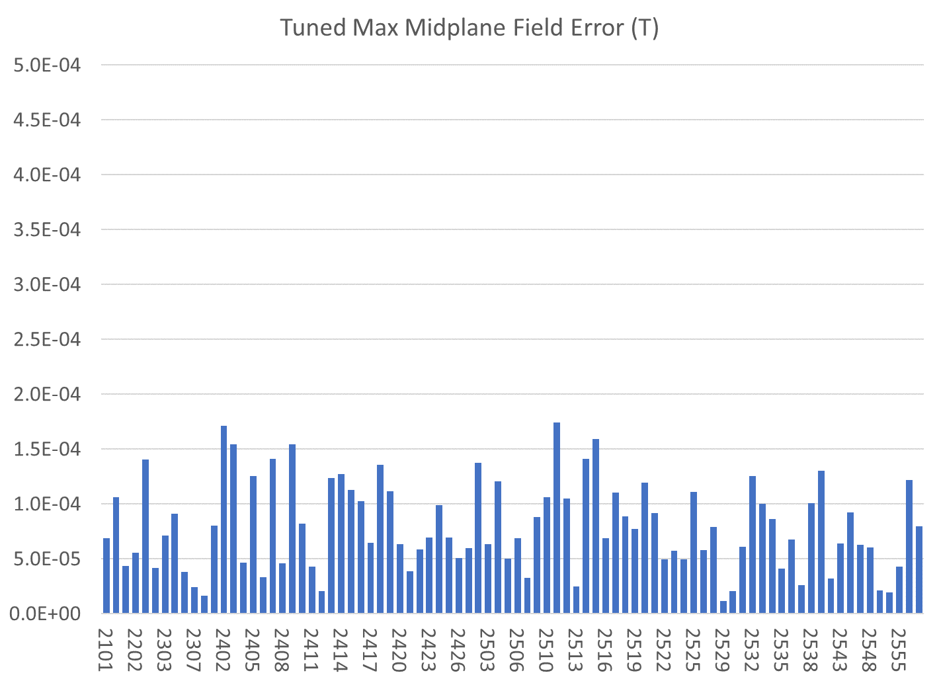
Only tuned magnets shown (3 “rejects” also removed)
BDT1
BD
QD
QF
BDT2

Slide 8
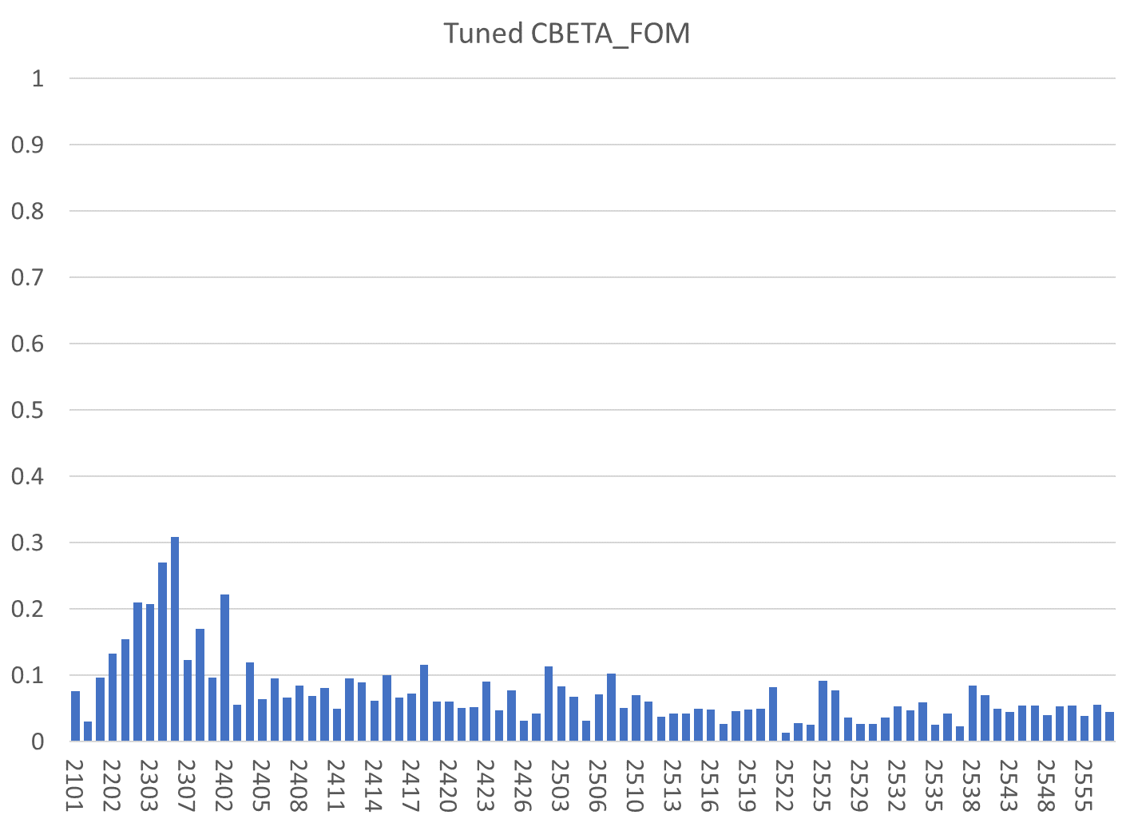
Only tuned magnets shown (3 “rejects” also removed)
BDT1
BD
QD
QF
BDT2

Slide 9
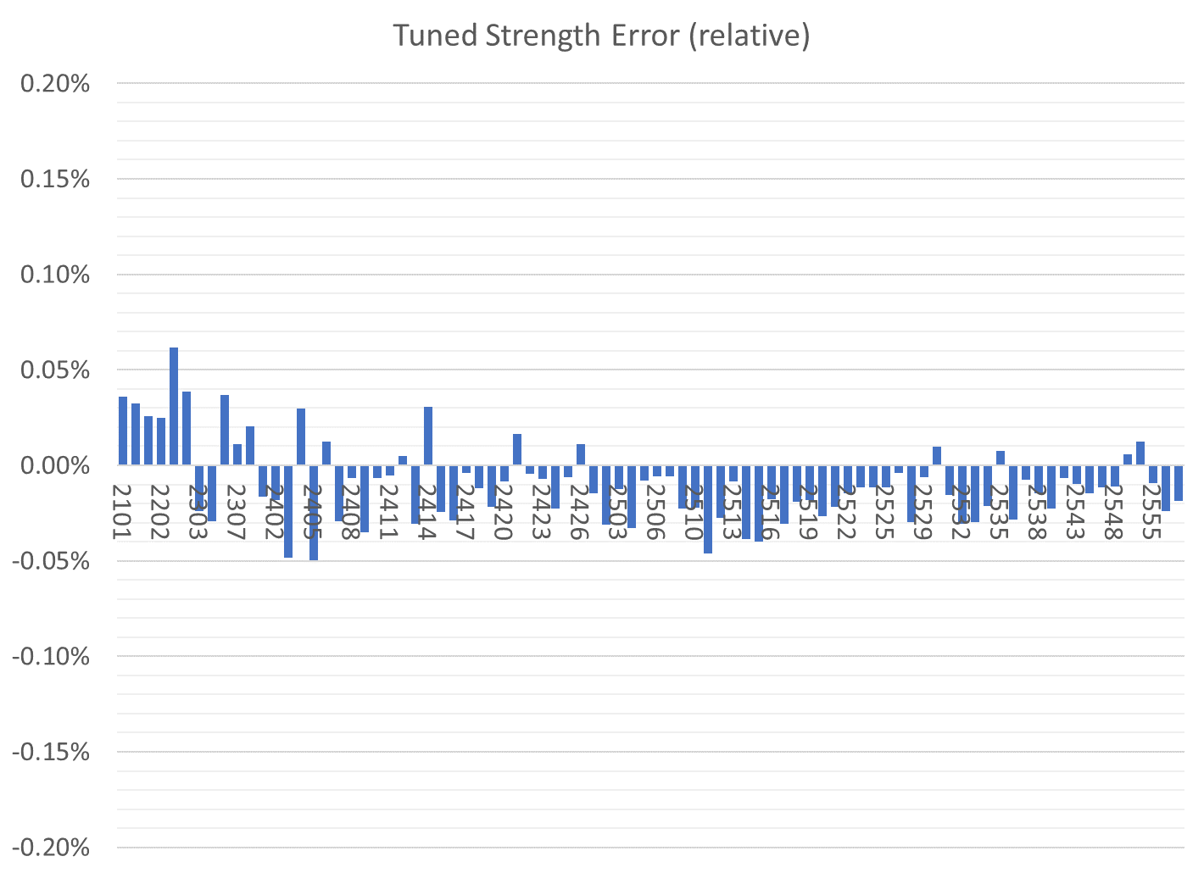
Only tuned magnets shown (3 “rejects” also removed)
BDT1
BD
QD
QF
BDT2

Slide 10
Tuned Magnets Criteria
Midplane error (G) | Units FOM | CBETA FOM | Quad error at x=0 (rel.)
≤ 1.5 | ≤ 10 | ≤ 0.375 | ≤ 0.05% (Q)
For full data see spreadsheets “initialmagnets” “finalmagnets”
Midplane error generally hardest to achieve
May go in and out of spec slightly (~0.5G) due to chiller cycle
Achieving all the above triggers “quick accept”

Slide 11
Status
Tuning of 3rd crate containing QFs magnets is progressing well
4th crate to arrive this week, containing almost all remaining QFs (apart from ~12)
Separate delivery of 3 BD magnets coming soon to complete an arc girder
Girder production mostly on hold until BD/BDT magnets are available to go with QFs

Slide 12
Rejects / Waiting for Fixed Halves
The left half of BD 2305
Backwards block by KYMA
The left half of QF 2509
Backwards block by KYMA
The right half of QD 2427
Unknown: best match is wrong type block caused by a R1/R2 mislabelling at the AllStar factory

