Slide 1
Thoughts on FFA Injector Architecture for CEBAF
Initial scalings from CBETA

Slide 2
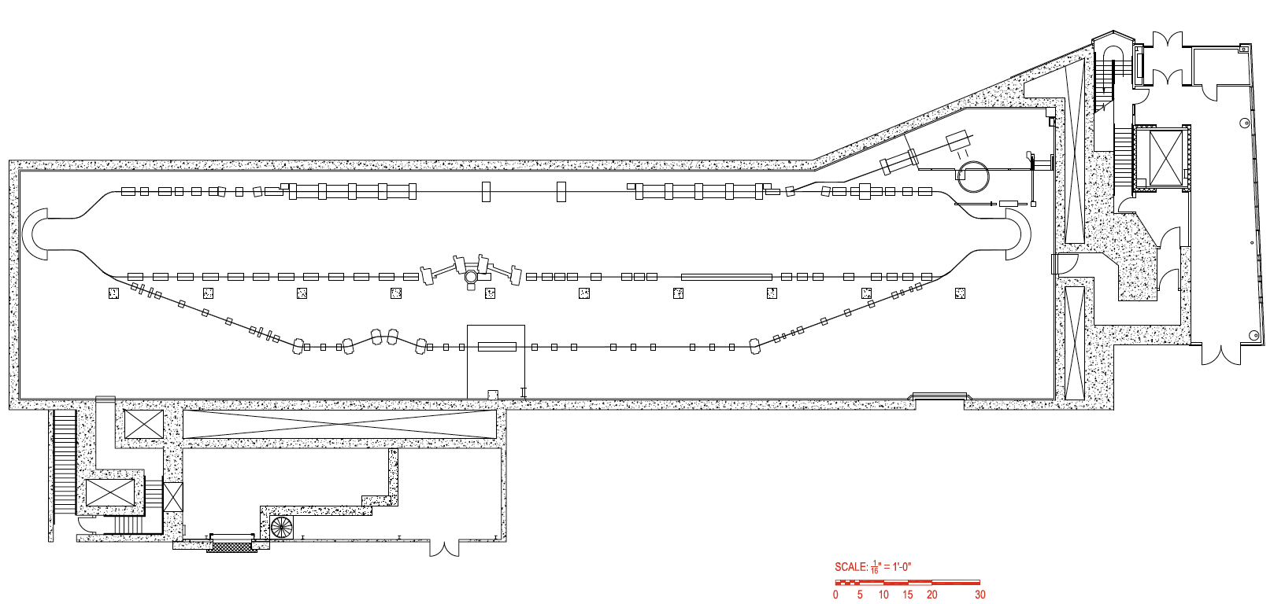
Hall Layout (from docs)
35’
63’
46’
54’
78’
210’
92’
200’of transport, plus extraction

Slide 3
CEBAF FFA Injector Schematic
First try (in same injection/extraction orientation as ERL layout)
Splitter for path length and R₅₆
Source
Adiabatic β change
Linac
FFA arc
Optional adiabatic β change on far side to decrease magnets in straight
FFA straight
Extraction
NB: extraction must come after linac but before FFA arc to get maximum number of passes.
Top side of machine rather crowded.

Slide 4
Second Splitter on Far Side?
Perhaps could put splitter adjustments at bottom if R₅₆ “survives” FFA arcs?
Mini-splitter for extraction, steering
Source
Adiabatic β change
Linac
FFA arc
Splitter for path length and R₅₆
Adiabatic β change on far side might help with splitter
FFA straight
Extraction
Still need extraction mini-splitter after linac.
At least linac is not fighting main splitter for longitudinal space any more.

Slide 5
Alternative Injection/Extraction?
Turn the entire machine upside-down!
Source
Splitter for path length and R₅₆
Adiabatic β change
Linac
FFA arc
Optional adiabatic β change on far side to decrease magnets in straight
FFA straight
Extraction
Not sure of alternate placement of source and linac are feasible in the hall(?)

Slide 6
Hall Dimensions (from docs)
35’
63’
Bad news
46’
54’
78’
210’
Good news
92’

Slide 7
Important Obvious Constraint
Width of the hall is only 46ft = 14.02m
For FFA arcs to fit need R<7m
But the CBETA FFA arcs had R=5.1m!
Not much more room than CBETA
Only <1.4× energy increase can come from making the arc bigger (150→210MeV)
Rest has to come from making magnets stronger
Forget about 1GeV FFA, or enlarge building

Slide 8
Hall Layout Compared to CBETAs
35’
63’
46’
54’
78’
210’
92’

Slide 9
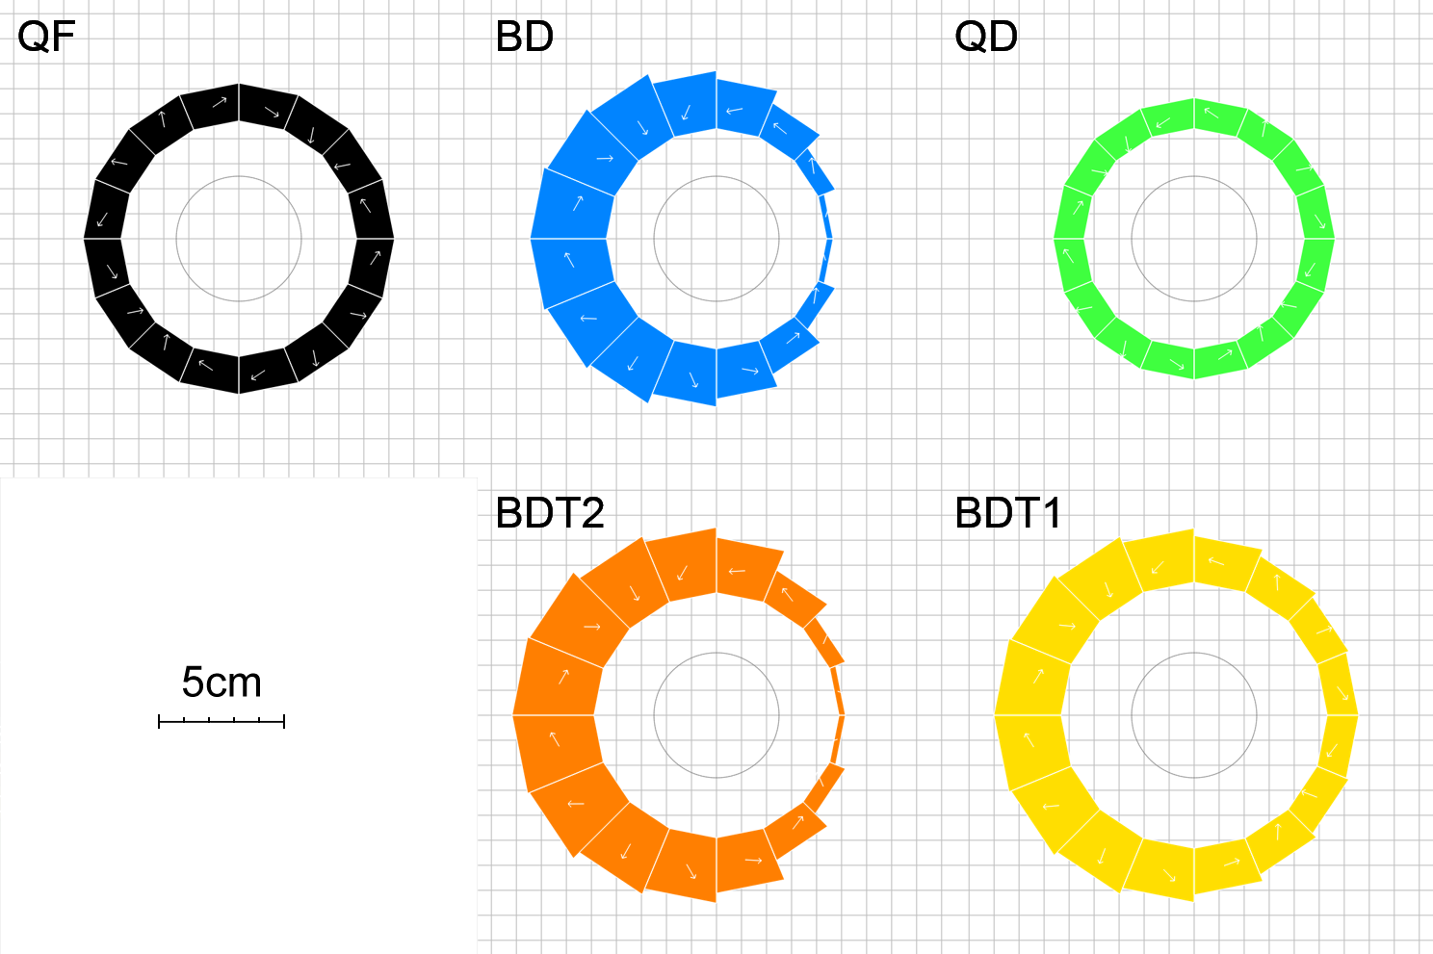
CBETA Magnet Types
Magnet | Dipole (T) | Quad (T/m) | Good field radius (mm) | Aperture radius (mm) | Max field (T) (good region) | Max field (T) (aperture)
QF | 0 | -11.5624 | 25 | 43.1 | 0.2891 | 0.4983
BD | -0.3081 | 11.1475 | 25 | 40.1 | 0.5868 | 0.7551
BDT2 | -0.2543 | 11.1475 | 25 | 44.938 | 0.5330 | 0.7552
BDT1 | -0.1002 | 11.1475 | 25 | 49.085 | 0.3789 | 0.6474
QD | 0 | 11.1434 | 25 | 40.1 | 0.2786 | 0.4469

Slide 10
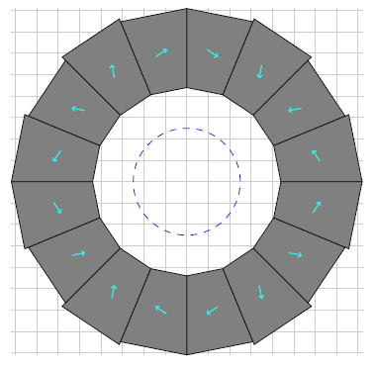
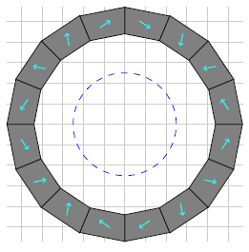
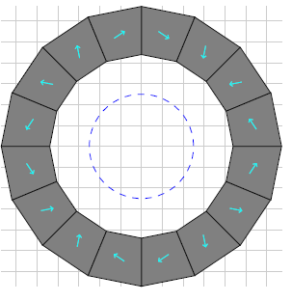
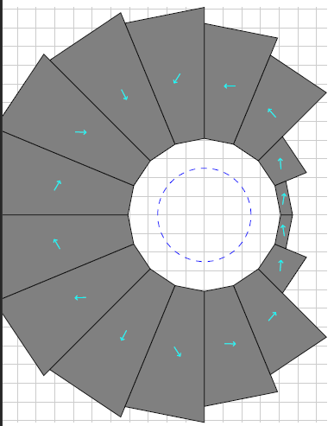
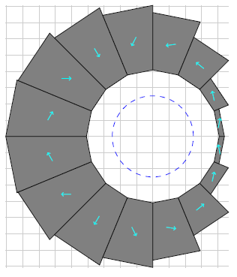
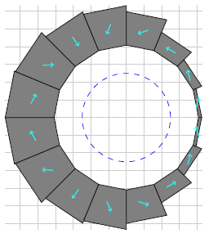
Field-Scaled CBETA Magnets
1×
1.5×
2×
CBETA was quite conservative so we have an more headroom here than you’d usually find in an accelerator.
Increasing the field by a factor of two gives max ~400MeV in the FFA arcs.
Magnets still require R&D and prototyping to check.
QF
BD

Slide 11
Turns and Energies
ERL document says there is a 9MeV booster
2 turns* in FFA
200MeV main linac
209, 409, extract 609MeV
3 turns* in FFA
133.3MeV main linac
142, 276, 409, extract 542MeV
4 turns in FFA
100MeV main linac
109, 209, 309, 409, extract 509MeV
(* fewer turns might let us improve the lattice a bit from the point of view of magnets, apertures and fields)
← I quite like this option as it gives some margin for linac, in fact 130MeV was mentioned as the ERL’s linac energy in the docs

Slide 12
Example Parameters
Parameter | CBETA | CEBAF injector | Units
Energy range | 42-150 | 140-410, ext. 540 | MeV
Turns | 4 | 3 + ext. 1
Momentum ratio | 3.572 | ~2.93 | ×
Radius of curvature | 5.08787 | ~6.75 | m
Effective avg. dipole | 0.09834 | ~0.2026 | T
Cell length | 0.444 | ~0.511 * | m
* If scaled from CBETA with same orbit excursion. In reality, 3 turns will have a smaller orbit excursion than 4, which is good, but the small arc radius means we still have fairly short cells.
Would be interesting to optimise 3-turn cells and magnets a bit, if this sort of parameter range (500-600MeV injector) is of interest.

Slide 13
Future Issues
Positive
Going from 3.57× momentum range to 2.93× will give lower on-orbit fields at the same curvature
This is orthogonal to choice of gradient/orbit excursion
Negative
Adding an open midplane, if necessary, will make magnets harder
At higher fields, radiation resistance is likely to be worse than at CBETA

Slide 14
FFA scaling* laws
* not scaling FFA laws
Scaling type (by factor a) | Length | Angle | Dipole | Gradient | Quad offset (=dipole/grad) & orbit excursion
Momentum (~energy) | 1 | 1 | a | a | 1
Machine radius | a | 1 | a⁻¹ | a⁻² | a
FFA beta length (fixed bend radius, fixed cell tune) | a | a | 1 | a⁻² | a²
FFA arc-to-straight (=row 3/row 2) | 1 | a | a | 1 | a
FFA radius with fixed orbit excursion and field (row 2*row 1/sqrt(row 3)) | a^{1/2} | a^{-1/2} | 1 | 1 | 1
This one is the knob for changing gradients and orbit range: an engineering trade-off

