Slide 1

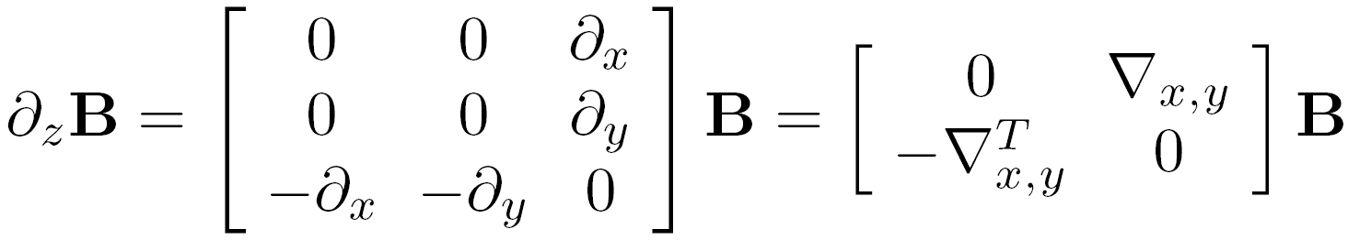
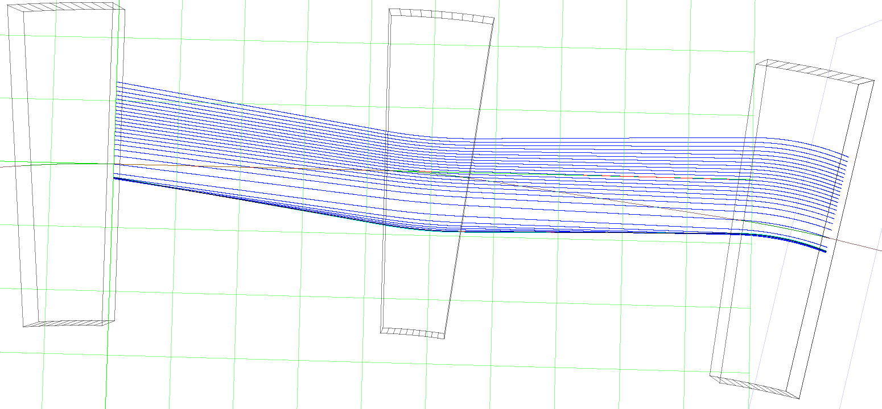
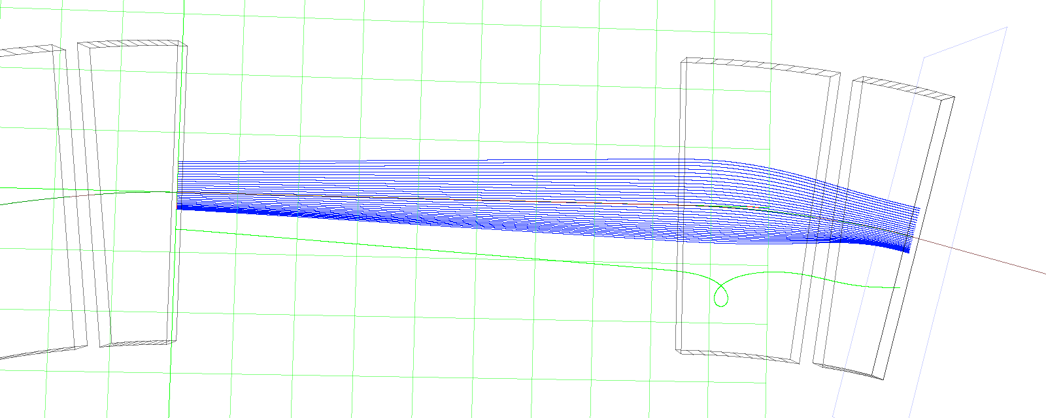
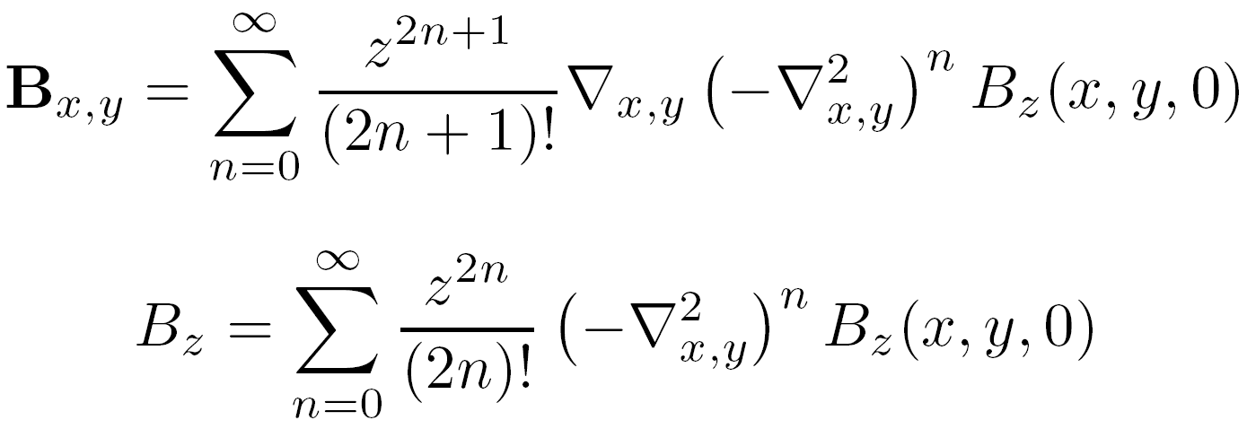
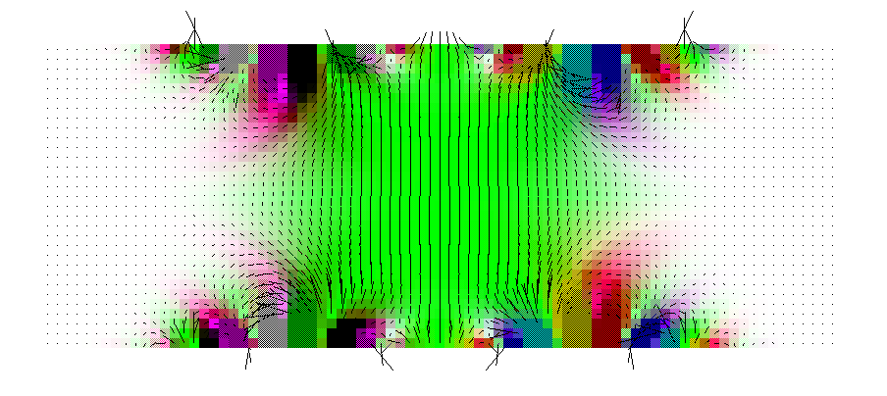
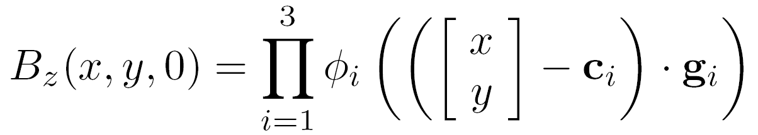
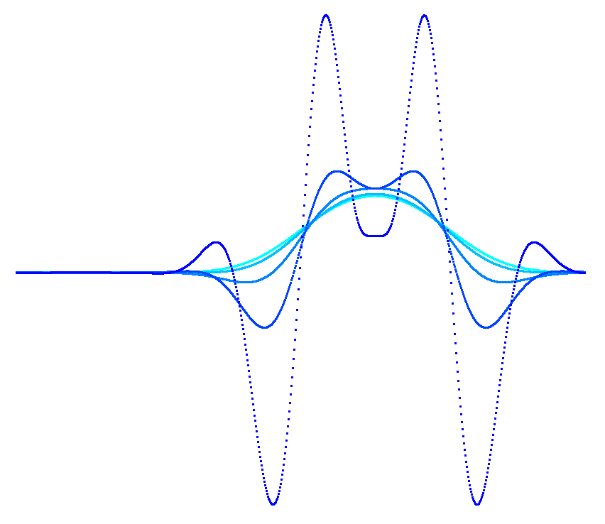
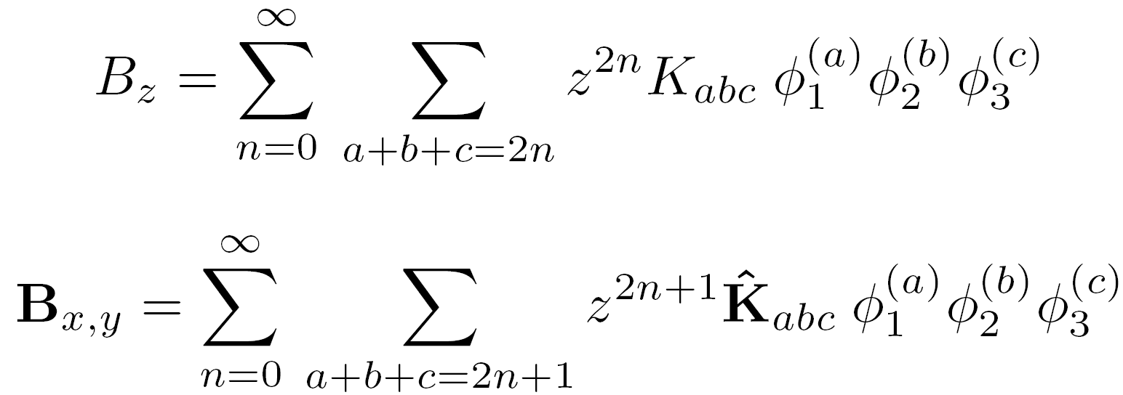
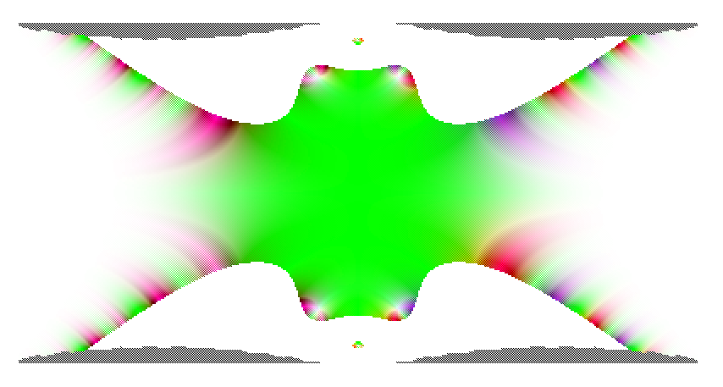


Extending the Energy Range of 50Hz Proton FFAGs
S.J. Brooks {stephen.brooks@stfc.ac.uk}, RAL, Chilton, OX11 0QX, UK
Magnetic Field Examples Enforcing the free space Maxwell equations may have unanticipated consequences if the wrong on-plane function is chosen, or the field is calculated further off-plane than is physically achievable (e.g. where a magnet coil or iron pole piece would be). Above is a cross-section through the field calculated for a magnet with two ends shaped like integrated Gaussian functions. Note how the field is realistic near the midplane but develops oscillating behaviour (which increases rapidly in magnitude) further out. Successive cross-sections of the vertical field are graphed below (left) with a modified diagram (right) showing what the shape of the physical aperture of the magnet would be if it was defined only by the condition that fields around the magnet must not exceed 1.5 times the magnitude of those on the mid-plane. | Magnetic Field Model Starting with Maxwell’s equations in free space, the various partial derivatives of components of B can be rearranged to give the z-derivatives in terms of the others. That is, the set of equations can be rephrased as an evolution problem. This can be solved for the whole field when B is specified on a single z-plane. Alternatively it can be used to reexpress the repeated z-derivatives in a Taylor expansion in z to find a sum of an infinite series that gives the off-plane field to any desired level of accuracy, provided all the on-plane field’s derivatives can be calculated. In the application of optimising the field shapes of FFAG magnets, the magnets are assumed to be symmetrical with only a z-component of the field on the z=0 midplane and a product of three linear functions for that field component to simplify calculation of the higher derivatives. Typically i=1 and i=2 will be used for the fringe fields at either end of the magnet, here the integral of a Gaussian function is used. The third function specifies the transverse field profile of the magnet, with polynomials being tried so far in this research. Finally, the series formulae for the off-plane fields may be rewritten in terms of some coefficients K that may be precalculated once for the magnet and repeated derivatives of the 1D profile functions, which only need to be calculated once for each point (rather than each term in the sum). | FODO Cell Lattice The Muon1 code was used to track protons through a cell with its 4th order Runge-Kutta algorithm with some extra code logic added to find closed orbits and optics. The existing genetic algorithm optimiser could then be run to improve the figure of merit derived for the entire cell, starting off with random designs within the allowed range and recombining or mutating the best of these repeatedly to increase the overall score. For each cell being tested, closed orbits are searched for at energies starting at 12GeV and decreasing by 5% steps, with linear transfer matrices (and optical stability) determined at each stage. A `FODO' cell with two drifts each at least long enough to hold two RF cavities was tried first and optimisation reached a design with stable optics down to a low energy of 3.46GeV. Orbits through the FODO cell, from 3.5GeV (bottom) to 12GeV (top). Grids are 1m square. Magnet field profiles in the FODO cell, the beam sweeps from the left to right end of the graph with increasing energy in both cases. FODO cell tune variation with energy and matched beta function at the end of the `BD' magnet. | Doublet Cell Lattice The doublet optimisation found a cell with stable orbits down to 2.70GeV. The field used in this lattice are more reasonable than the FODO cell but there is still a cusp in the horizontal tune where it goes very close to 180° in the region of 3.4GeV. Both of the magnets have some positive field part in this cell, which is advantageous for making high energy rings smaller because there is no reverse magnet whose bending has to be entirely undone by others around the circumference. The horizontal orbit excursions are still very large here, of the order of a metre. Reducing the magnet widths alone will keep the dipole bending the same but increase the quadrupole component to the point where it overfocusses in a long drift. It may then be useful to consider a shorter focussing period length, for instance with a small doublet where each magnet of the FODO would have been. Orbits through the doublet cell, from 2.7GeV (bottom) to 12GeV (top). Grids are 1m square. Magnet field profiles in the doublet cell, the beam sweeps from the left to right end of the graph with increasing energy. Doublet cell tune variation with energy and matched beta function at the start of the long drift space.
Abstract
Using an FFAG for rapid-cycling proton acceleration has the advantage that the acceleration cycle is no longer subject to constraints from the main magnet power supply used in an RCS. The RF can be used to its maximum potential to increase the energy range in a short 50Hz cycle as proposed for multi-MW proton driver projects. The challenge becomes an optical one of maintaining a stable lattice across a wide range of beam momenta without magnet sizes or the ring circumference making the machine prohibitively expensive for its purpose. Investigations of stable energy ranges for proton FFAG lattices in the few GeV regime (relativistic but not ultra-relativistic) are presented here.
Field (T)
X position (m)
Poster reference: FR5PFP025

