Slide 1
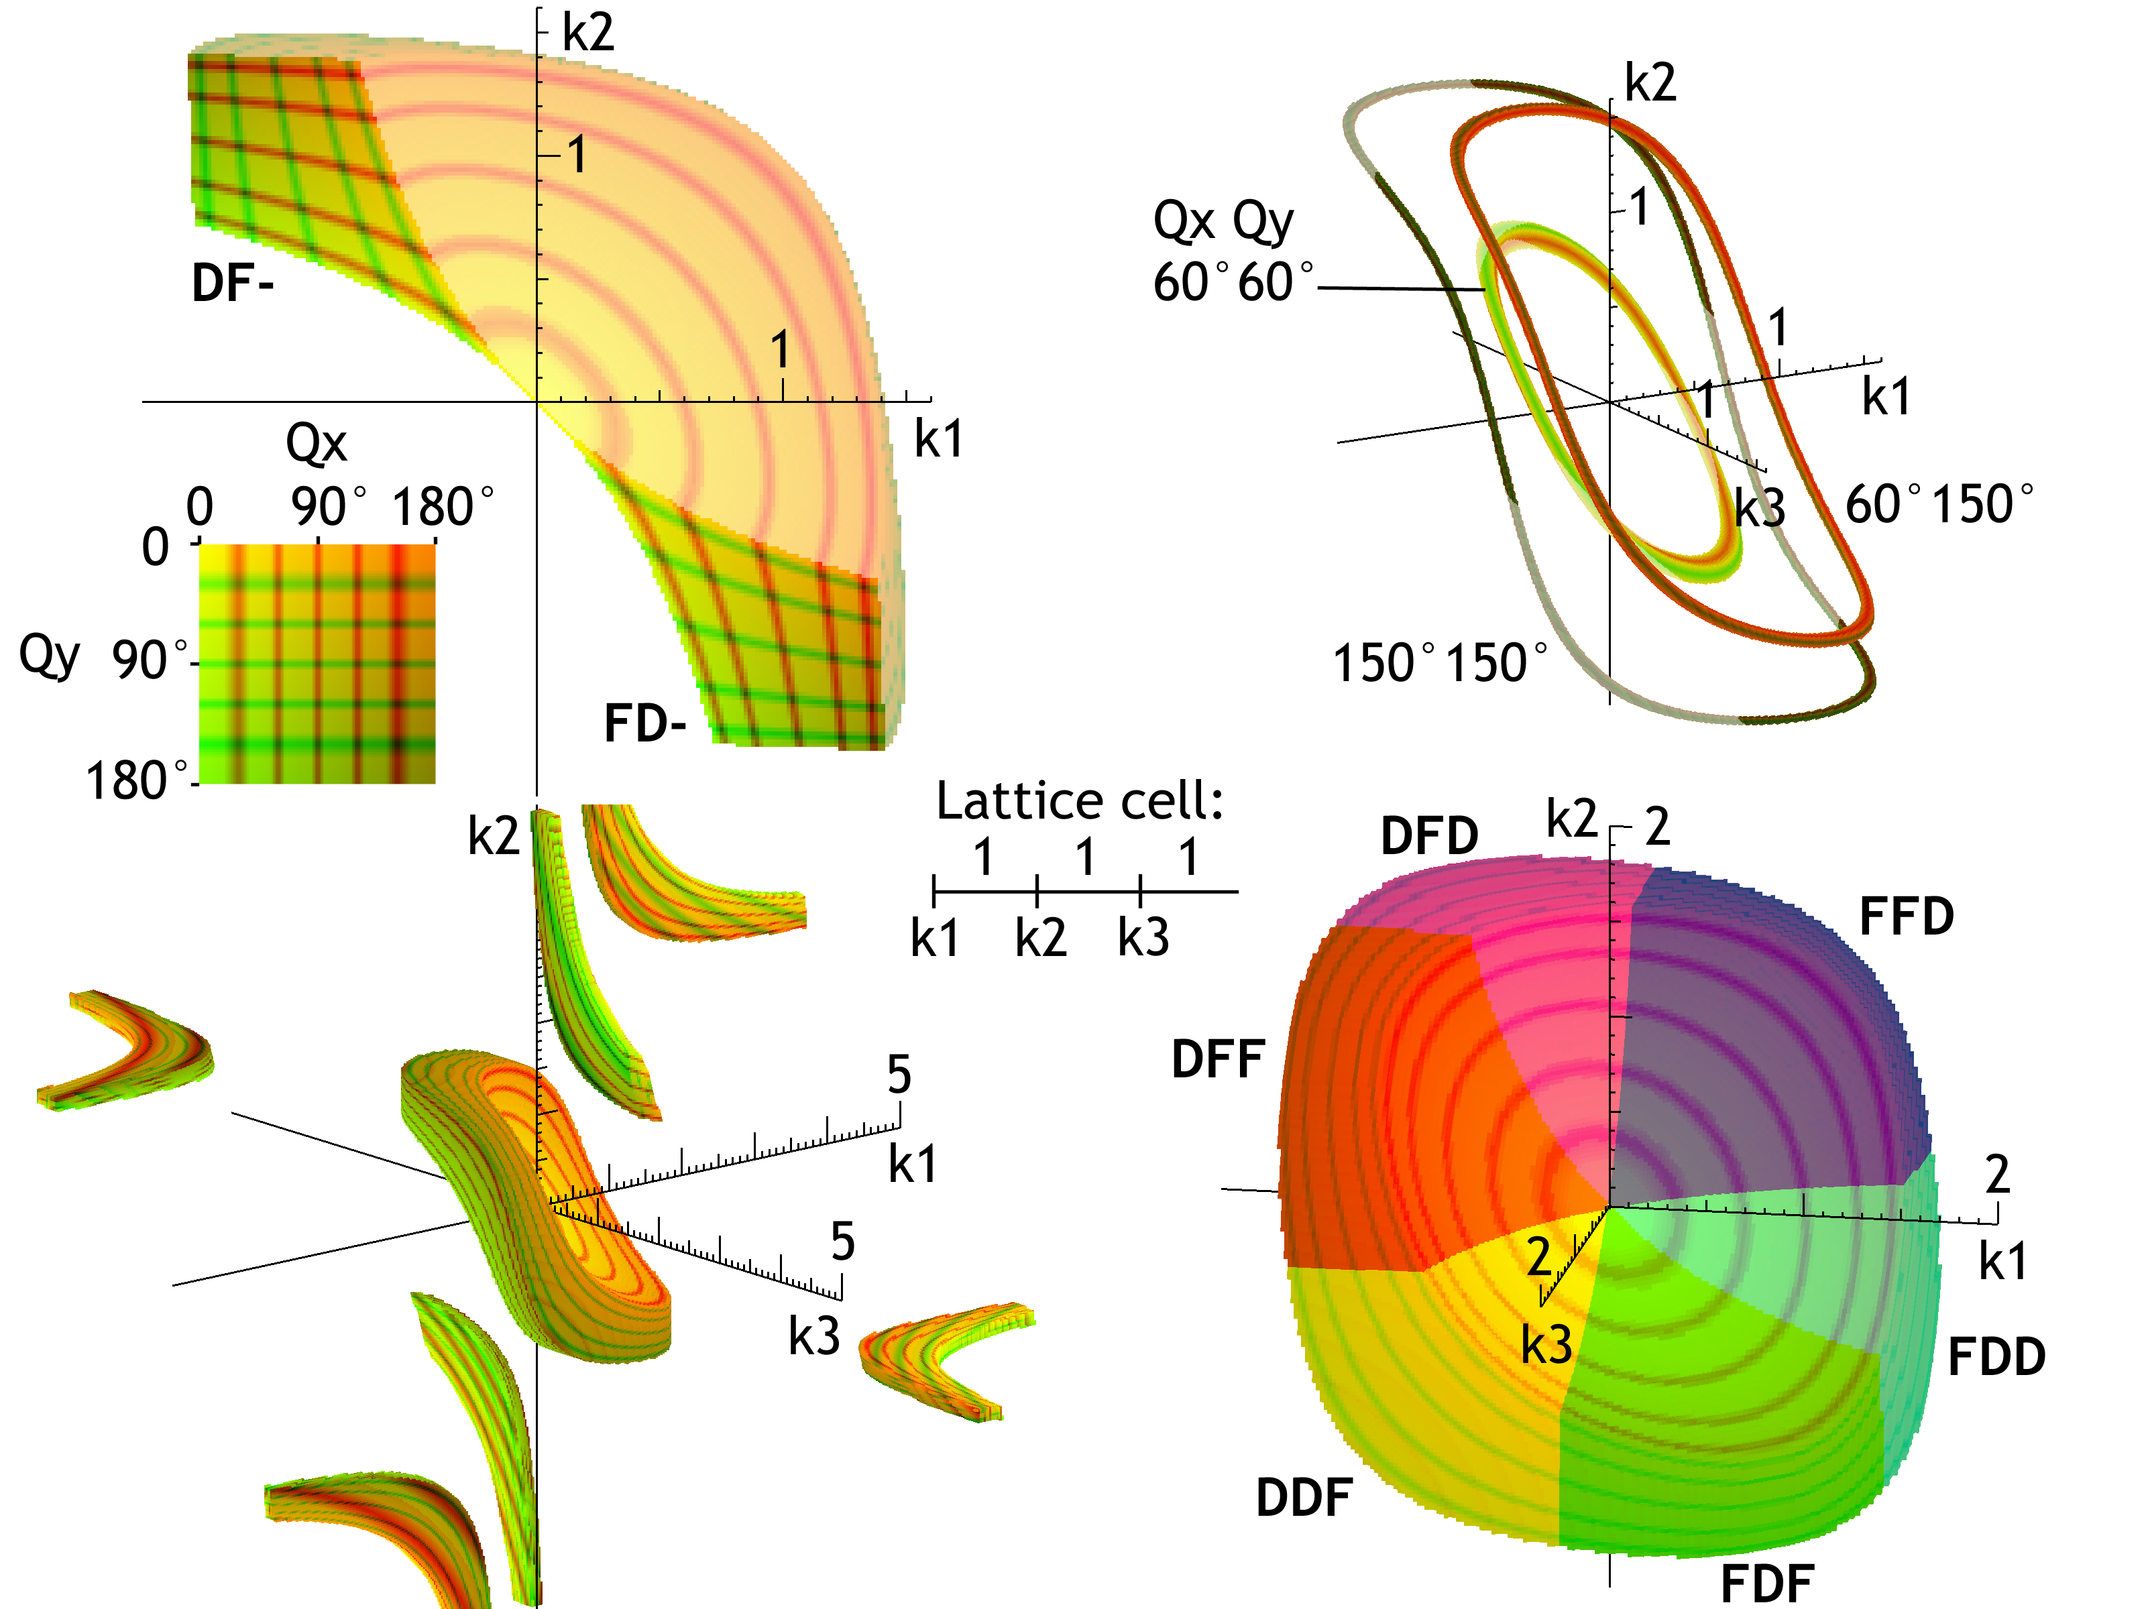
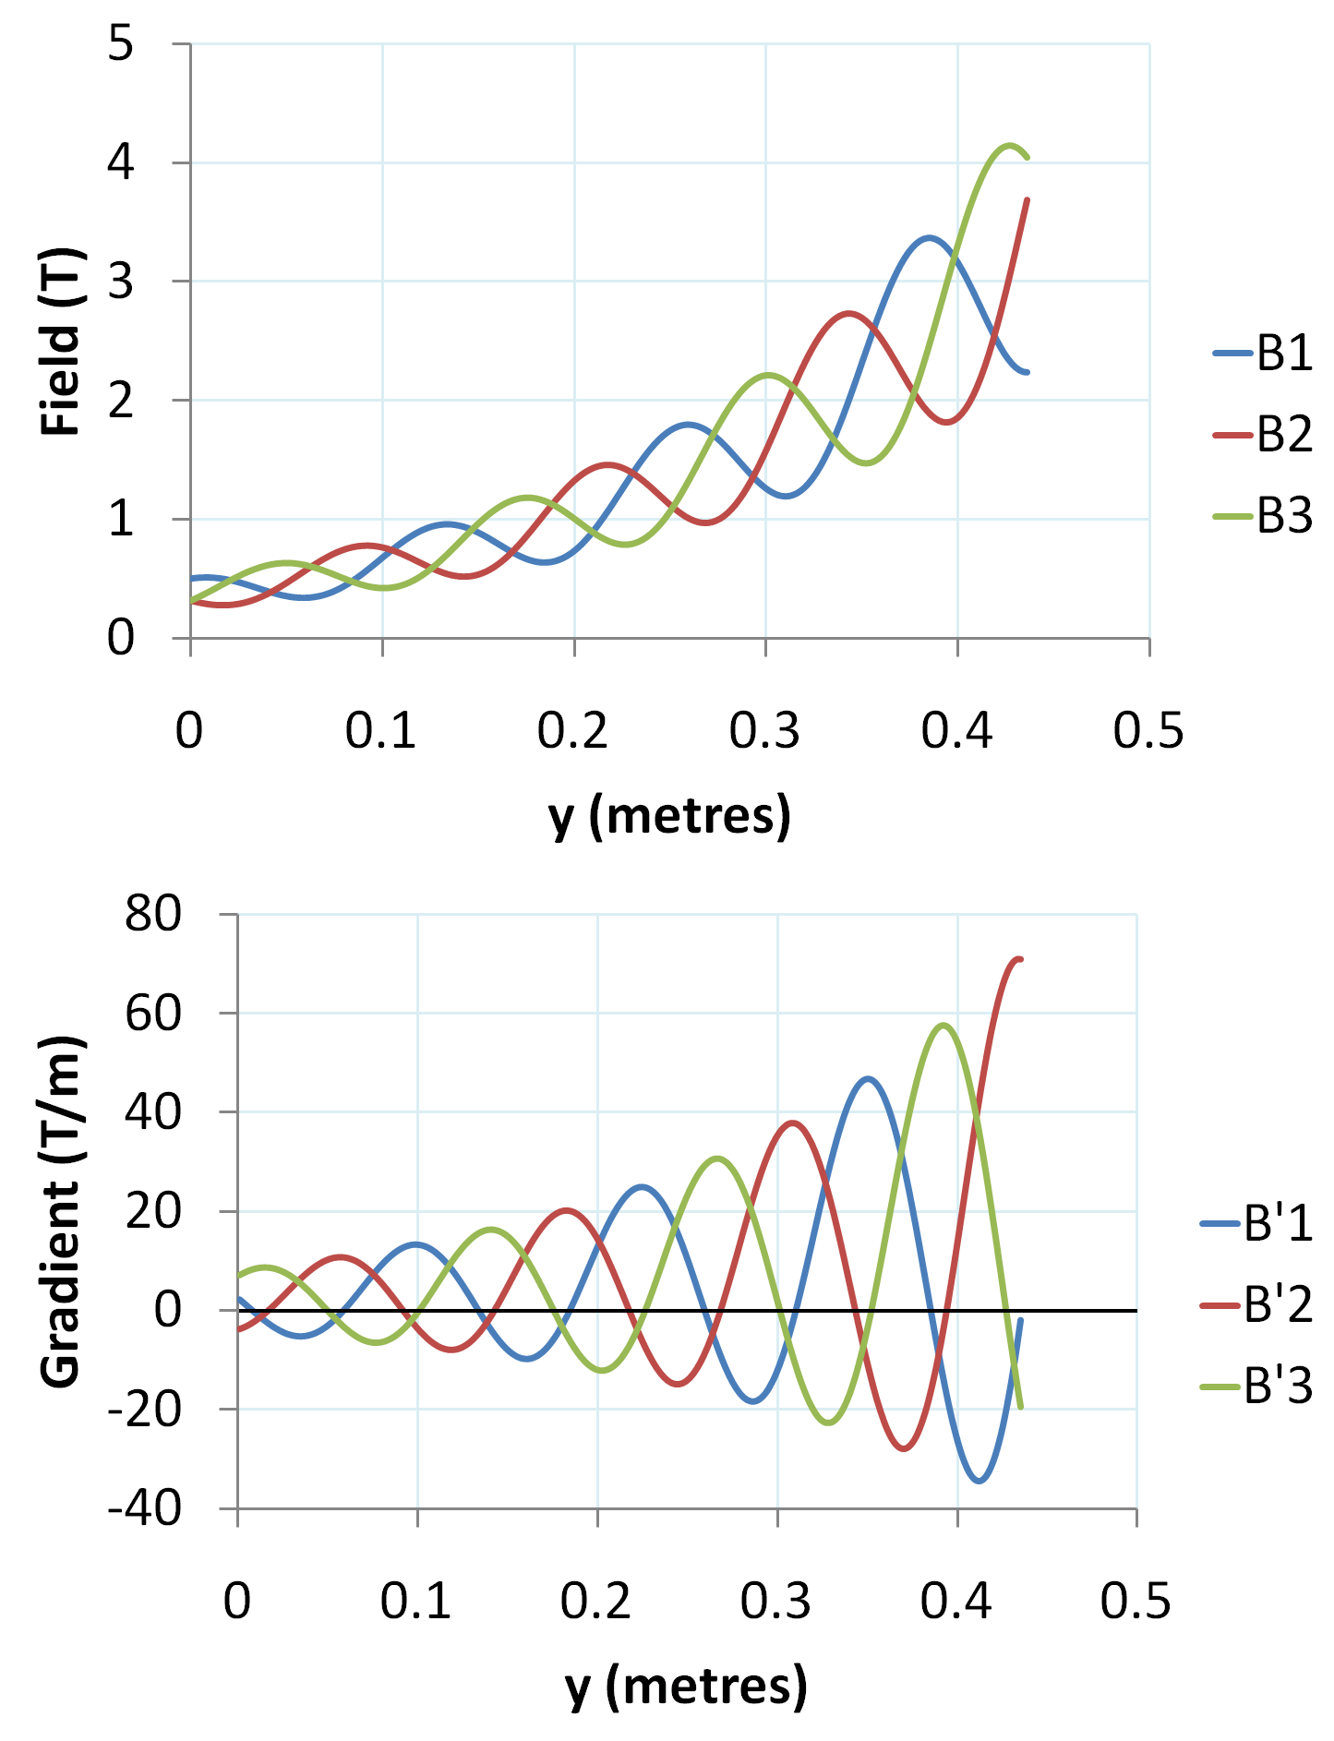
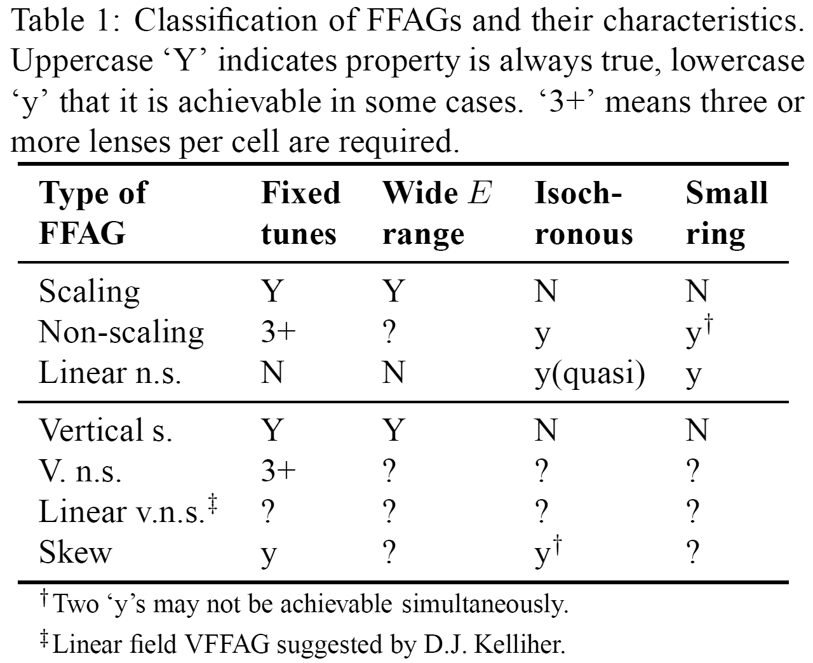
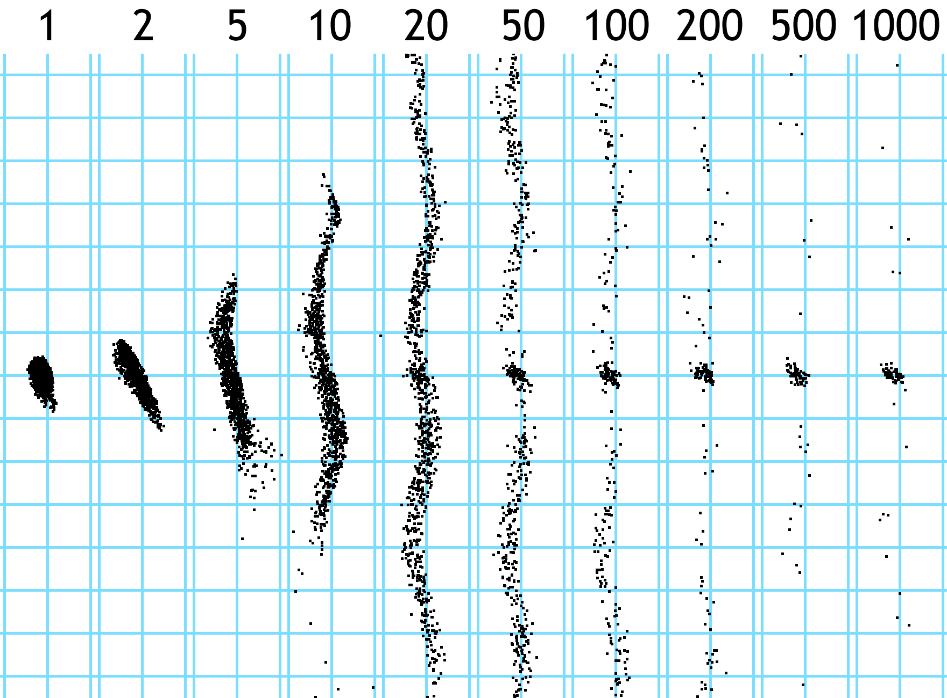
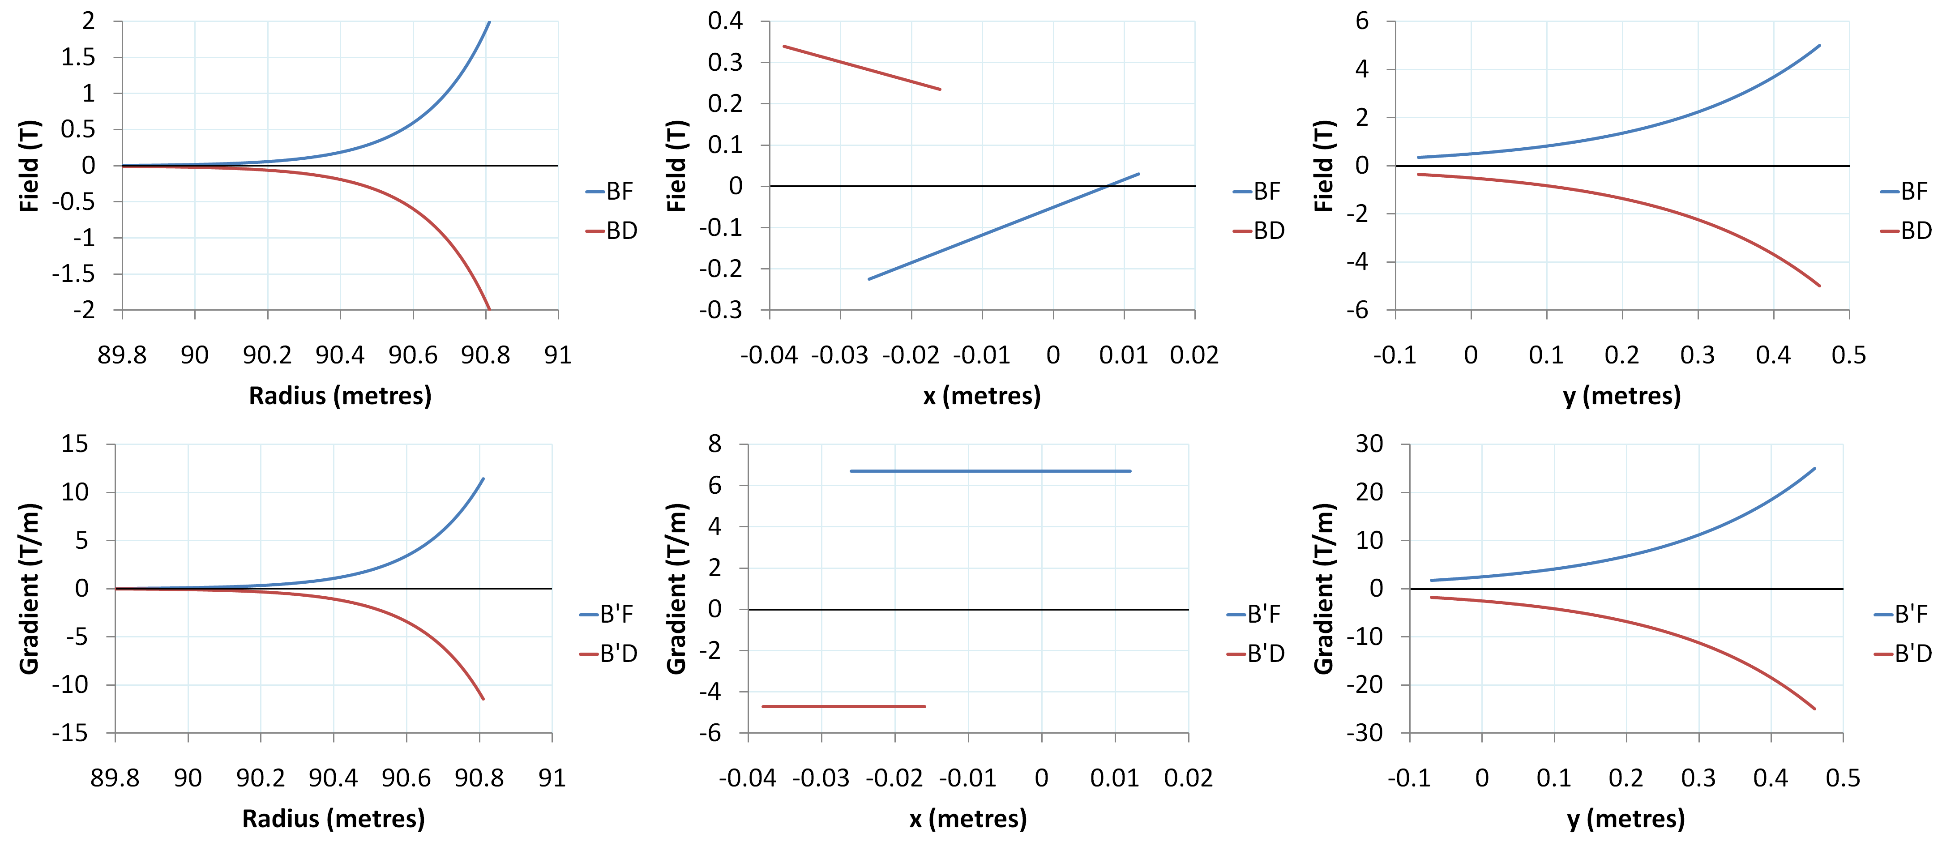


Three-Lens Lattices for Extending the Energy Range of Non-scaling FFAGs
S.J. Brooks {stephen.brooks@stfc.ac.uk}, RAL, Chilton, OX11 0QX, UK
 | Top left: cut-away of the stable volume in the k₃=0 plane reveals two-dimensional necktie diagrams, coloured by cell tunes Q_{x,y}. Bottom left: zooming out reveals secondary stable regions with tunes above π. | Top right: loci of constant tunes within the volume. Bottom right: colouring by signs of the three lenses reveals a cycle of six lattice types. | Oscillating Exponential Magnets Combining the exponential field of the VFFAG with an oscillation to move the focussing system around the stable volume of the 3D necktie diagram suggests field profiles where a and w control the amplitude and frequency of the oscillations and ϕ_{n} is a lattice pseudo-phase that varies between magnets, so they do not all focus simultaneously. The e^{ky} term here could be replaced by the r^{k} law of horizontal scaling FFAGs to construct a variant with horizontal orbit excursion, where the areas of positive field ‘spiral’ outwards from one magnet to the next.
Abstract
The Three-Dimensional “Necktie” Diagram
This is the three-dimensional ‘stable volume’ in (k₁,k₂,k₃)-space for a lattice with three quadrupole lenses of strength k_{i} separated by unit drifts. For any transverse cell tunes Q_{x},Q_{y} there is a ring of possible lattices at that tune point. Quadrupoles may change from F to D without encountering unstable lattices (as happens with cells containing only two magnet types).
In this paper it is found that a three-quadrupole focussing system can be morphed continuously through FFD, FDF and DFF variants and back again while maintaining stable optics and even keeping the two transverse tunes constant. This relates to non-scaling FFAGs, where the magnet gradients define both the focussing and the variation of the field with momentum as the closed orbit sweeps across it. A two-lens focussing system cannot change the sign of either gradient without becoming unstable, meaning non-scaling FFAGs built with such a lattice eventually encounter too large a magnetic field at low energies. However, a theoretical system of magnet field variations using three lenses, with a potentially unlimited energy range and fixed tunes is presented here.
Left: field and gradient profile for a set of three oscillating exponential magnets with k=5m⁻¹, w=50m⁻¹, B₀=0.375T and a=1/3. The pseudo-phase ϕ=2π (n-1)/3 for the n^{th} magnet. At least one of the gradients is negative at any position.
Below: weak vertical focussing behaviour in a lattice with three k=0, w=12m⁻¹ oscillating exponential magnets. Grid is 10cm in (x,y), numbers are cells tracked. Particles are focussed horizontally by all lattices over several pseudo-phase cycles.
Field Profiles of existing two-magnet FFAGs
Scaling (MURA Mk. I) Non-scaling (EMMA) Vertical exponential (VFFAG)
Poster reference: WEPS086

