Slide 1
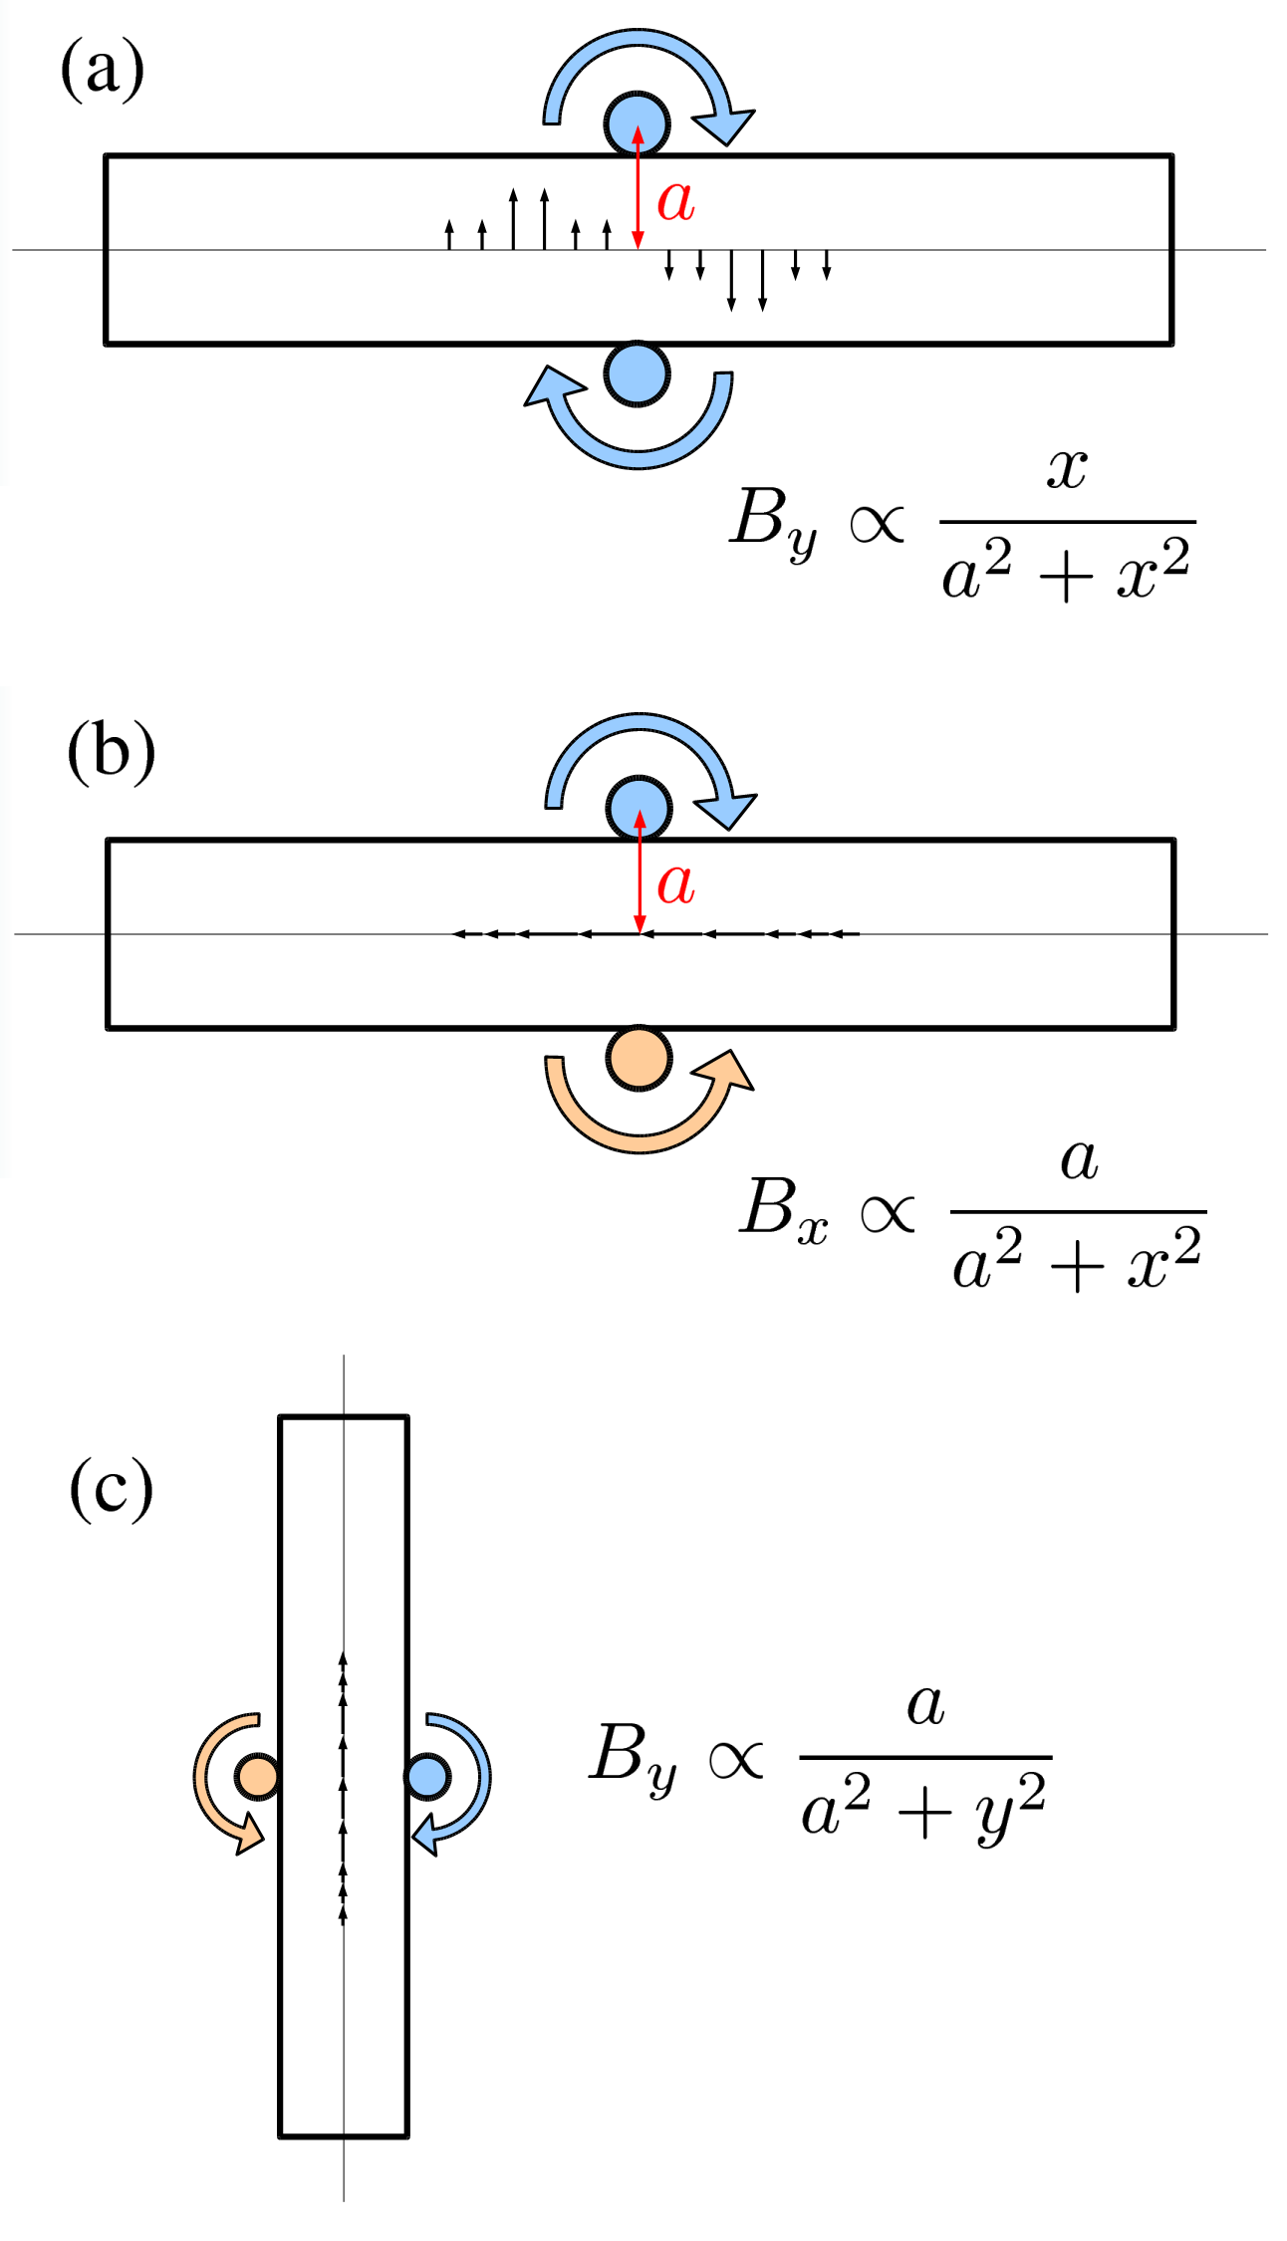
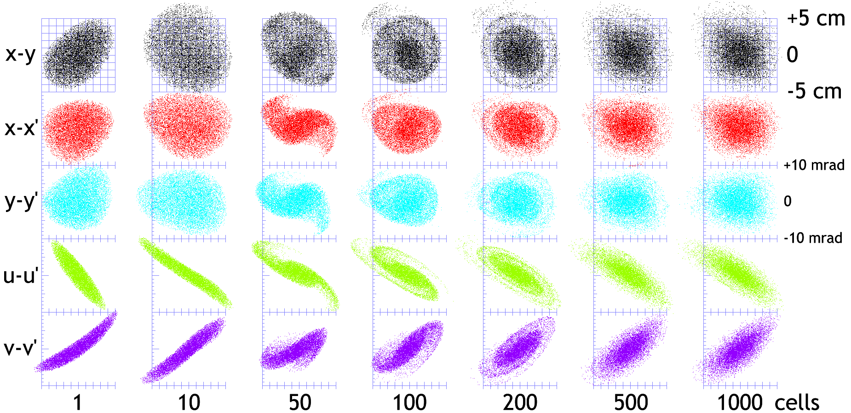
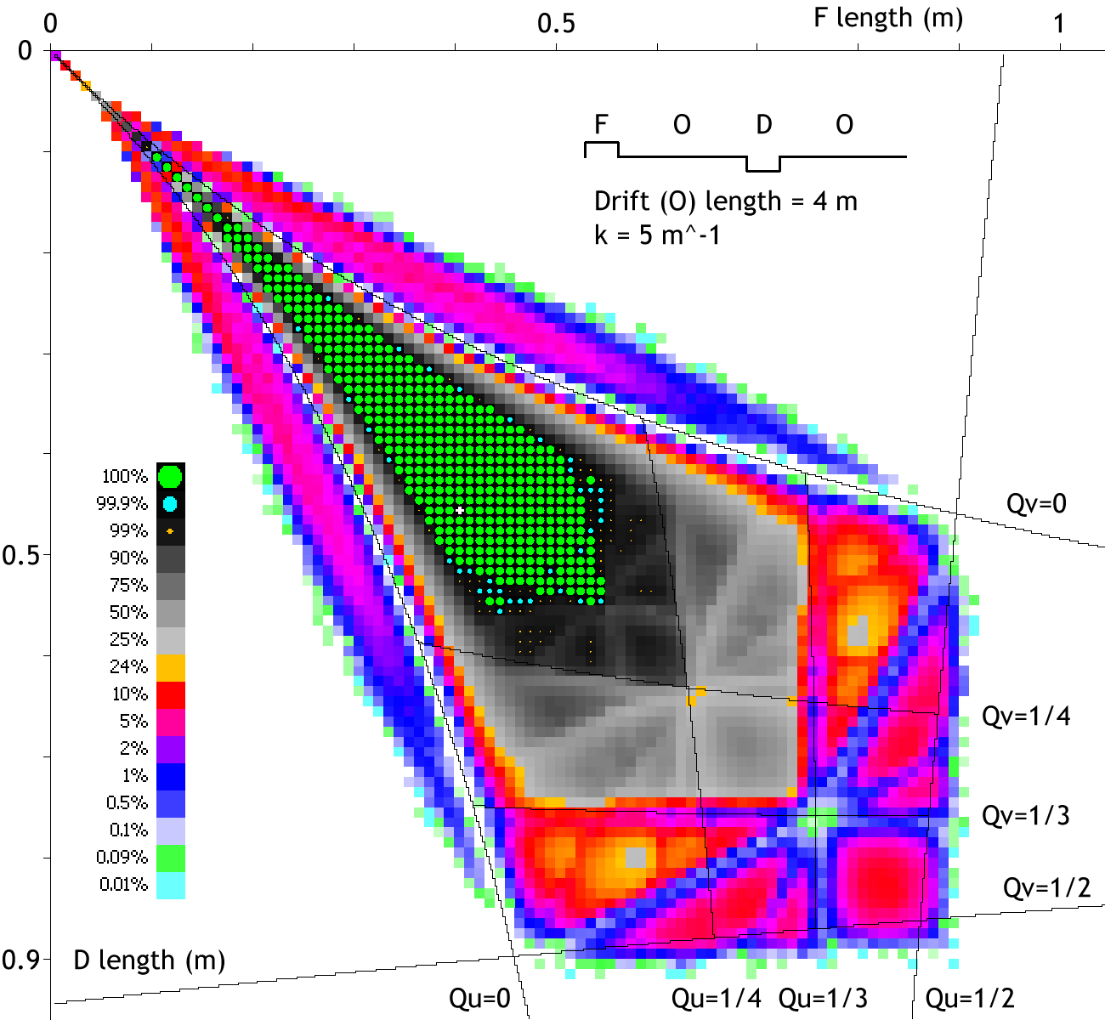
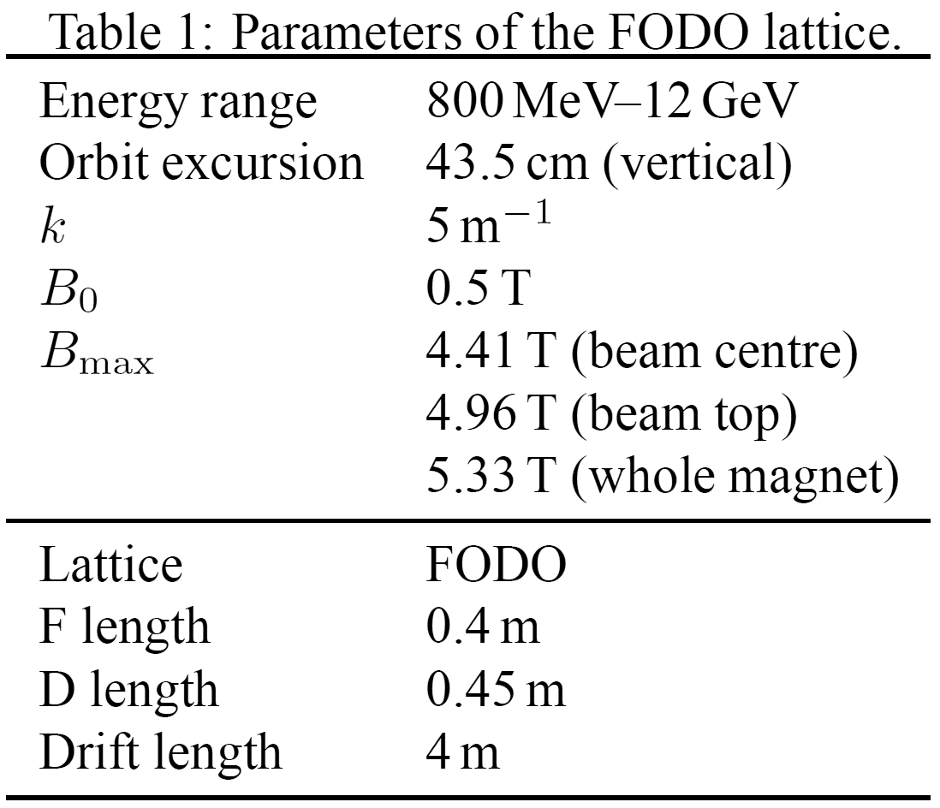
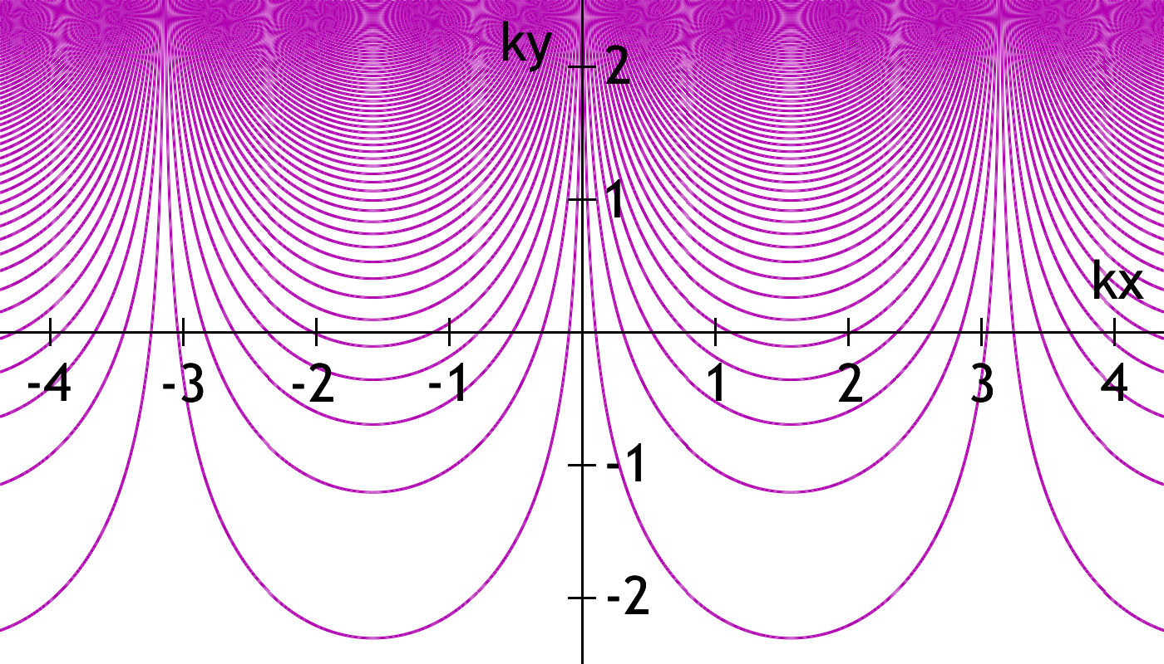
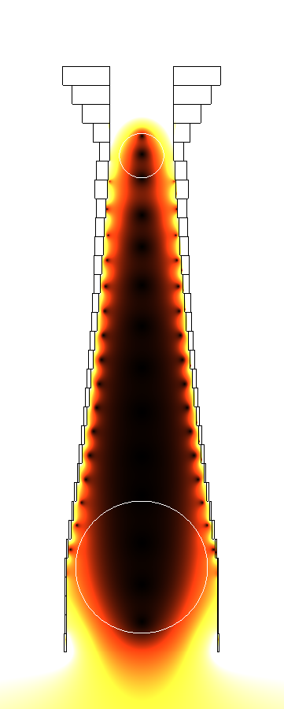
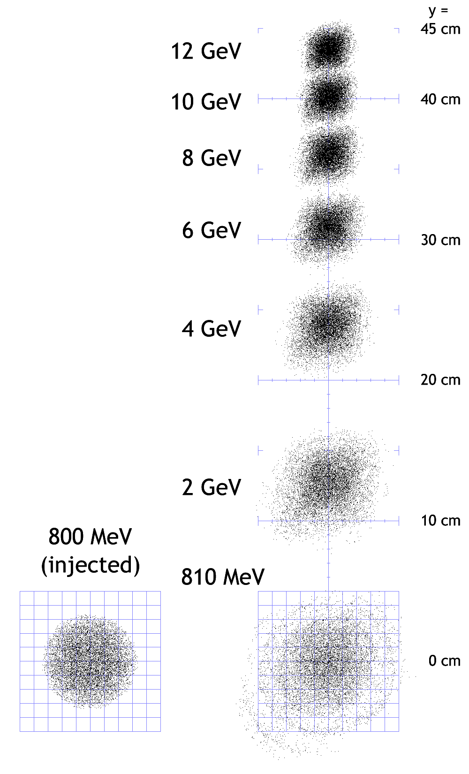
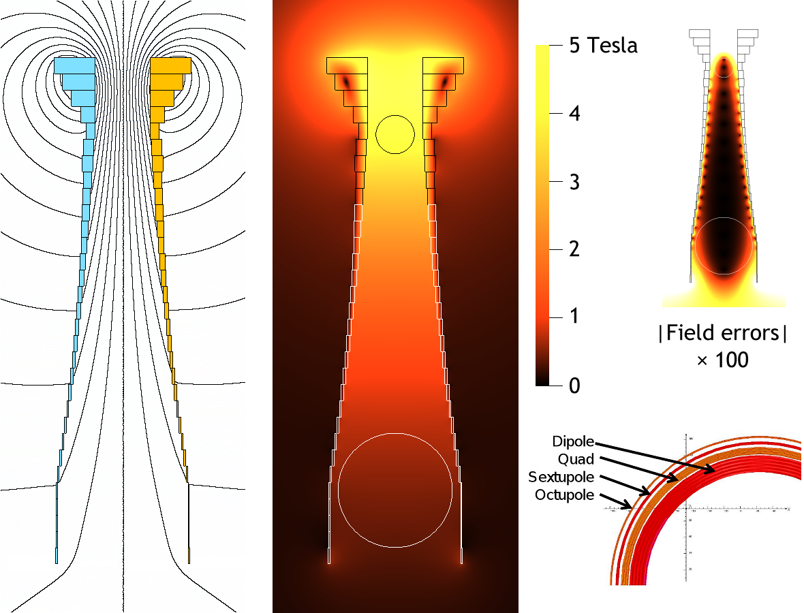
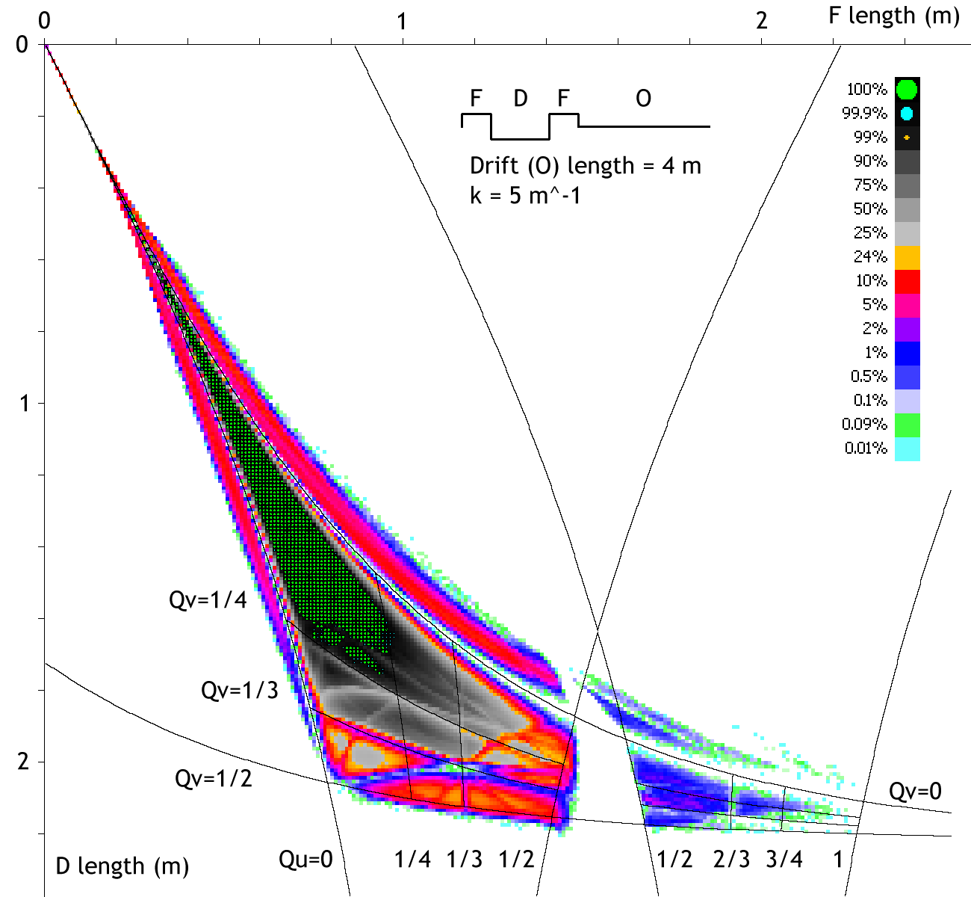
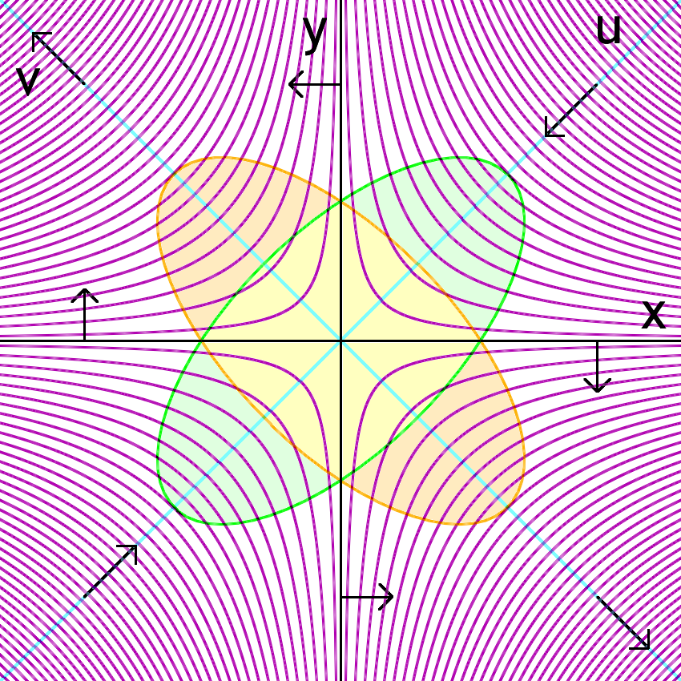
Vertical Orbit Excursion FFAGs
S.J. Brooks {stephen.brooks@stfc.ac.uk}, RAL, Chilton, OX11 0QX, UK
‘Scaling’ Magnet Field for Vertical Orbit Excursion | Magnet Design Implications | 2D Tracking of the FODO Lattice | Dynamic Aperture/Resonance Scans
Abstract
Fixed-field strong focussing accelerators (FFAGs), in which the beam orbit moves with increasing momentum into higher field regions, have been widely studied. Less well-known is that the central orbit does not need to move outwards with energy: it can move in any direction including the vertically-moving orbit discussed in this paper. This allows for a magnet design with a smaller magnetised volume for a larger total energy range. A vertical analogue to the scaling FFAG is defined and its dynamic aperture studied for the case of an energy booster to the 800 MeV ISIS synchrotron at RAL with various possible lattices.
(left) (a) Conventional method for producing a vertical dipole field on a horizontal slot aperture using conducting coils. (b) Reversing the direction of one current gives constructive interference but field in the B_{x} direction. (c) Rotating by 90° gives a vertical dipole field in a vertical aperture.
(below) Cross-section of a 250 A/mm² superconducting magnet design to produce the vertically-scaling field.
(top) The 150 mm.mrad beam in real space, normal and skew phase space planes after increasing numbers of cells in the lattice given on (right).
(below right) Acceleration of the beam in real space, showing vertical motion and the increase in size of the beam as it matches to the nonlinear equilibrium phase space of the magnets over the first few MeV after injection.
(above) Plot of the exponential vertically-scaling field.
(left) Local skew focussing forces from the quadrupole field component.
(below) Second stability region is found but does not have enough dynamic aperture for the whole ISIS beam.
PAMELA magnet (to scale)
Poster reference: MOPD19

