Slide 1
Generalised Halbach Magnets for a Non-Scaling FFAG Arc
Thanks to:
George Mahler – engineering
John Cintorino, Animesh Jain – magnet measurement

Slide 2
20-80MeV NS-FFAG Beamline
Parameter | Value | Units
Particle species | Electron
Energy range | 20-80 | MeV
Cell Length | 0.251751 | m
Cell Angle | 6.666… | degrees (54 per turn)
R = avg. radius of curvature | 2.16364 | m
Max orbit excursion | 19.83 | mm (from circle radius R)
Tune range per cell | Q_{y,80} = 0.032, Q_{x,20} = 0.410 | cycles
Cell lattice | halfD2, QF, D1, BD, halfD2
Drift lengths | D1 = 67.55, D2 = 64.90 | mm
Number of cells | 6
Total length | 1.51051 | m
Total angle | 40 | degrees

Slide 3
20, 40, 60, 80MeV in NS-FFAG Cell
1cm grid

Slide 4
Tunes

Slide 5
40 degree NS-FFAG Beamline
10cm grid
6 cells, 12 magnets

Slide 6
Why am I making this odd thing?
I had some spare Halbach magnets from CBETA prototyping that they’re not using
The 20-80MeV BNL ATF energy range matches the energy range of CBETA magnet halves
This is by luck, also George Mahler’s idea
It demonstrates 4x energy range in a non-scaling FFAG for the first time (I think)
Very useful for risk-reduction in the eRHIC design, which uses exactly such FFAGs as transfer lines

Slide 7
Two Magnet Ideas
Generalised Halbach arrangement
Vary the size and magnetisation direction of the magnet wedges
Can produce “any” field configuration
Or an existing field configuration shifted to better reflect the aperture required by the beams
Permanent magnet shimming with iron wires
Reduces field errors from “factory” ~1e-2 level to ~1e-4 level for accelerator magnets, cheaply

Slide 8
Magnet Parameters
Parameter | “QF” magnet | “BD” magnet | Units
Length | 57.44 | 61.86 | mm
Dipole B_{y}(x=0) | 0 | -0.37679 | T
Quadrupole dB_{y}/dx | -23.624 | 19.119 | T/m
Inner radius (magnet pieces) | 37.20 | 30.70 | mm
(shim holder) | 34.70 | 27.60 | mm
“Pole-tip” field (magnet pieces) | 0.879 | (-)0.964 | T
Max field at r=1cm | 0.236 | (-)0.568 | T
Outer radius (magnet pieces) | 62.45 | 59.43 | mm
(tubular support) | 76.2 | 76.2 | mm

Slide 9
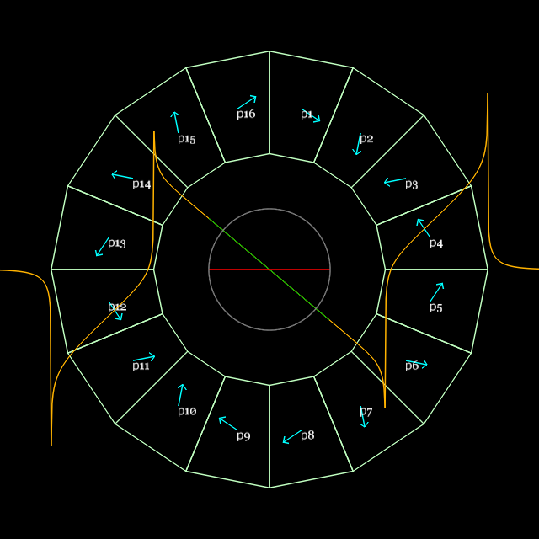
Generalised Halbach design
My current sheet approximation code (PM2D) is good enough
Material grade: N35SH from AllStar Magnetics, B_{r}(eff.)=1.194T

Slide 10
Scaling FFAG example
B₀ = 0.2T
R₀ = 5m
k = 125
“e-fold length” = R₀/k = 40mm
Target GFR = 20mm
Aperture radius = 36.5mm
x (mm) B_{y} (T)
-36.5 0.0800
-20 0.1212
0 0.2000
20 0.3294
36.5 0.4965
Max field error = 5.4 Gauss
RMS field error = 0.9 Gauss
Cross-section area = 45.0cm²

Slide 11
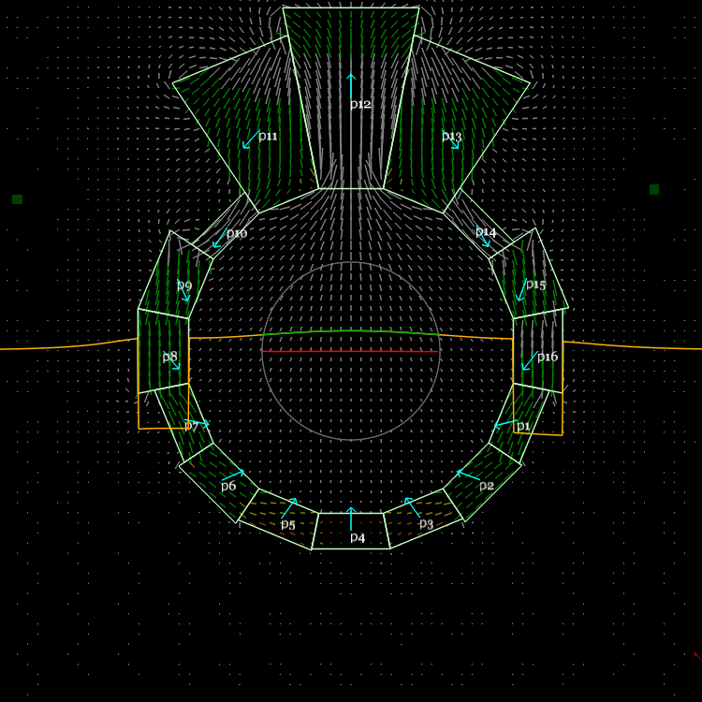
VFFAG example
B₀ = 0.2T
k = 25m⁻¹
“e-fold length” = 1/k = 40mm
Target GFR = 20mm
Aperture radius = 36.5mm
y (mm) B_{y} (T)
-36.5 0.0803
-20 0.1213
0 0.2000
20 0.3297
36.5 0.4981
Max field error = 3.0 Gauss
RMS field error = 1.0 Gauss
Cross-section area = 43.1cm²

Slide 12
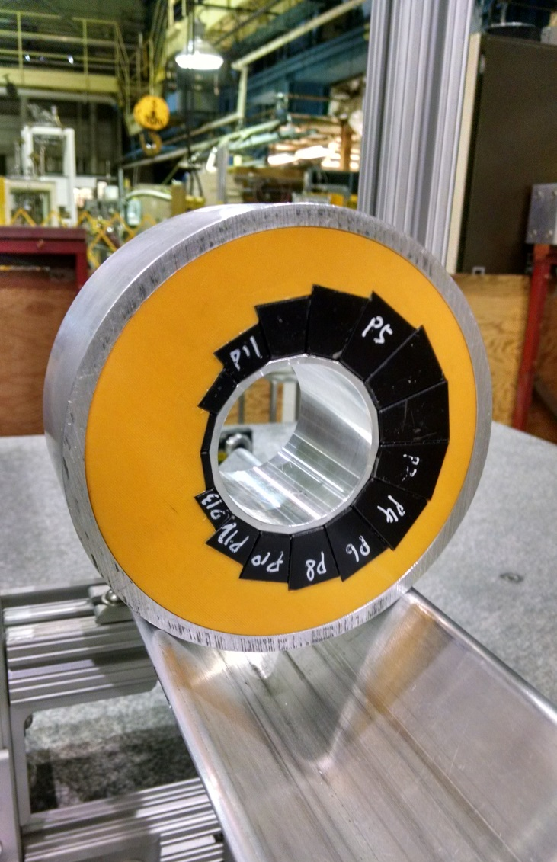
Photos of magnets (unshimmed)

Slide 13
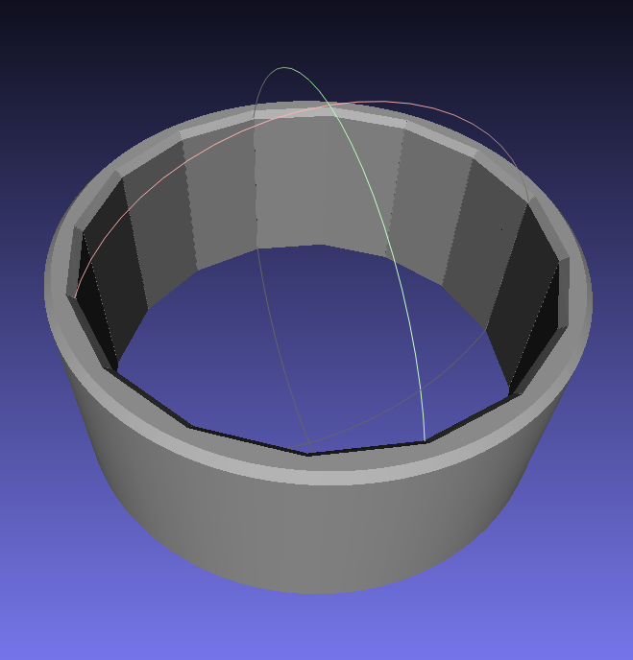
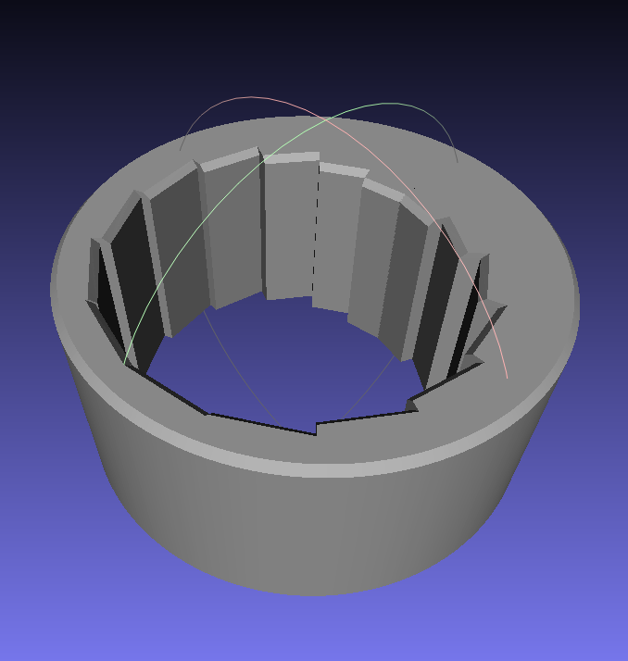
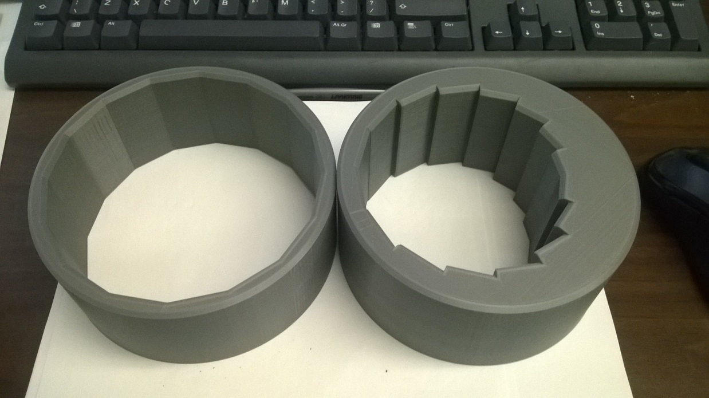
3D Printed Magnet Holder
Field optimiser
→ Magnet wedge dimensions
3D print file (.stl mesh)
and block spec. for manufacturer

Slide 14
Assembly with Dummy Blocks
Old magnet but new ones work the same way

Slide 15
Rotating Coil
Gives multipole field amplitudes at a given radius (R=10mm here)
Stated as fraction of main multipole (quad here) times 10000 to give “units”
<0.5 unit accuracy
Even older magnet shown here but brass tube is a rotating coil at BNL

Slide 16
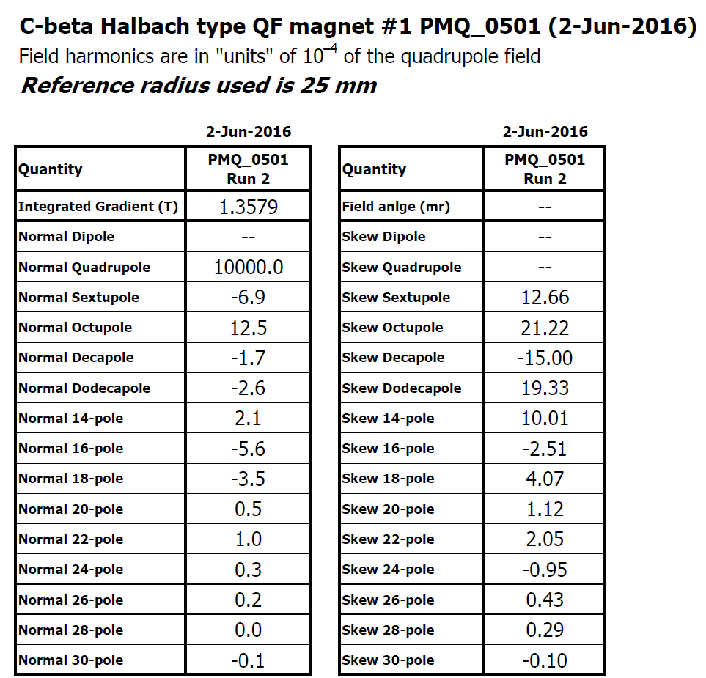
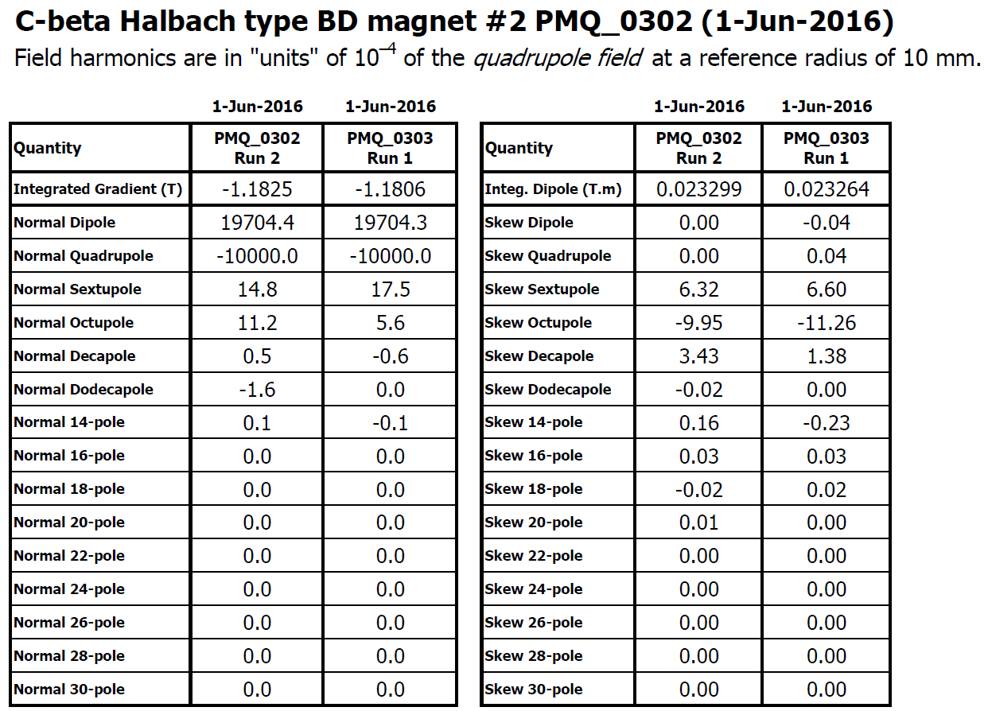
Unshimmed Rotating Coil Results

Slide 17
Higher Harmonic Figure of Merit
Quadrature sum of units (normal and skew) from sextupole up (10000 units = main quad)
Depends on reference radius
Small radius: sextupole is dominant
Large radius: higher order pole contributions increase rapidly

Slide 18
Figure of Merit vs. Radius

Slide 19
Iron Wire Shimming Theory
Placing a μ=∞ iron cylinder into
a uniform B field distorts the field
lines so they are perpendicular to the surface
Cylinder acquires the surface currents of a cos(θ) dipole, giving uniform B and M inside and an external dipole outside
Optimise masses/radii of 32 iron wires placed inside magnet bore to cancel measured errors

Slide 20
3D Printed Shim Holder

Slide 21
Shimming Results (one iteration)
One iteration of shimming reduces multipoles by between 3.2x and 6.5x
Re-measured on different sized rotating coil check
Re-aligned the coil, check
Software error!
No improvement

Slide 22
Best so far: QF3

Slide 23
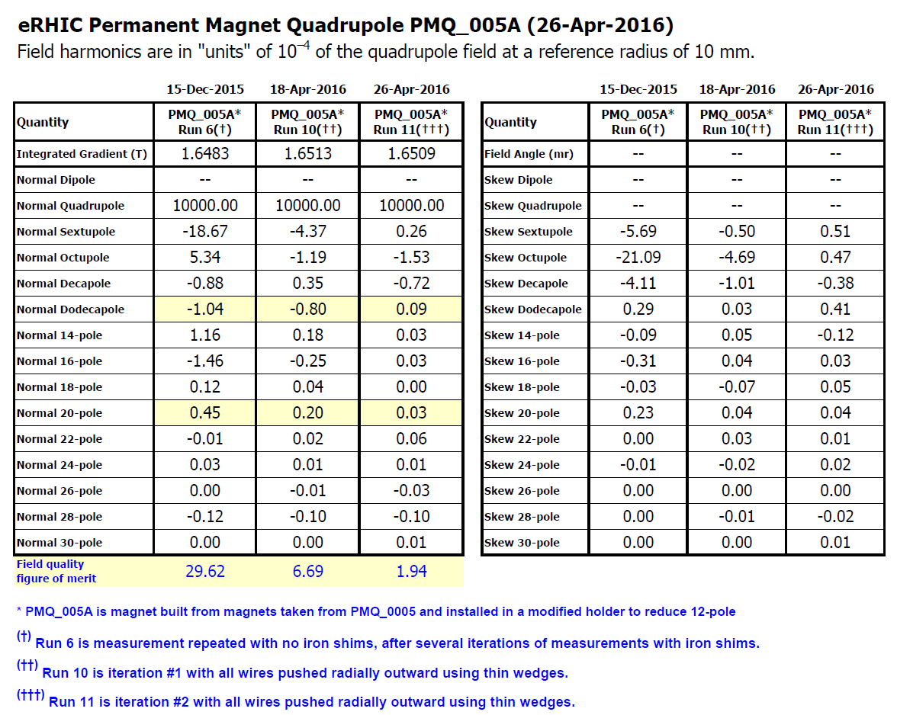
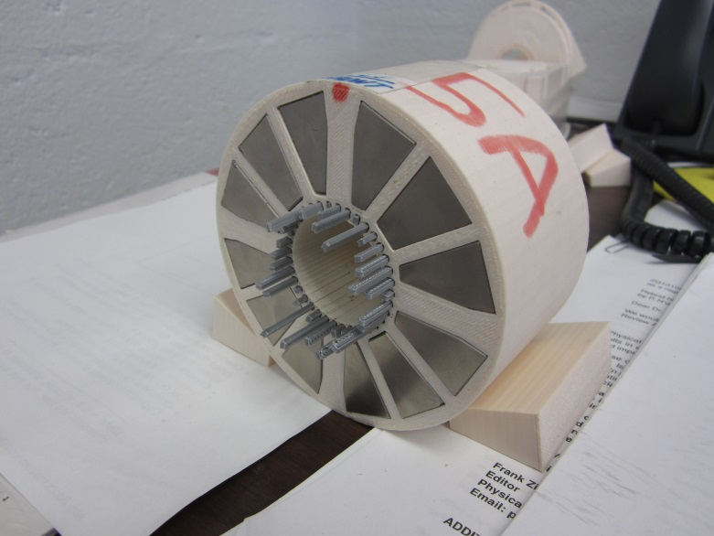
2nd shimming iteration
Of a previous test quadrupole magnet “5A”
3D printer was worse so had to use clamps for position accuracy!
1 iter → 4.4x, 2 iters → 15.3x

Slide 24
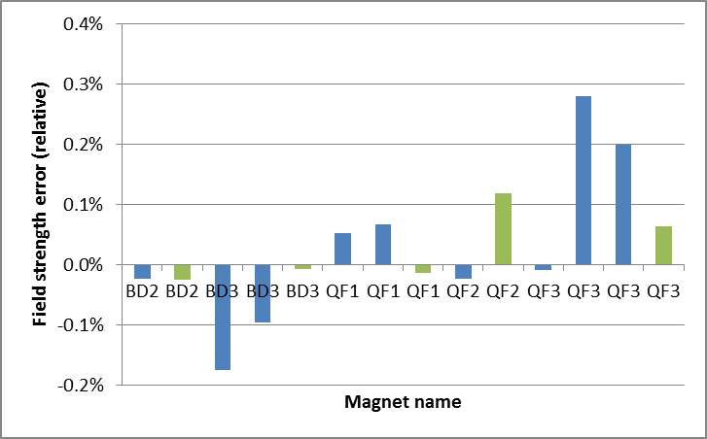
Field Strength vs. Spec
Average (integrated) quadrupole for 1st shim iteration:
-19.1142, -19.1176 T/m for BD
goal: 19.1191 T/m
23.6203 to 23.6514 T/m for QF
goal: -23.6236 T/m
Overall sign error because I got the Hall probe the wrong way around during block testing

Slide 25
Cost and Labour per Magnet
Permanent magnet wedges (AllStar N35SH)
$1052.67 per QF magnet (16 wedges)
$758.00 per BD magnet (16 wedges)
Labour ~8h per magnet: 3h measurement, 2h shimming, 2h assembly, 1h 3D printer setup
Required infrastructure
3D printer ($2-3k), used Ultimaker 2 Extended+
Rotating coil (~$50k)

Slide 26
Limitations
Strength
Upper limit to quad*aperture (pole tip field)
Watch out for demagnetisation from reverse fluxes (OK so far up to ~1T pole tip)
Choosing a high H_{cj} grade increases resistance to this
Can’t have rapidly varying field w.r.t. aperture
Temperature coefficient of NdFeB ~-0.12%/K
Choose high H_{cj} grade for radiation resistance

Slide 27
Benefits
No power consumption
No power supply, no copper wires or windings
Any field shape you like within strength limits
No “cross-talk” between iron surfaces in compact lattices
Can be assembled with mallet
1e-4 accuracy is possible after shimming
Seems cheap, at least for short magnet length

Slide 28
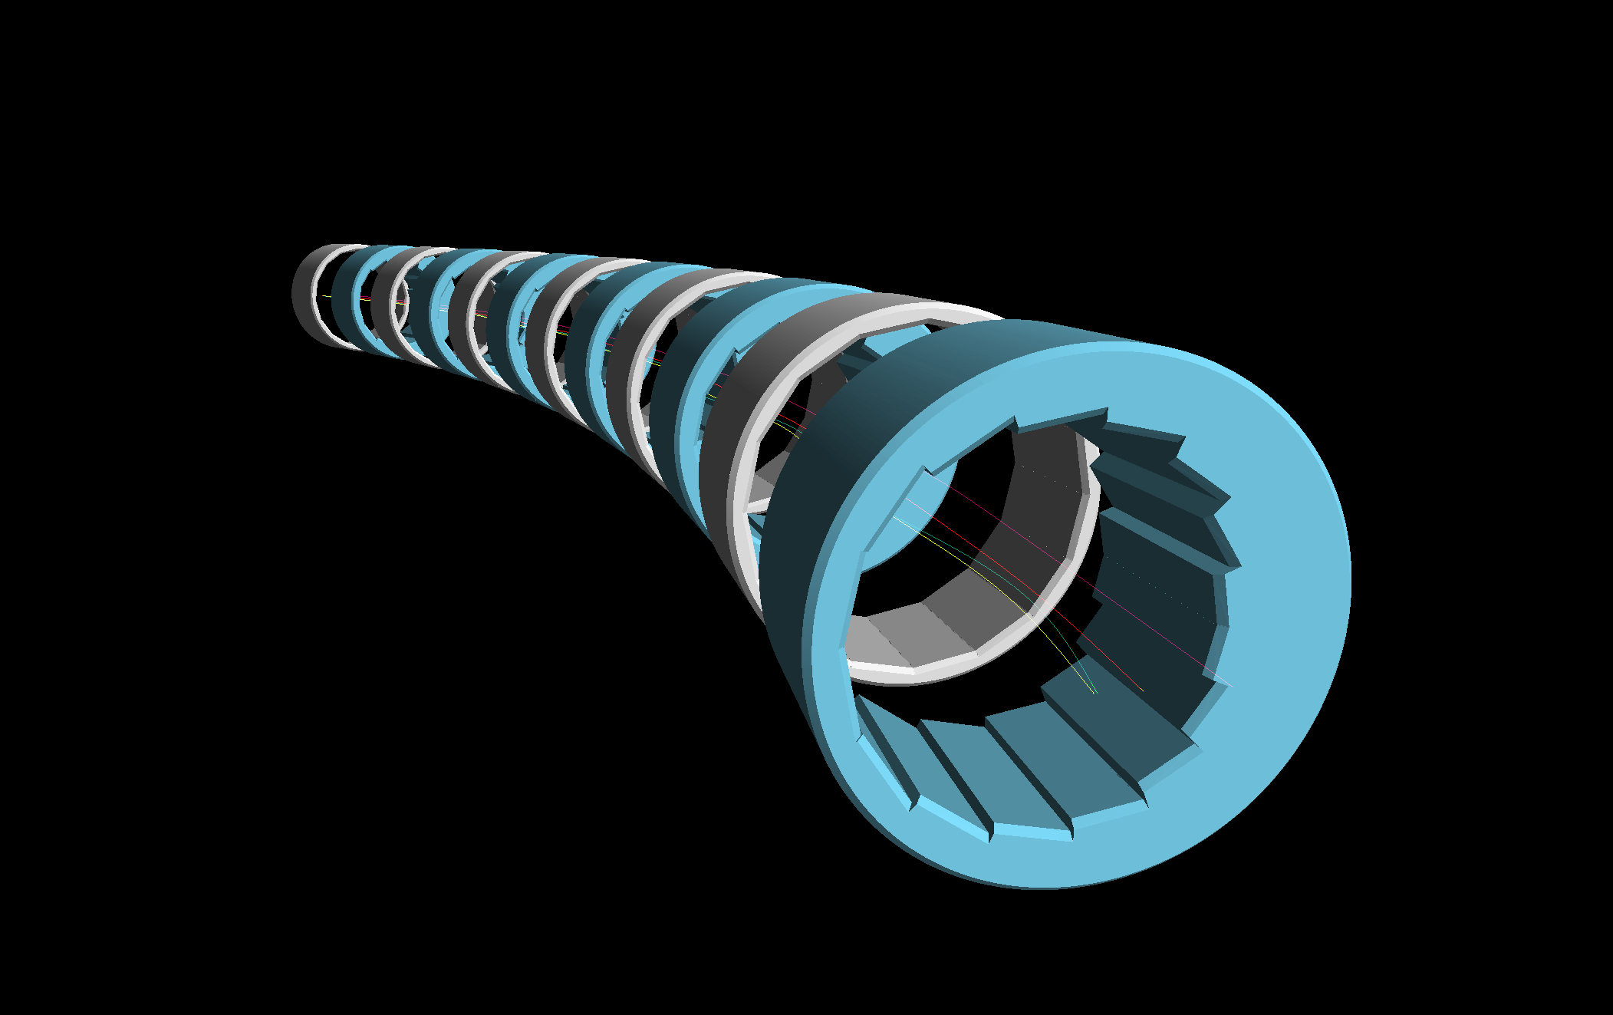
THE END

