Slide 1
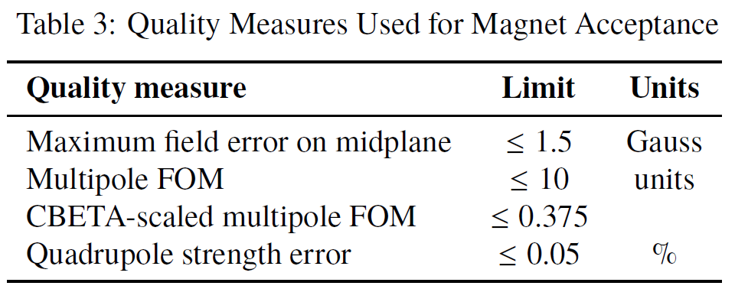
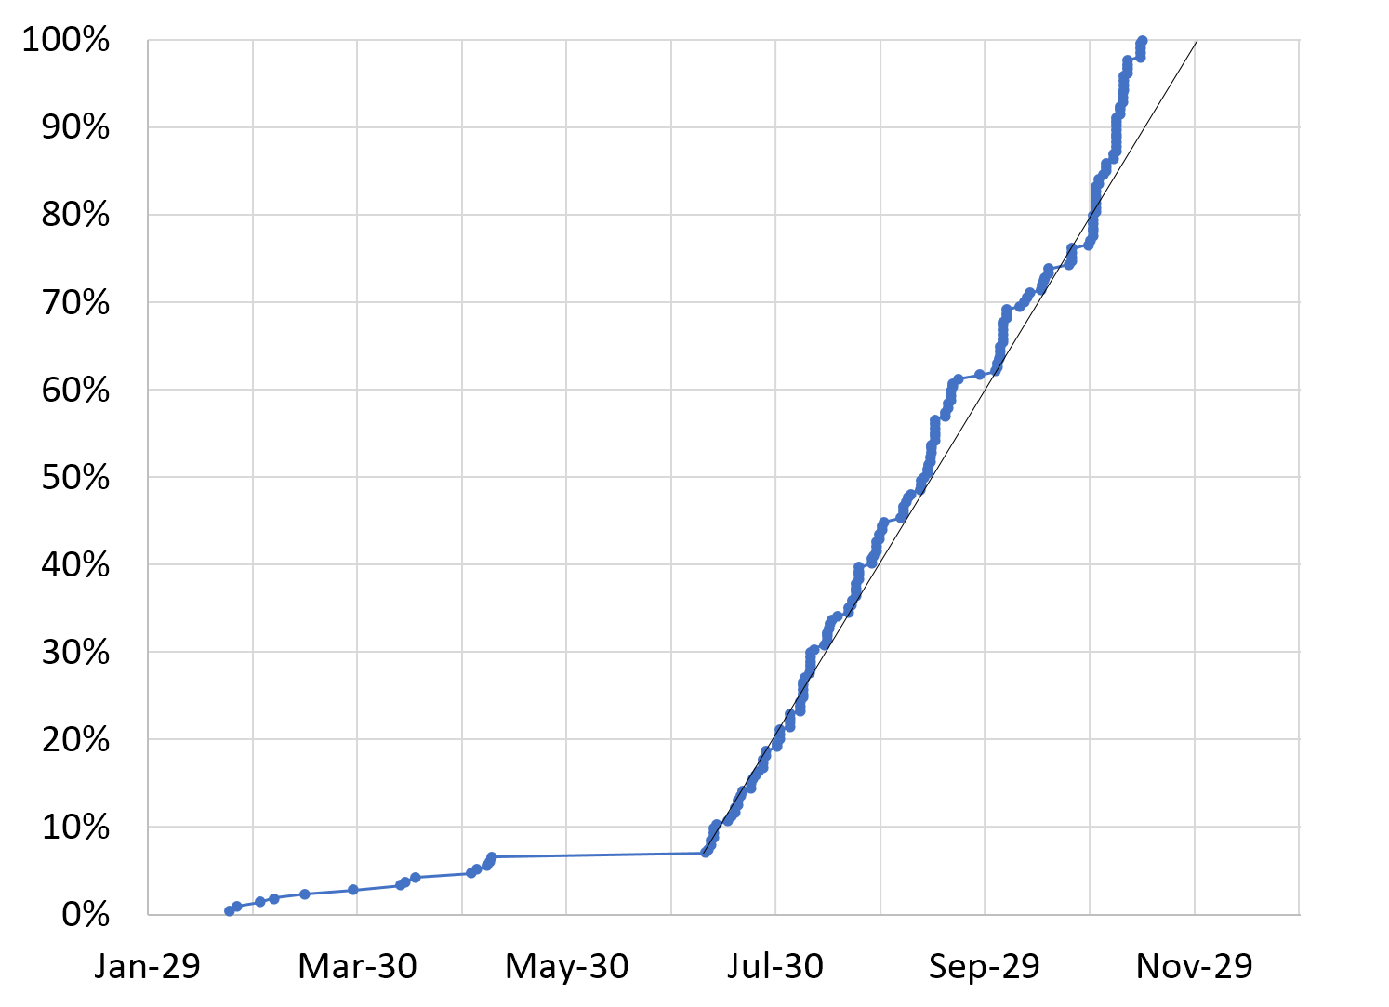
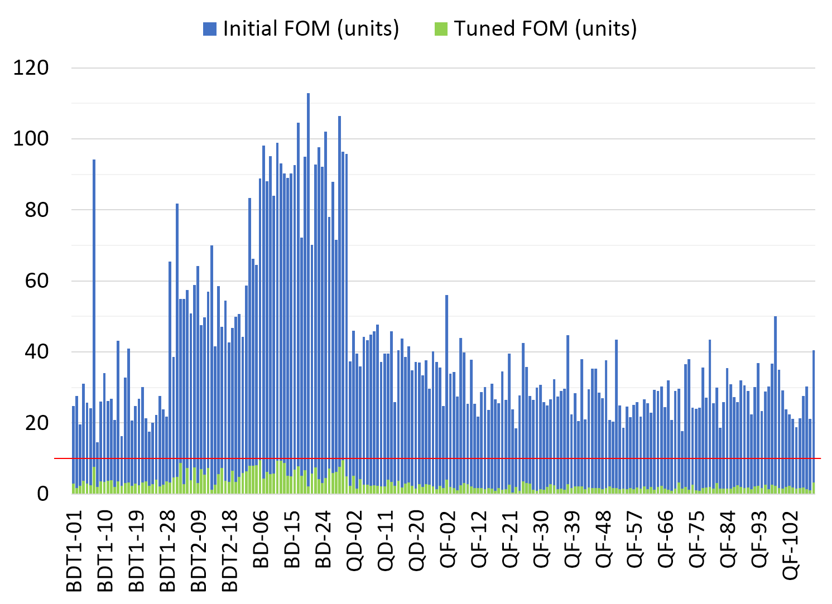
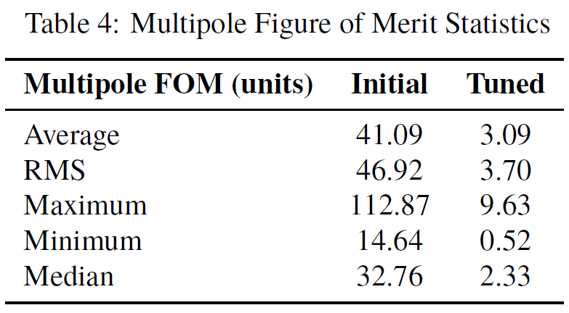
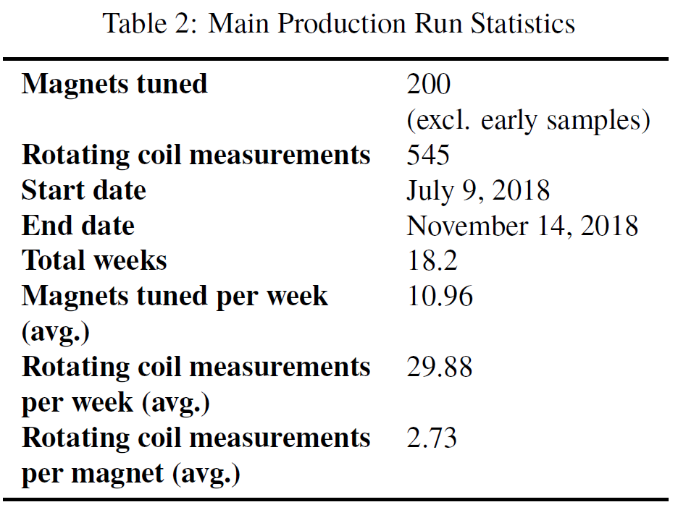
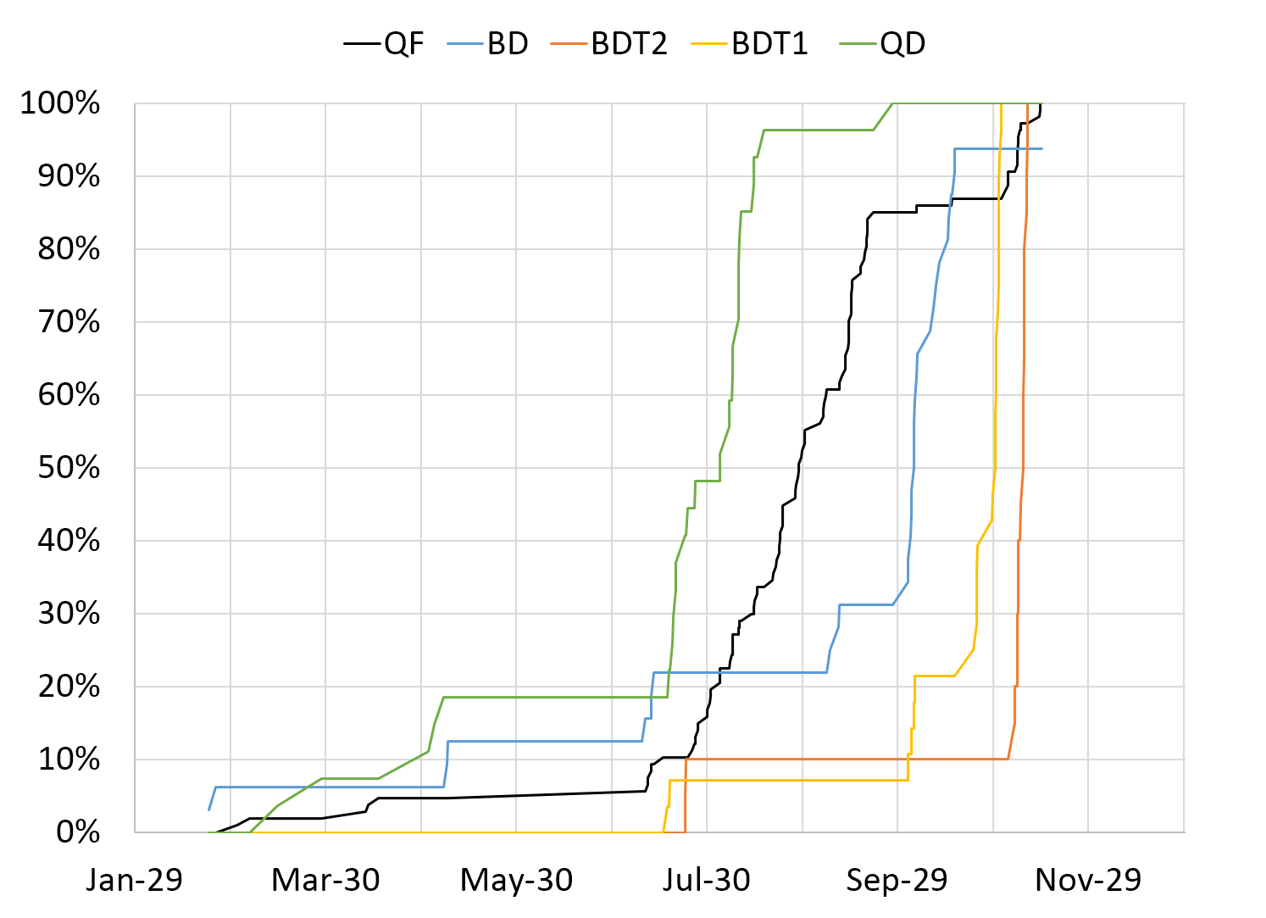
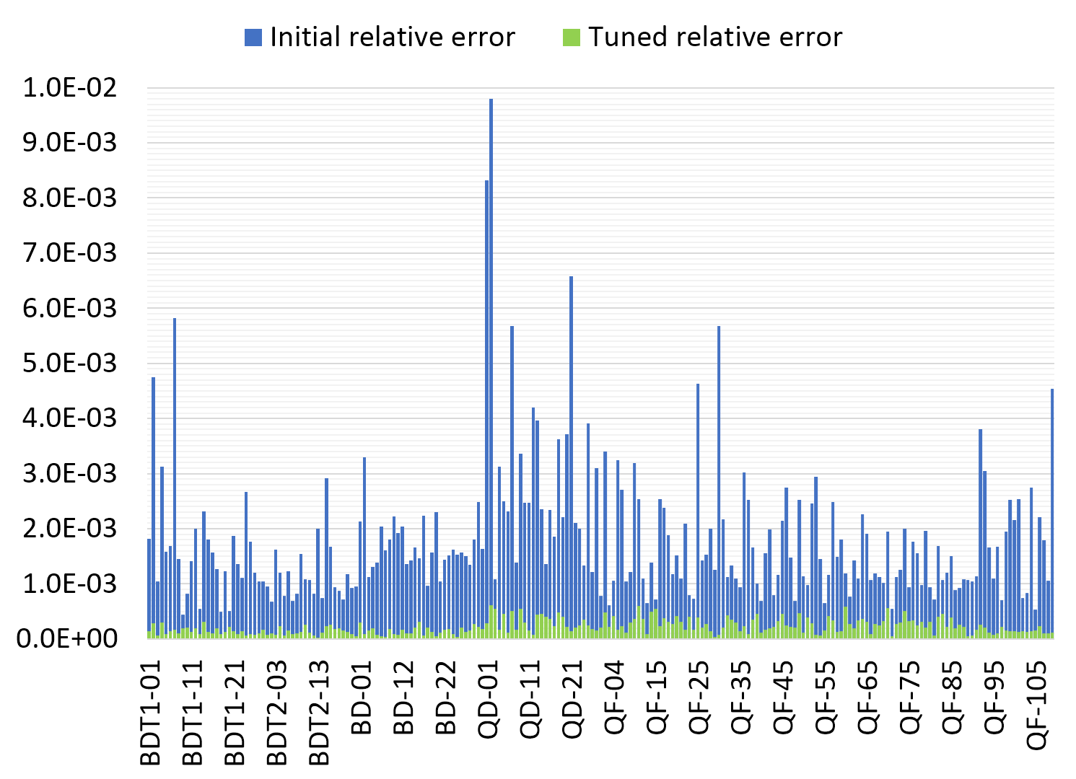
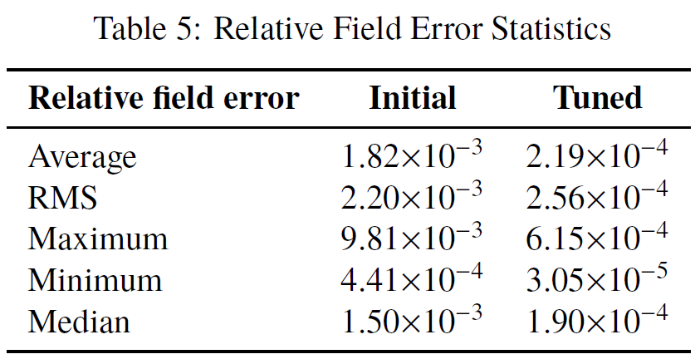
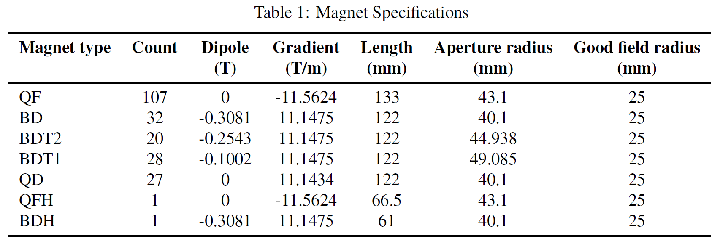
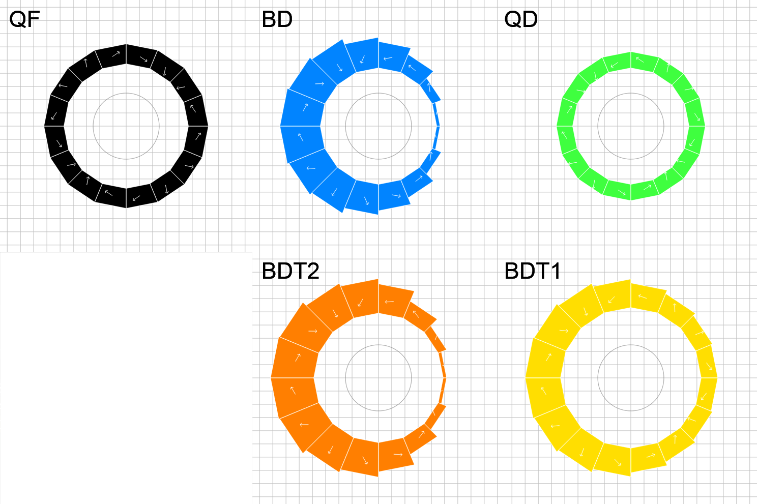
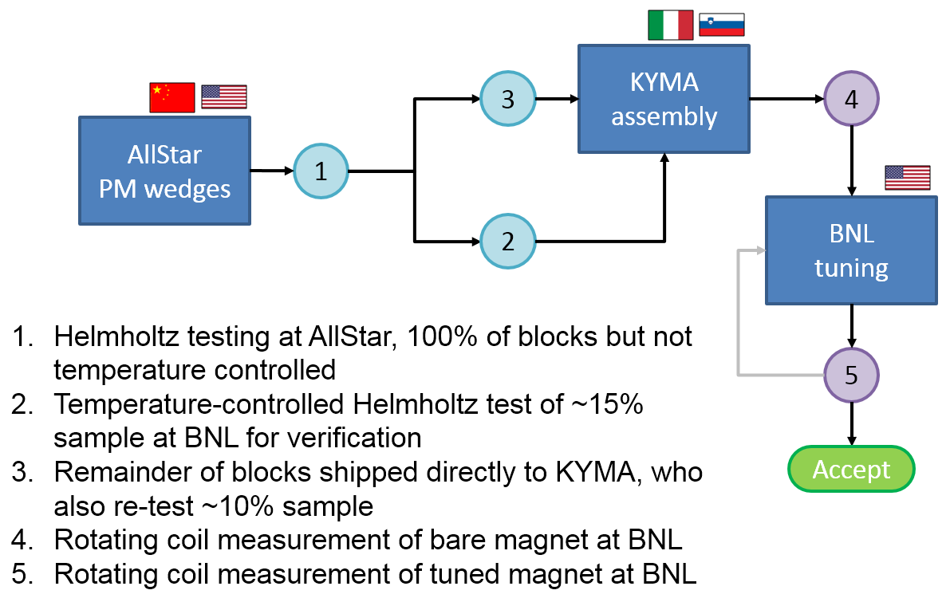
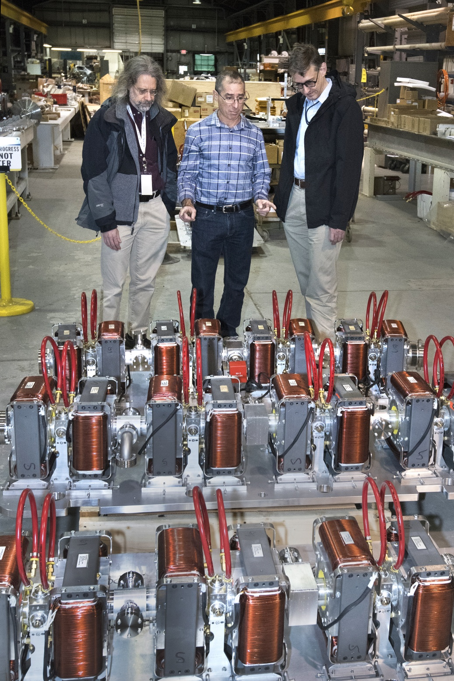
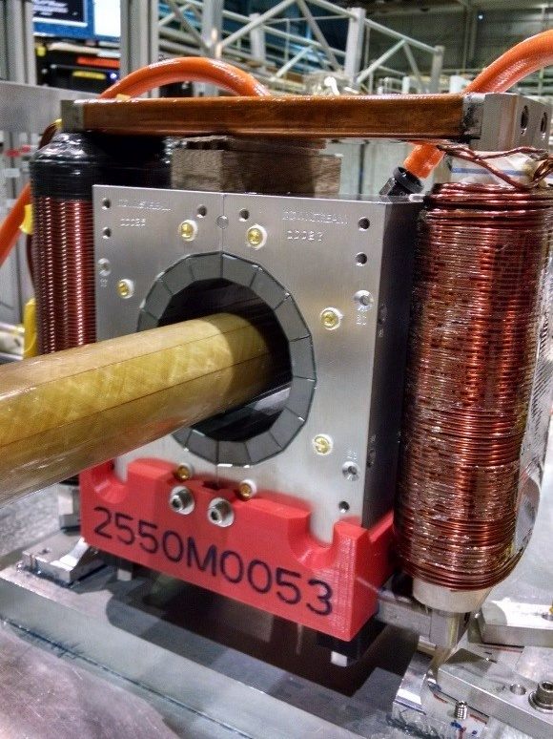
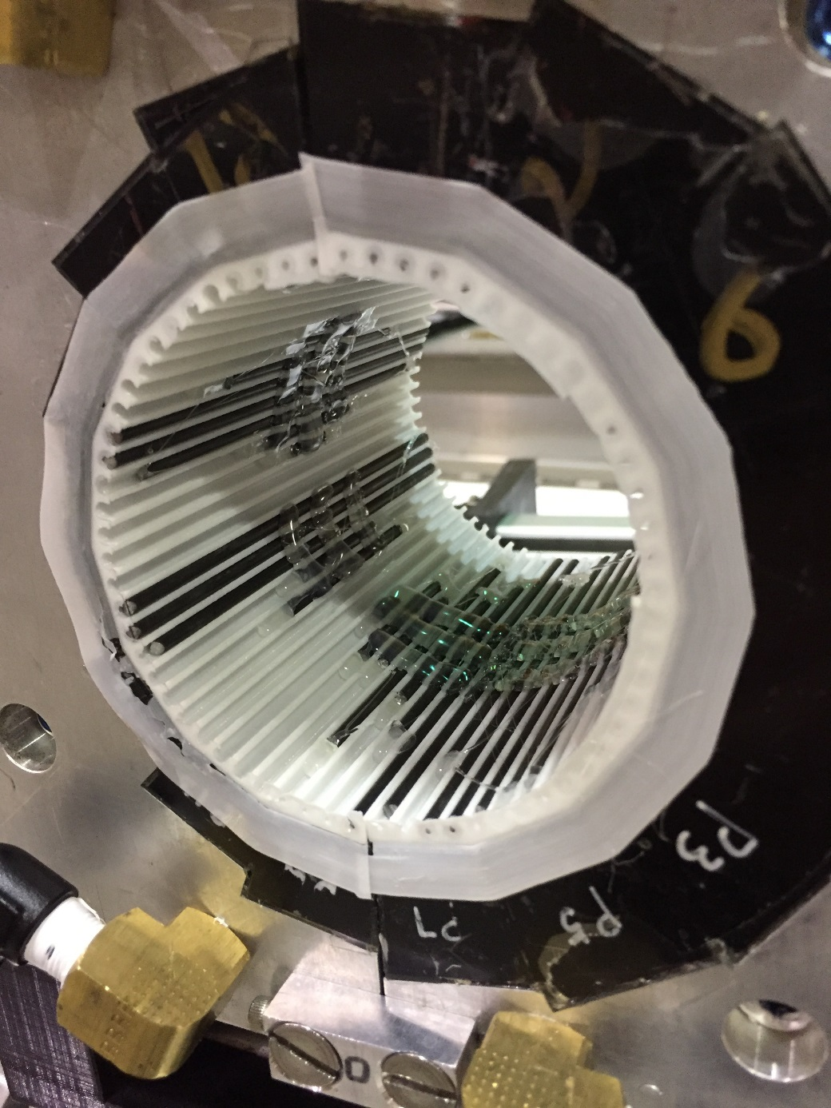
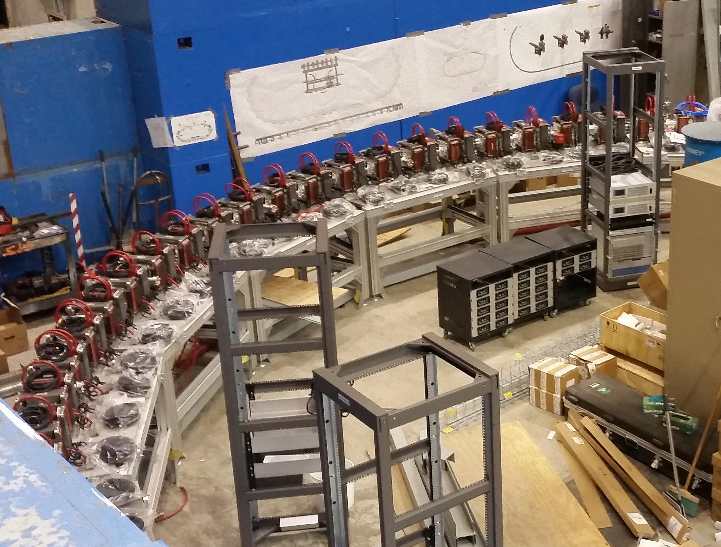
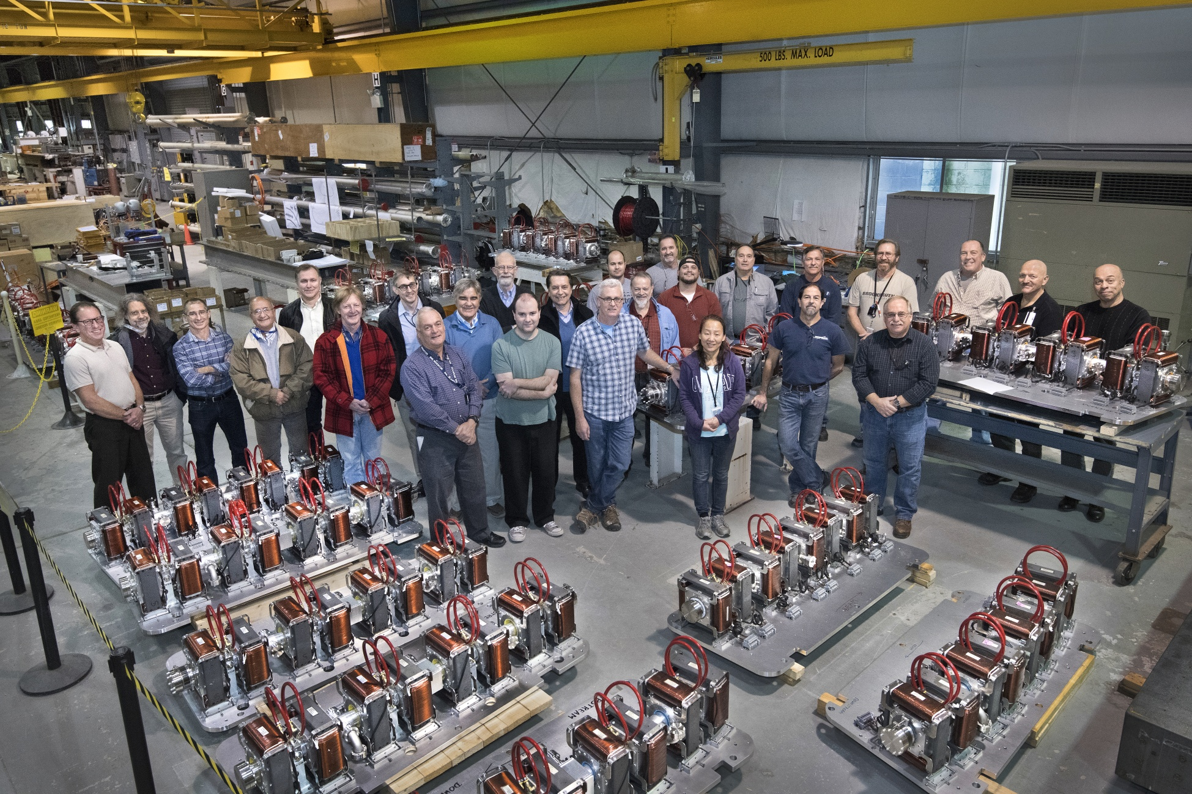
CBETA Permanent Magnet
Production Run
S. Brooks (sbrooks@bnl.gov), G. Mahler, J. Tuozzolo, R. Michnoff
Abstract 214 neodymium permanent magnets have been manufactured for the return loop of the CBETA multi-turn ERL being built at Cornell University. There are 5 types of quadrupole and combined-function gradient magnets using a variant of the circular Halbach design. These are made out of NdFeB material and glued into an aluminium housing with water channels for temperature stabilisation. The NdFeB wedges and magnet construction were done by outside companies, while the final “tuning” using inserts containing 64 iron wires per magnet was done at BNL over a period of about 6 months. Average relative field errors of 2.3×10⁻⁴ were achieved on the beam region. The magnet strengths vary by type but are of order 10T/m for quadrupole component and up to 0.3T for the dipole. This paper reports on the field quality and timeline achieved in this production process. Magnet Types and Quantities Different magnet cross-sections (above) are used in different parts of the CBETA return loop (below) to vary the curvature. | Schedule Achieved All the magnets were accepted by the November 30th 2018 deadline, as shown in the graph below. Production Method Permanent magnet wedges with 1°, 1% RMS magnetisation accuracy were produced by Allstar Magnetics using a manufacturer in China. The assembly was done by KYMA, who made the aluminium housings and glued the magnets into place to within ±0.25mm. The diagram below shows the quality control and acceptance process. Magnet Tuning (above left) QD magnet being measured with a rotating coil at BNL magnet division. The harmonic errors were used to determine an arrangement of iron wires to be inserted into the magnet bore: (above right) shows a BD magnet. | Field Quality Results Achieved distributions of “multipole FOM” and relative field error are shown below. The multipole FOM is defined as where a_{n} and b_{n} are multipole field amplitudes at R=25mm, scaled so that the main quadrupole is 10000 units. Relative field error equals taken over the y=0, x=±25mm beam midplane. The CBETA-scaled multipole FOM is defined as …where limits are derived from tracking studies. Cost and Conclusion
The magnet production run was a success, producing all magnets with good field quality within the deadline.
The cost per magnet for NdFeB material was $3303 and the total cost fit within the planned CBETA budget. (NB: the cost of rare earth materials varies substantially with global supply fluctuations.)

