Slide 1
Fixed-Tune Non-Scaling FFAs
Design for RAL FETS-FFA (3-12MeV p)
Analysis for cell of two thin lenses

Slide 2
Introduction
Recent studies by Dejan Trbojevic have confirmed that non-scaling FFAs can have their tune dependence on momentum flattened by adding non-linear components to the magnet fields, although not necessarily for an unlimited momentum range.
Quadrupole affects tune level, sextupole affects dQ/dp, octupole affects d²Q/dp², etc.

Slide 3
FETS-FFA requirements
3-12MeV protons
4m average radius
Several 1m drifts (one per cell here)
Fixed tunes: ΔQ_{x,y}<0.01 in ring, <0.001 per cell
Q_{x,y} tunable over full range of 1 in ring
  For exploration of the tune plane in R&D
  I chose 12 cells so this is 1/12 range per cell
Geometrical aperture 1250mm.mrad (large)

Slide 4
Algorithm
Runge-Kutta 4th order tracking step
Loop to get trajectory in cell
Finite difference to get transfer matrix
  Also gives tunes if orbit is closed
Iterate (Newton) to find closed orbit
Loop over all FFA energies
Finite difference parameters to get response matrix of tune functions to multipole changes
Iterate (optimiser) to find fixed-tune lattice
Muon1
Muon1 cell optics mode
Muon1 FFA optics mode
Fixed-tune FFA optimiser
(parallel)

Slide 5
Field Model
Midplane field is product of:
  Transverse polynomial up to dodecapole
    Rough initial field coefficients up to octupole were found by Muon1 genetic algorithm before using fixed-tune FFA optimiser
  Longitudinal integral of Gaussian at both ends
    Fringe length given by σ=6cm
Off-midplane fields extrapolated by repeated derivatives of this product of three functions

Slide 6
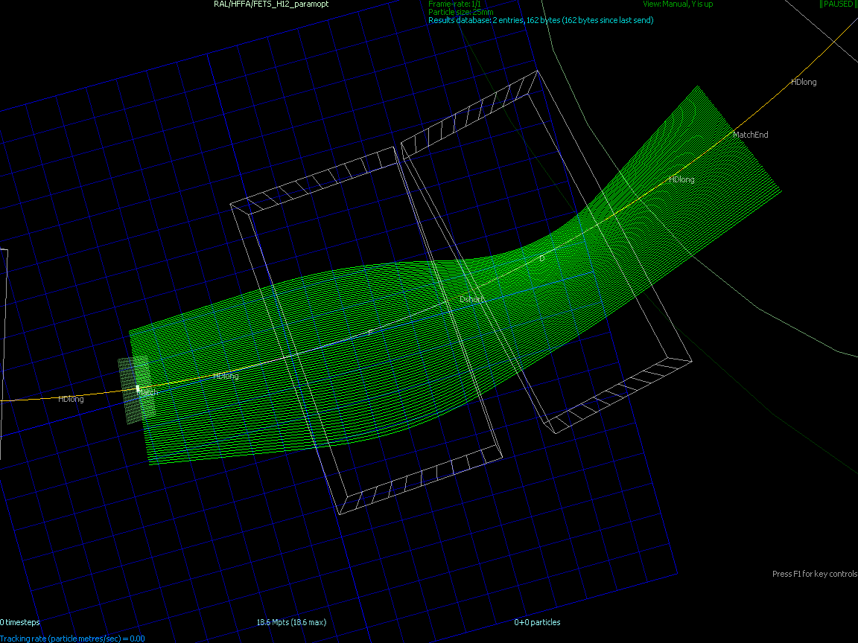
Fixed-Tune Cell Orbits
Target cell tunes Q_{x}=0.216, Q_{y}=0.213

Slide 7
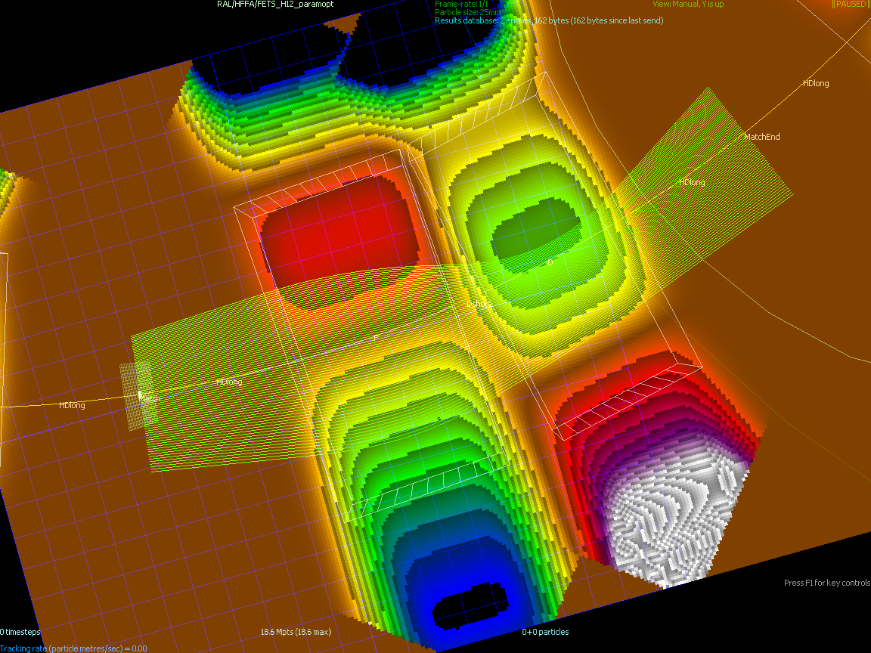
Fixed-Tune Cell Fields
F field +0.15 to -0.43T, D field -0.42 to -0.02T

Slide 8
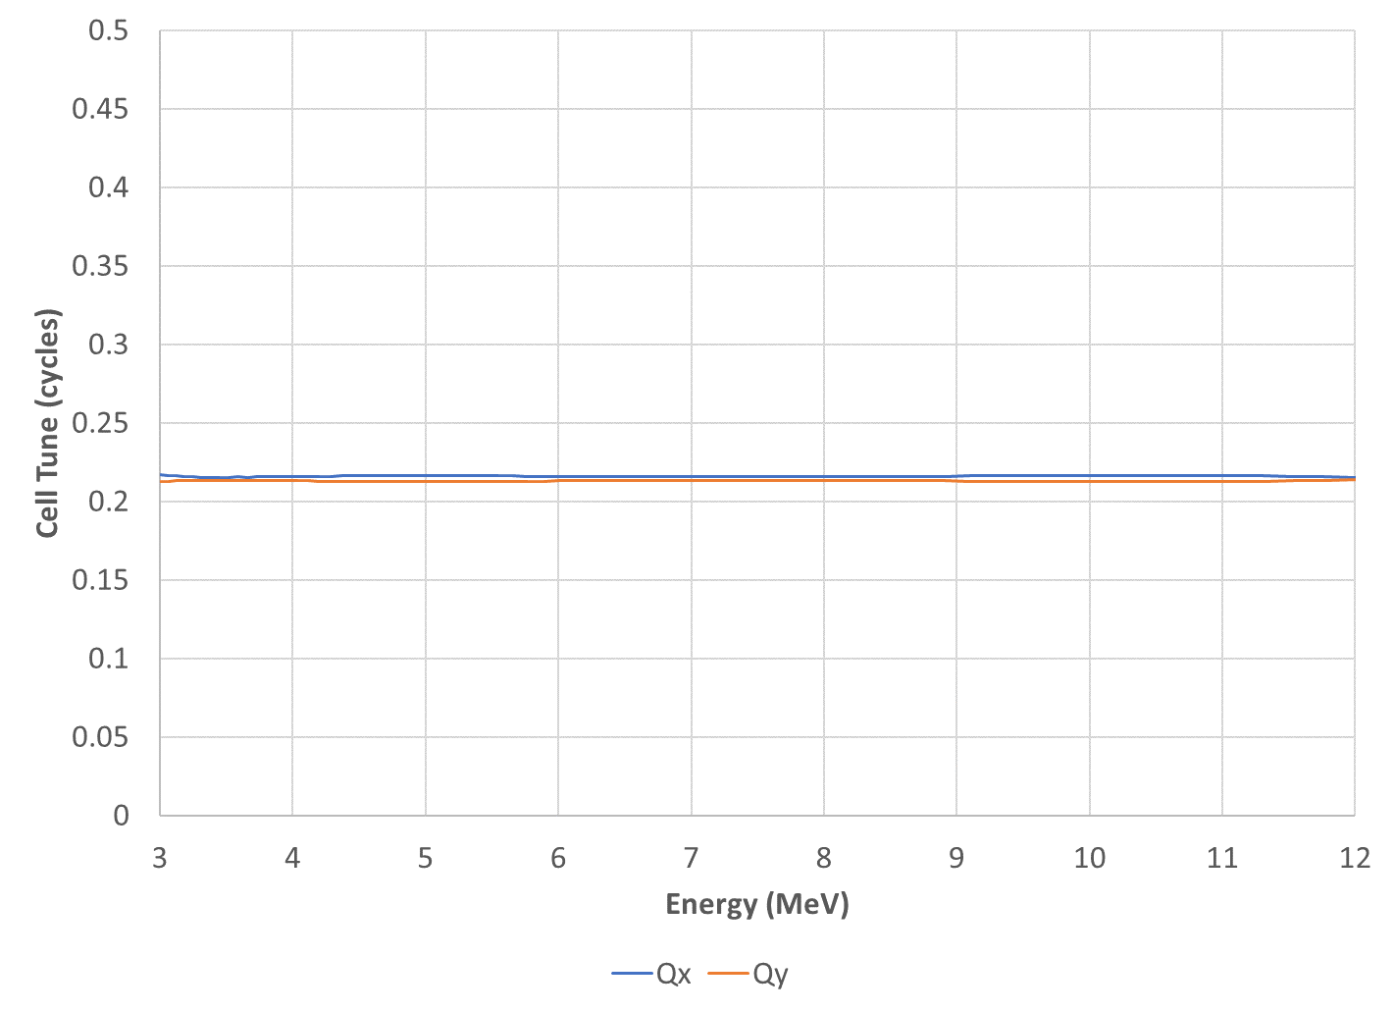
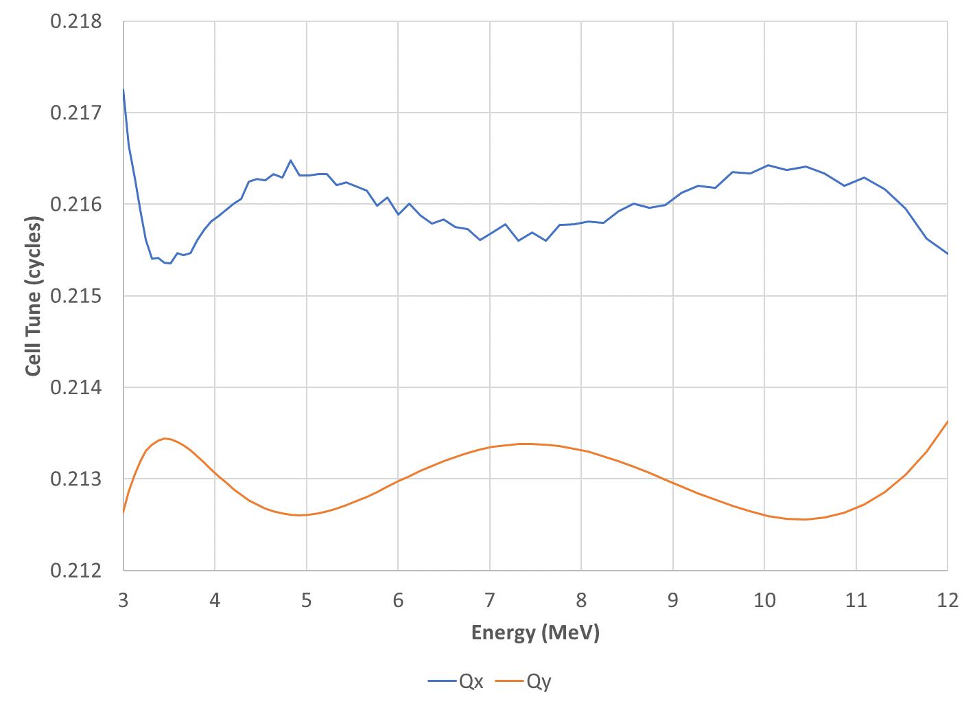
Cell Tunes
Target cell tunes Q_{x}=0.216, Q_{y}=0.213

Slide 9
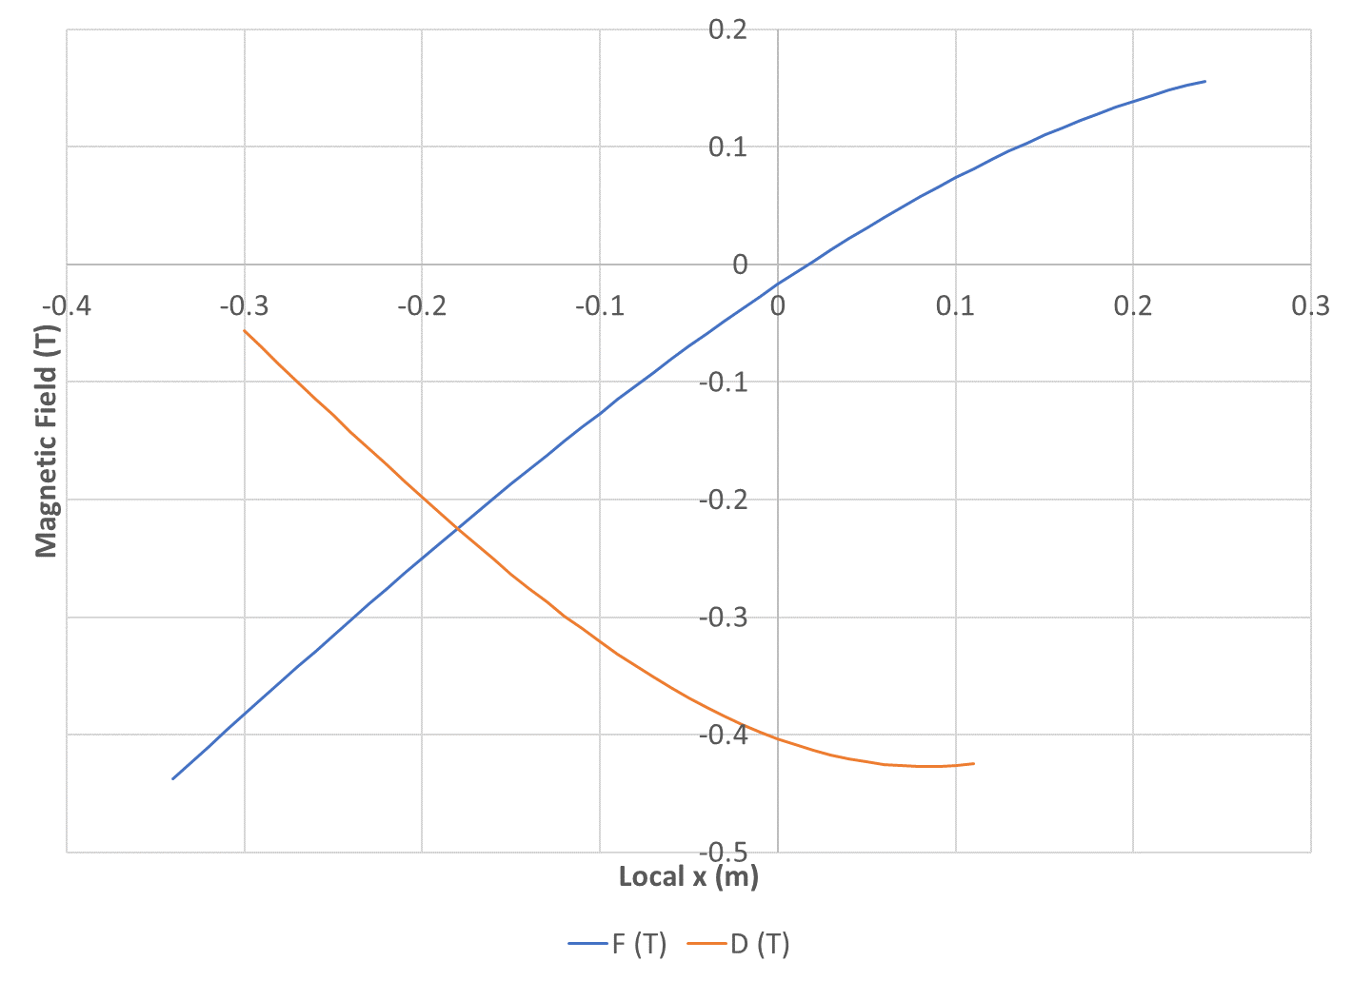
Field Profiles
← 12MeV, ring outside
3MeV, ring inside →
Only plotted in beam region, including sagitta

Slide 10
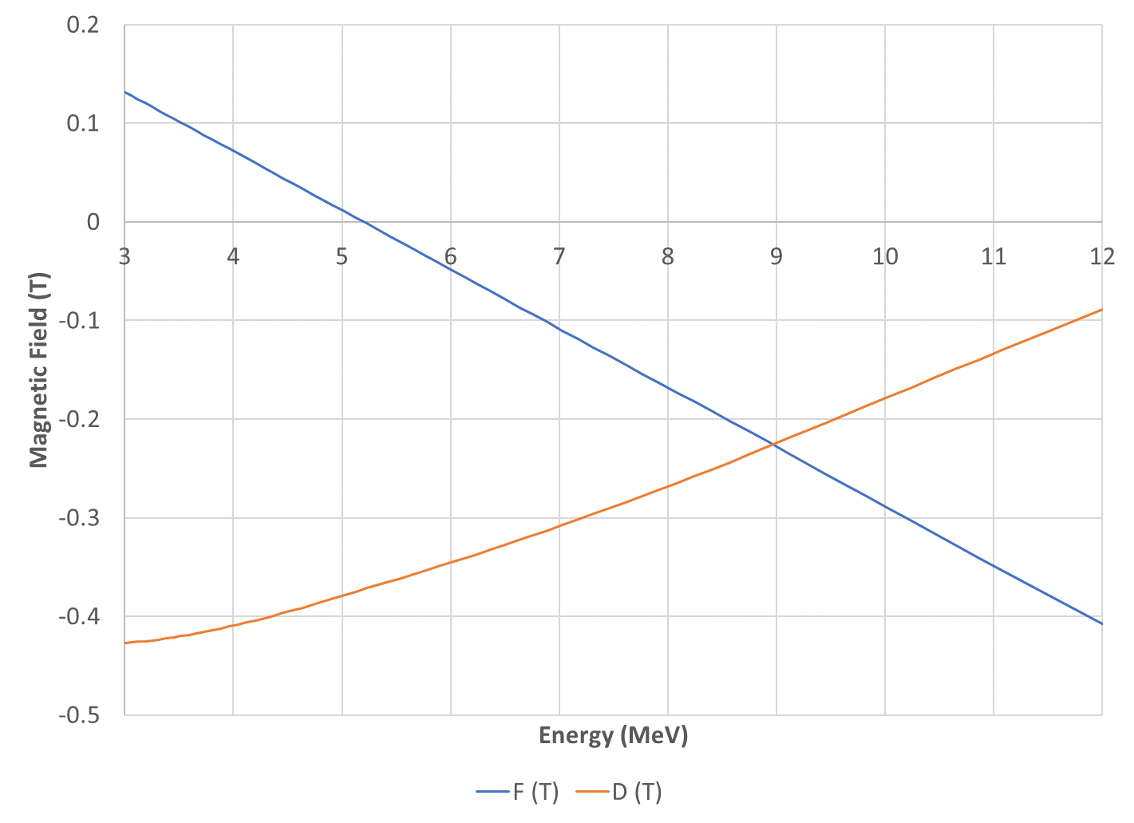
Field vs. Kinetic Energy

Slide 11
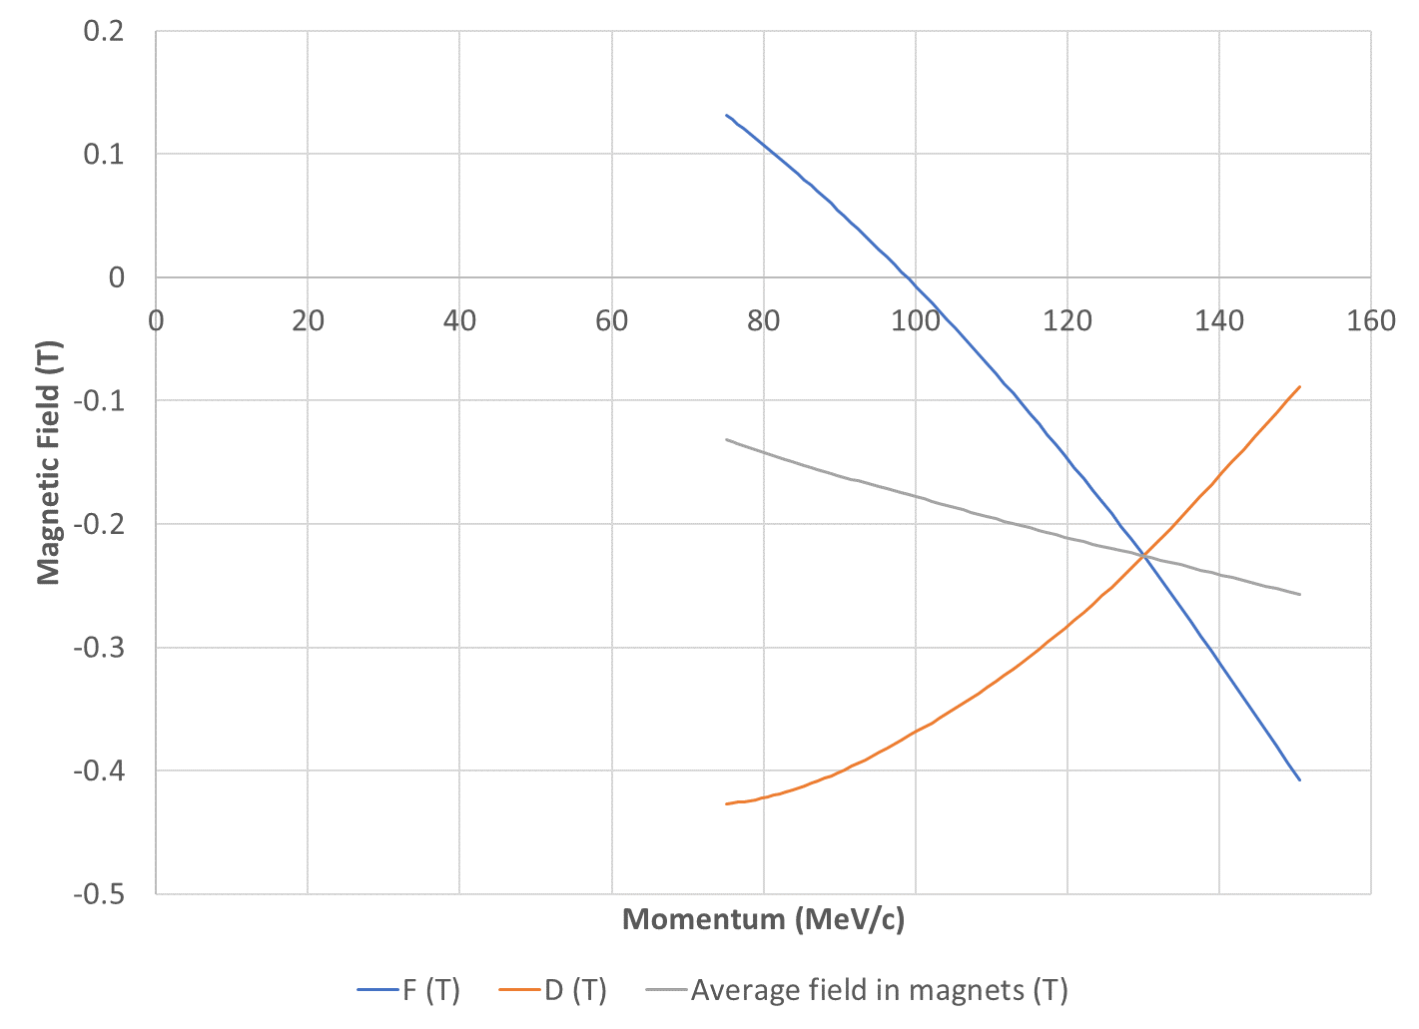
Field vs. Momentum
Average field should be proportional to momentum
Not exactly because I used “average” position in each magnet

Slide 12
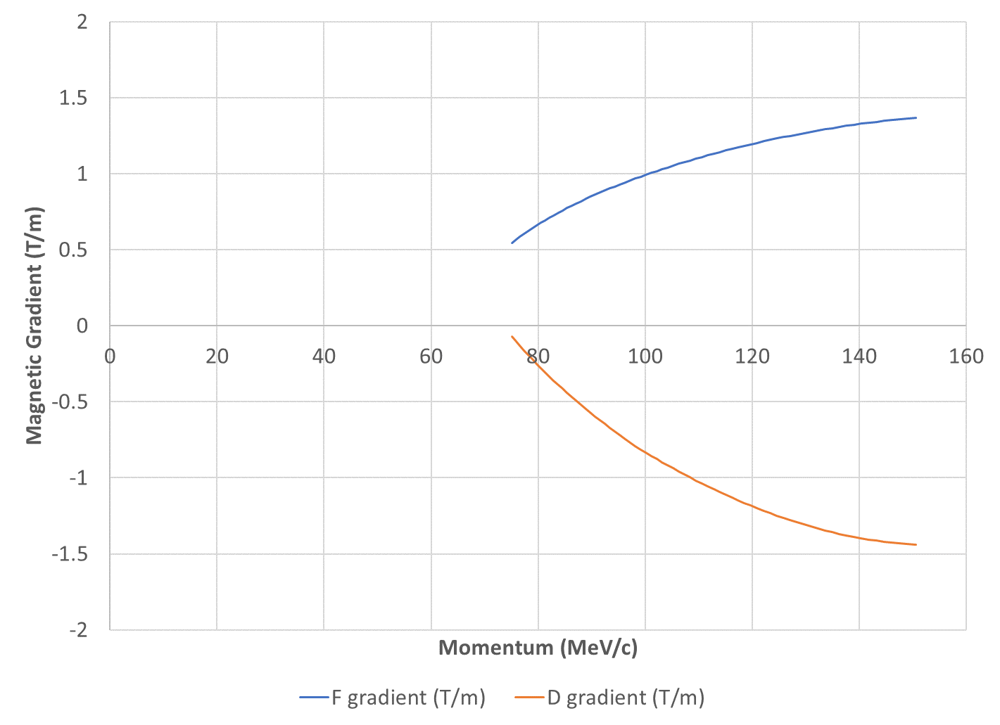
Gradient vs. Momentum
In a thin-lens model, the gradients should be proportional to momentum
Here they are not, I suspect edge focussing

Slide 13
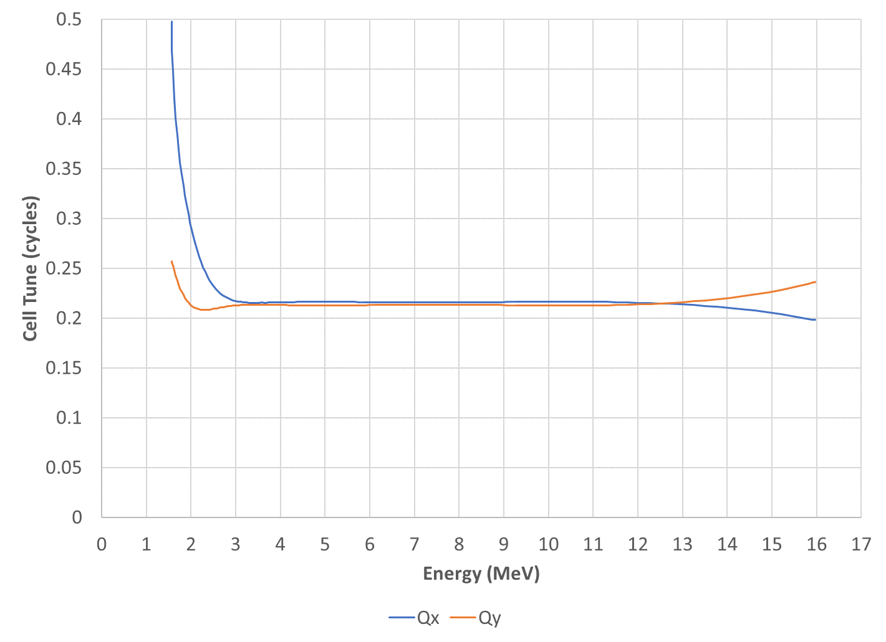
Tunes Beyond Energy Range
Target cell tunes Q_{x}=0.216, Q_{y}=0.213
Hits magnet bounding box

Slide 14
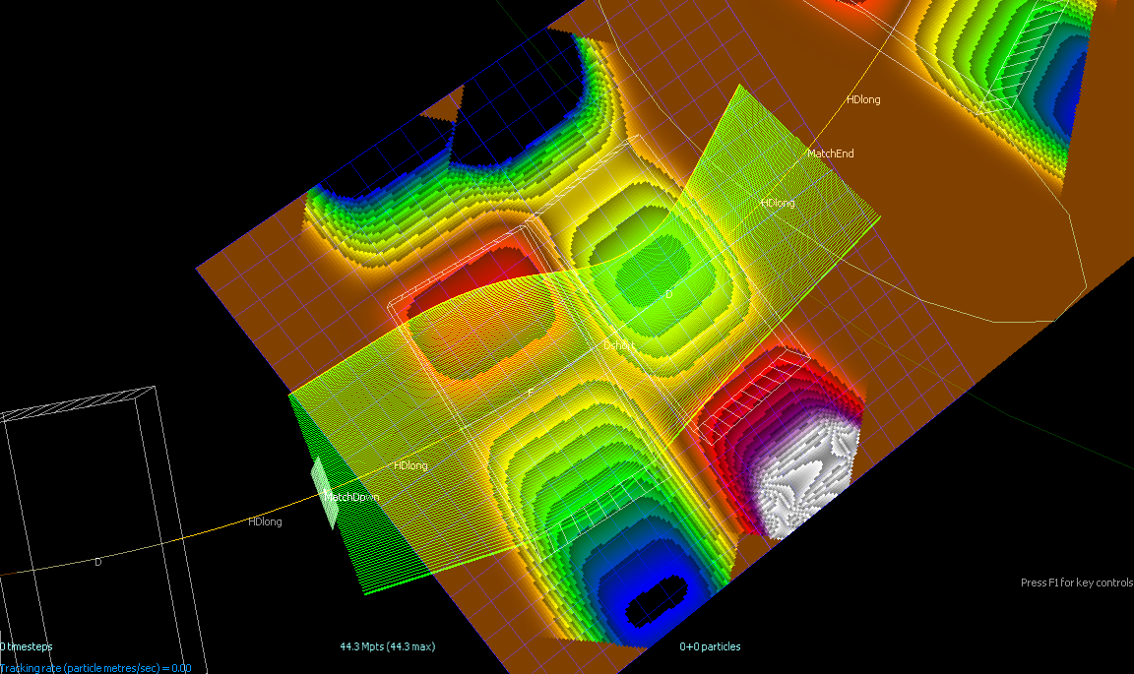
Orbits Beyond Energy Range

Slide 15
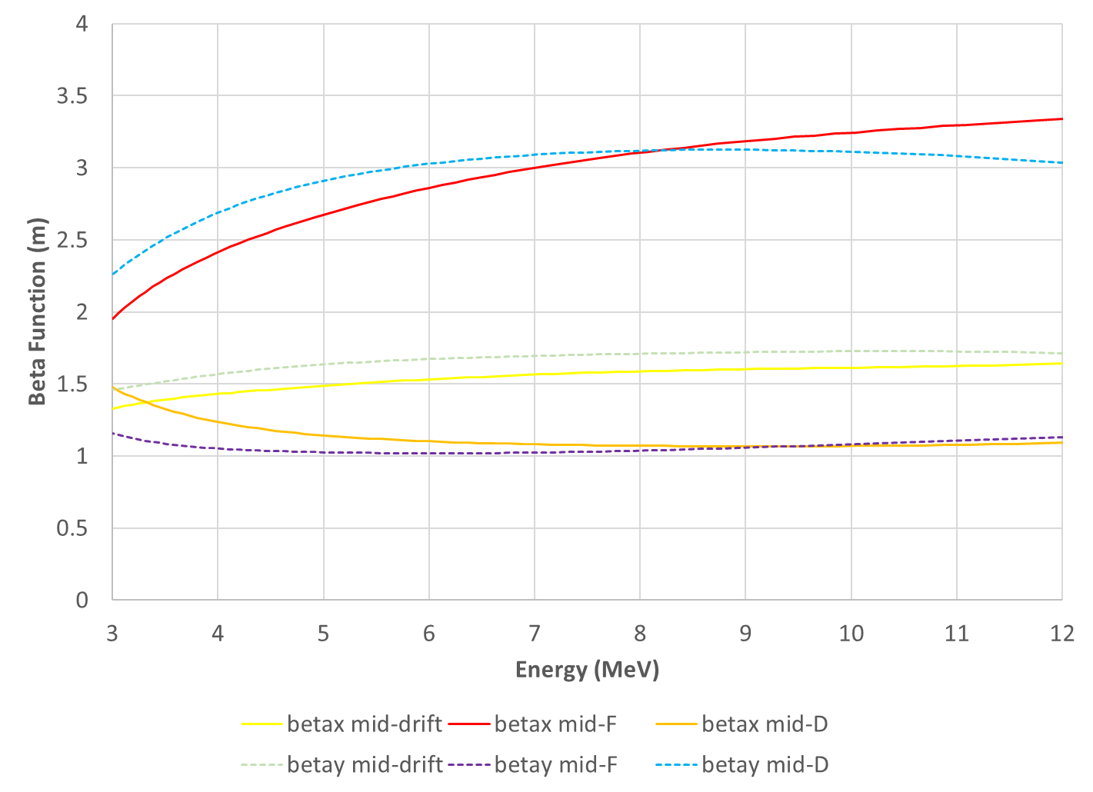
Beta x,y vs. Kinetic Energy

Slide 16
Tune Range Requirement
Q_{x,y} tunable over full range of 1 in ring
  For exploration of the tune plane in R&D
  I chose 12 cells so this is 1/12 range per cell
Q_{x}=0.216, Q_{y}=0.213 would be ring tune of (2.592,2.556)
So choose 2.5 to 3.5 ring tune range in both planes
  0.2083 to 0.2917 cell tune (all combinations)

Slide 17
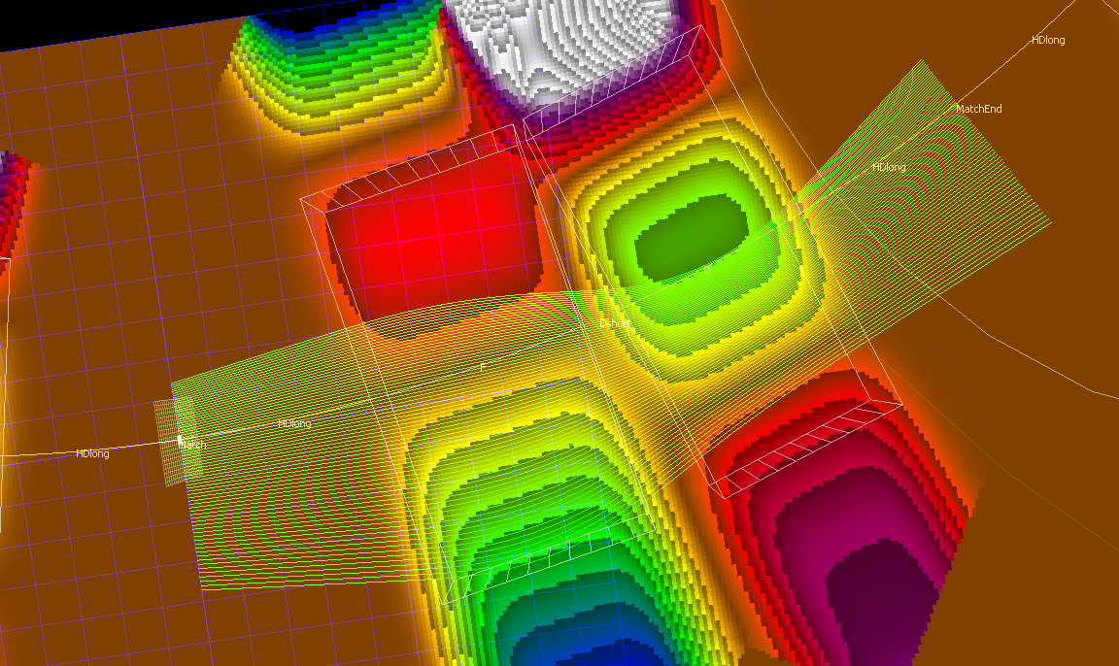
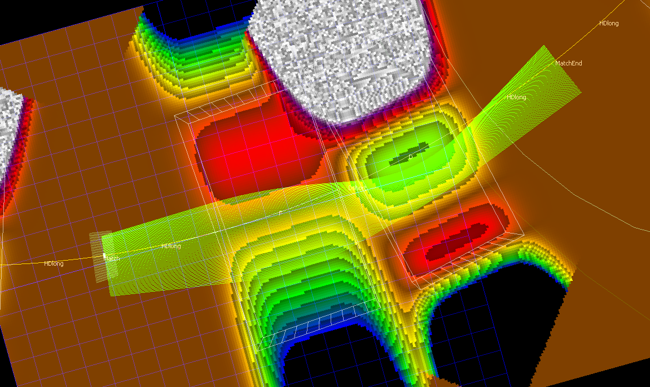
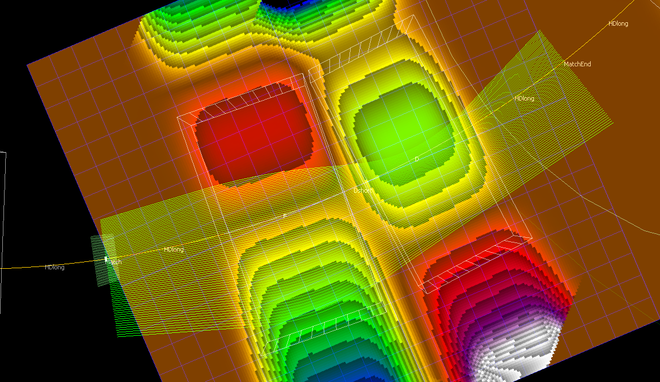
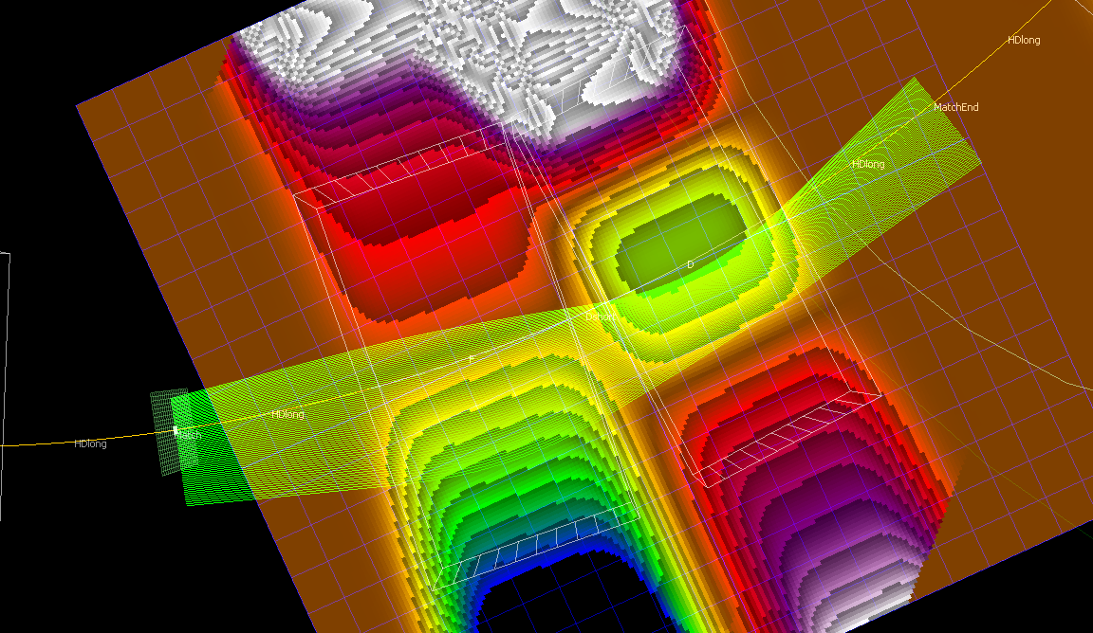
Four Tune “Corners”
Q_{x}=0.2083, Q_{y}=0.2917
Q_{x}=0.2917, Q_{y}=0.2917
Q_{x}=0.2083, Q_{y}=0.2083
Q_{x}=0.2917, Q_{y}=0.2083

Slide 18
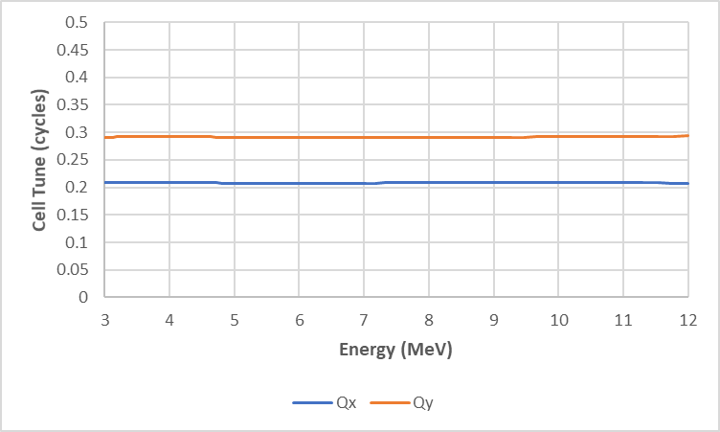
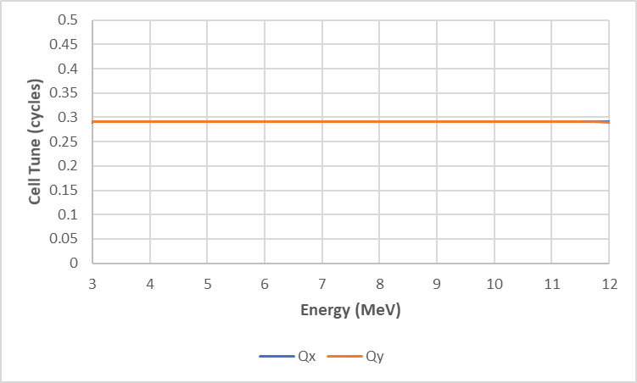
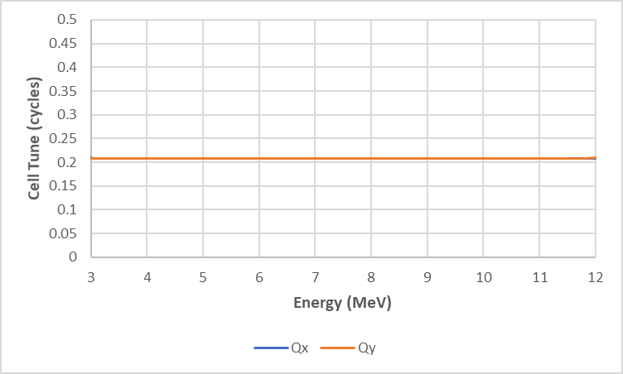
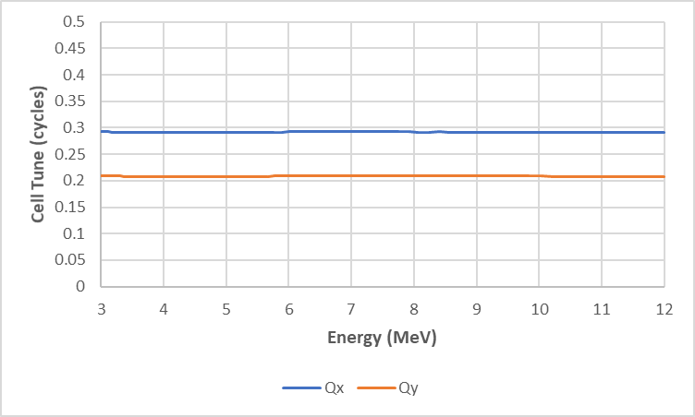
Cell Tunes at Corners
Q_{x}=0.2083, Q_{y}=0.2917
Q_{x}=0.2917, Q_{y}=0.2917
Q_{x}=0.2083, Q_{y}=0.2083
Q_{x}=0.2917, Q_{y}=0.2083

Slide 19
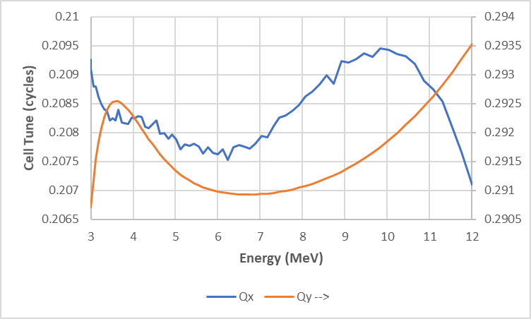
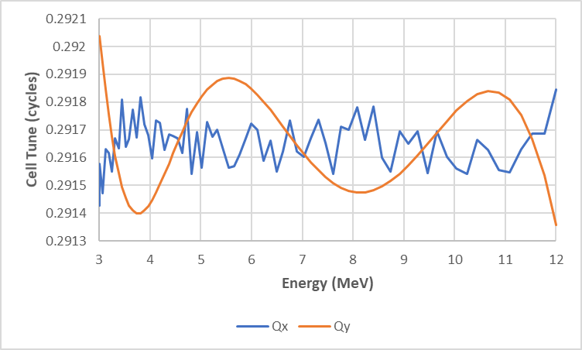
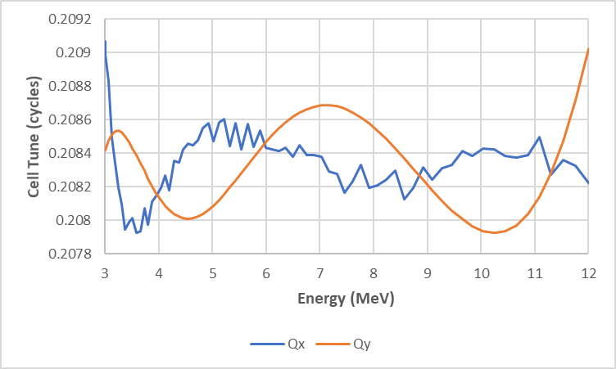
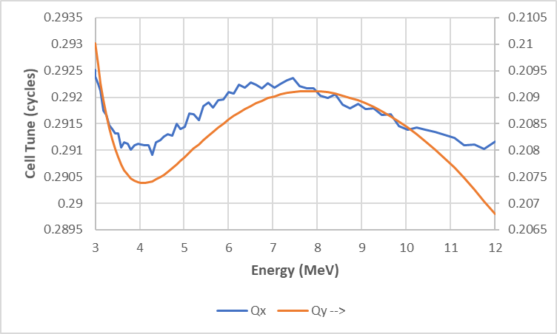
Cell Tunes at Corners (zoom)
Q_{x}=0.2083, Q_{y}=0.2917
Q_{x}=0.2917, Q_{y}=0.2917
Q_{x}=0.2083, Q_{y}=0.2083
Q_{x}=0.2917, Q_{y}=0.2083

Slide 20
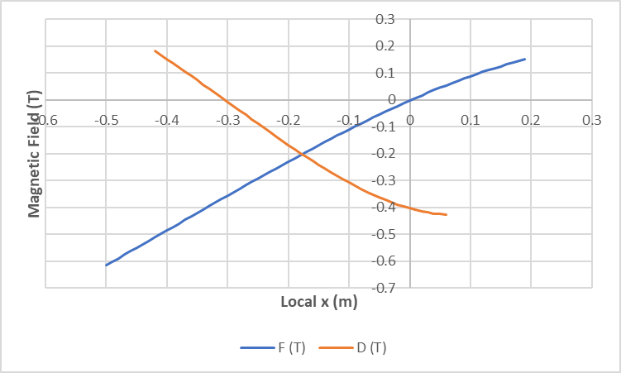
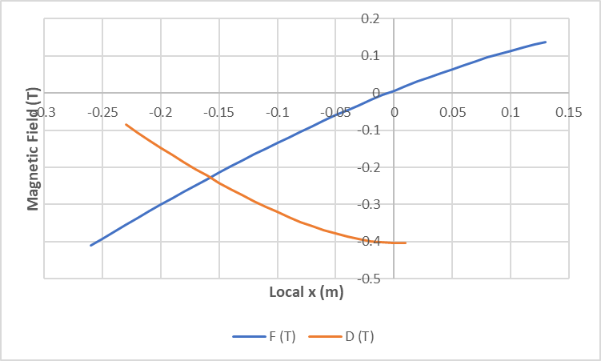
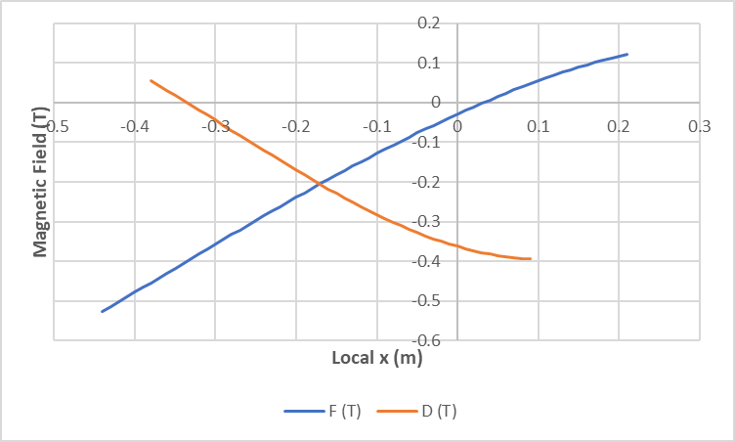
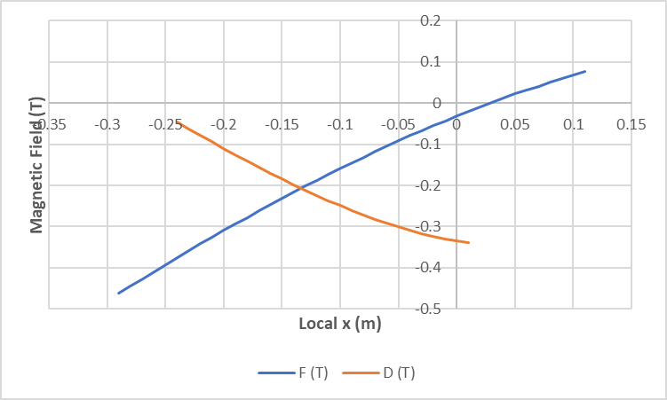
Field Profiles of Corner Designs
Q_{x}=0.2083, Q_{y}=0.2917
Q_{x}=0.2917, Q_{y}=0.2917
Q_{x}=0.2083, Q_{y}=0.2083
Q_{x}=0.2917, Q_{y}=0.2083

Slide 21
Designs Summary Table
Cell Q_{x} | Cell Q_{y} | Max tune error | Max field (T) | Orbit range (m)
0.2083 | 0.2083 | 0.00074 | 0.5204 | 0.641
0.2083 | 0.2917 | 0.00185 | 0.6128 | 0.688
0.2917 | 0.2083 | 0.00168 | 0.4466 | 0.389
0.2917 | 0.2917 | 0.00037 | 0.4004 | 0.381
0.216 | 0.213 | 0.00126 | 0.4310 | 0.573
Q_{x} low, Q_{y} high corner is most “unnatural”
  Largest orbit excursion, highest field
    Had to let optimiser vary dipole to stay in magnet box
Higher Q_{x} tunes greatly improve orbit range

Slide 22
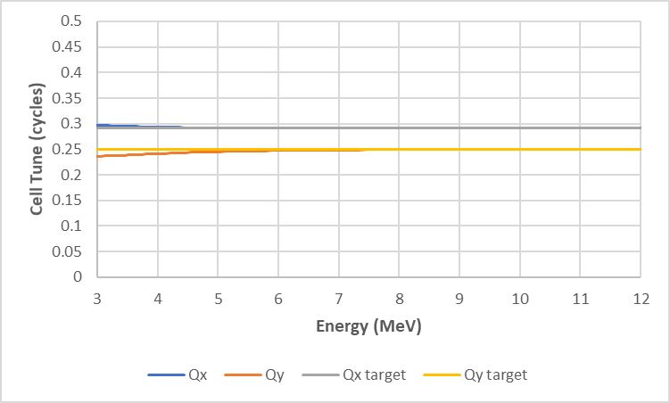
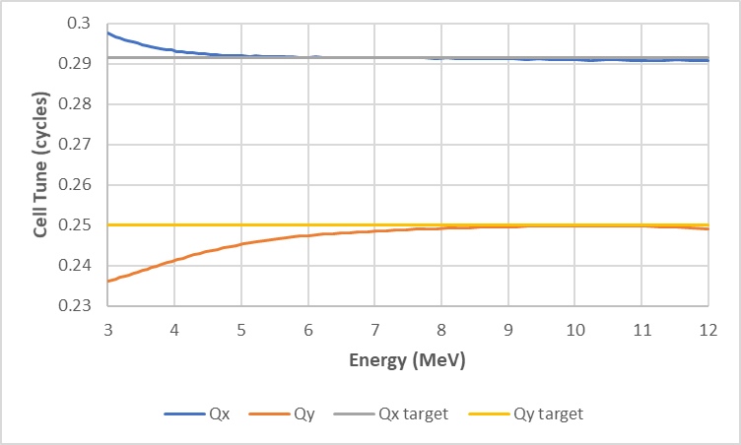
Half-way Interpolation Result
What happens if you average the fields (equivalently, multipole coefficients) between two of the corner designs?
  (0.2917,0.2083),(0.2917,0.2917) → (0.2917,0.25)?
Not so bad, especially at higher energies, but needs re-tuning iteration

Slide 23
Horizontal Omni-Magnets
Round ones were described in my IPAC’13 paper
“Arbitrarily” configurable field B_{y}(x)
  Are their own correctors
Try flat 80cm-wide poles, 8cm full gap, with large embedded pole face windings
  20 windings each top and bottom
  2x4cm cross-section, 4cm horizontal pitch
Main 8x16cm H-magnet-style coil for dipole
Pole face windings return on nearest side
  Produce quadrupole if all have equal current

Slide 24
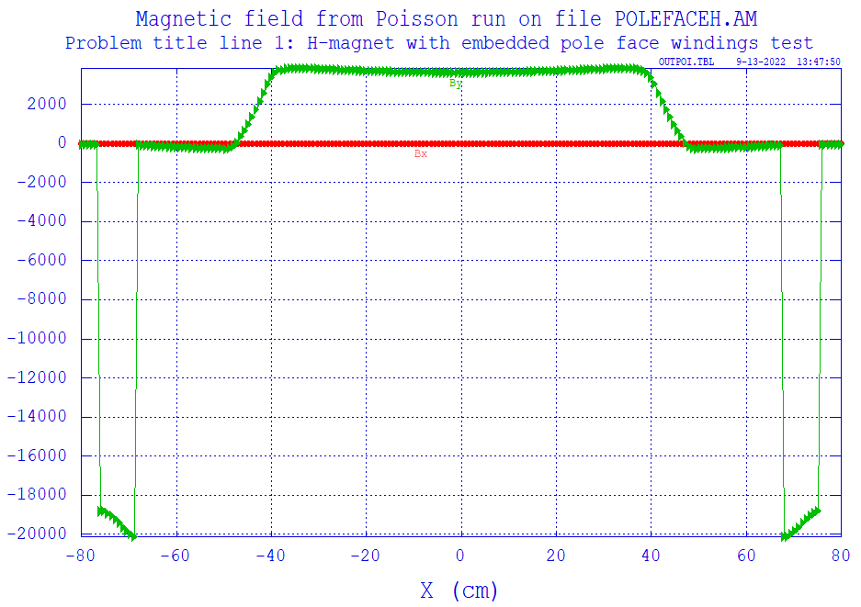
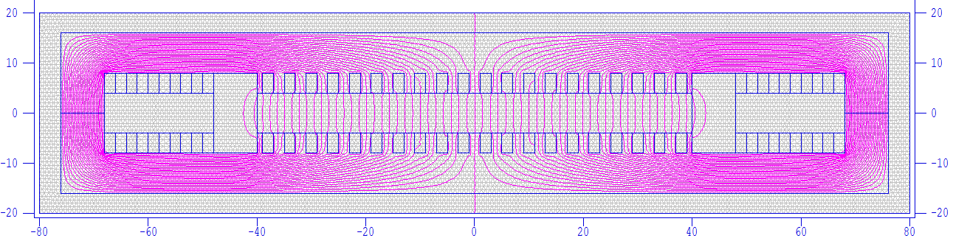
Main Dipole Coil @ 5A/mm²
Roughly flat field, about 0.4T
2D designs in Poisson/SuperFish
(plots are in cm, Gauss)

Slide 25
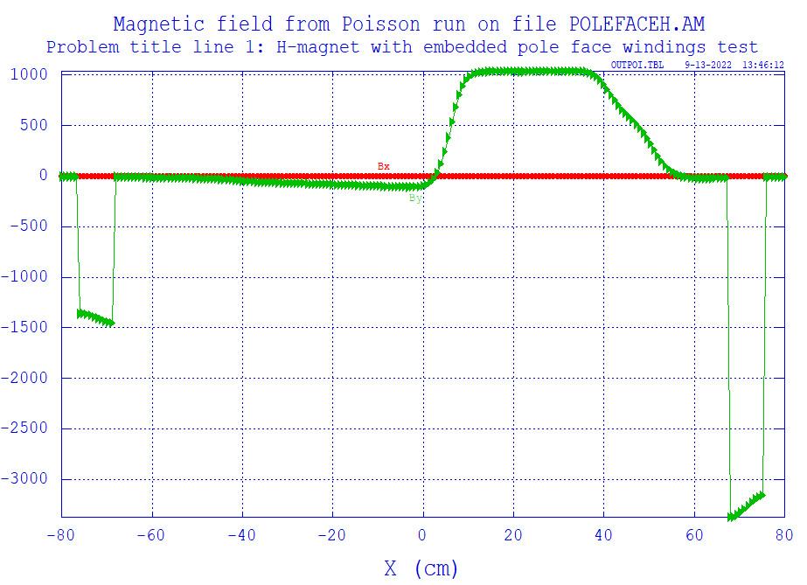
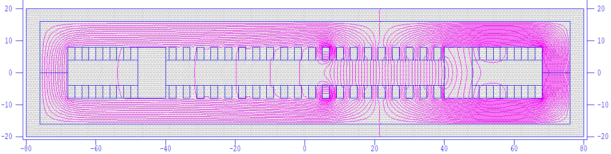
Single Pole Winding @ 5A/mm²
Produces ~0.1T field plateau to return side

Slide 26
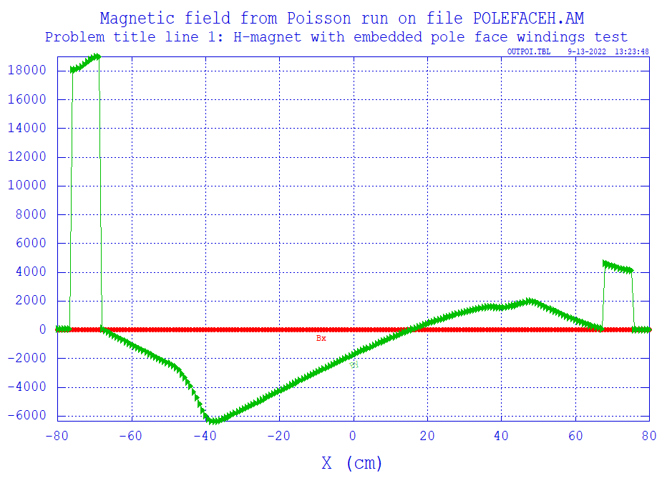
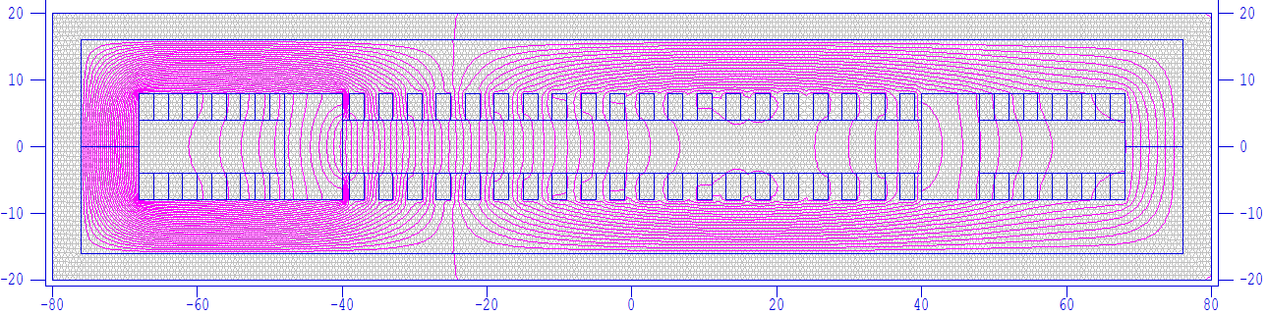
Q_{x}=0.2083, Q_{y}=0.2917 F magnet
0.613T peak field, “hardest case”

Slide 27
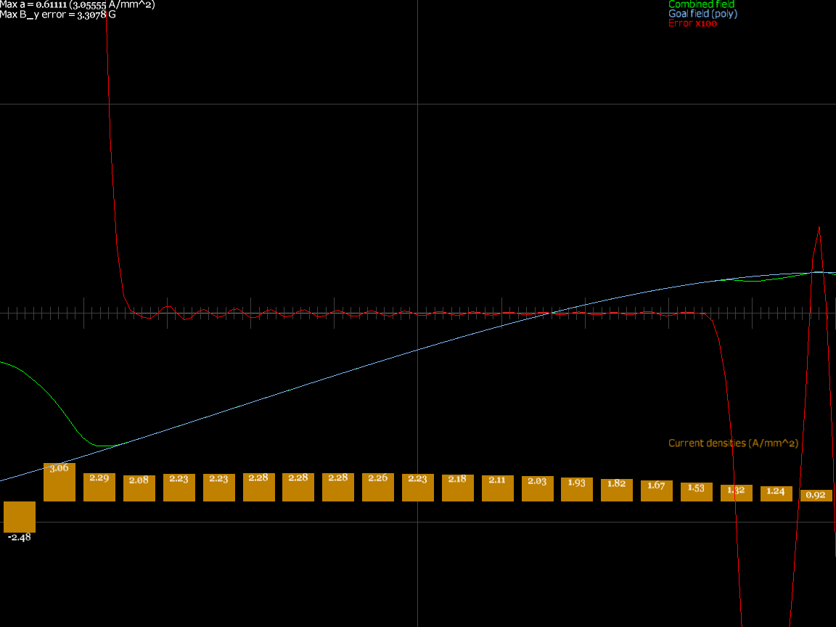
Q_{x}=0.2083, Q_{y}=0.2917 F magnet
Winding current densities were found by SVD / least squares

Slide 28
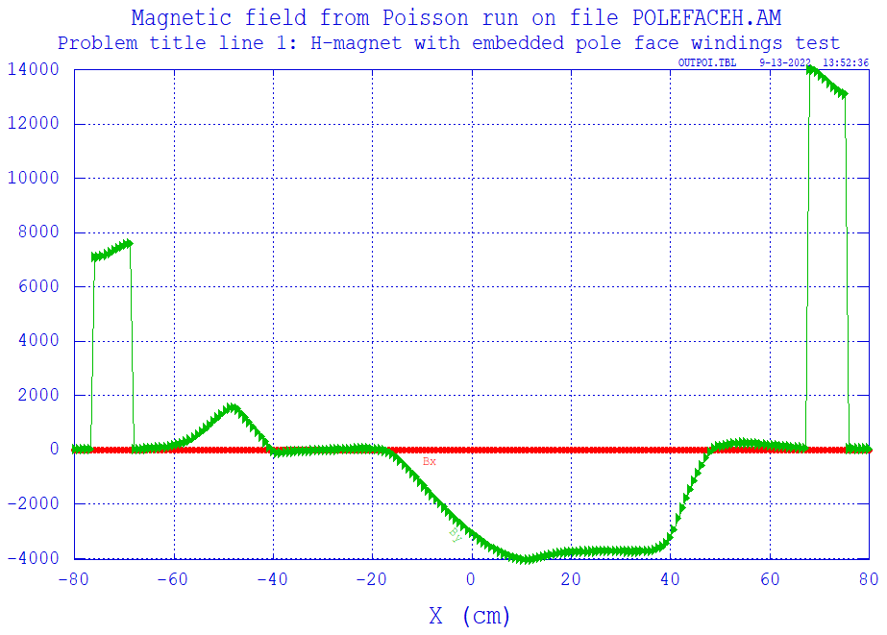
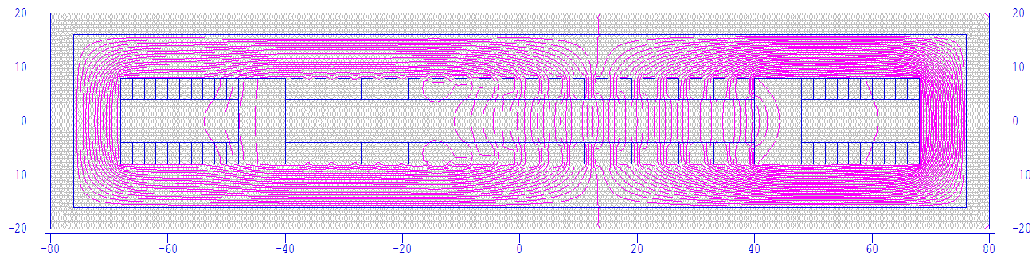
Q_{x}=0.2917, Q_{y}=0.2917 D magnet
0.404T peak field, only requires small part of aperture

Slide 29
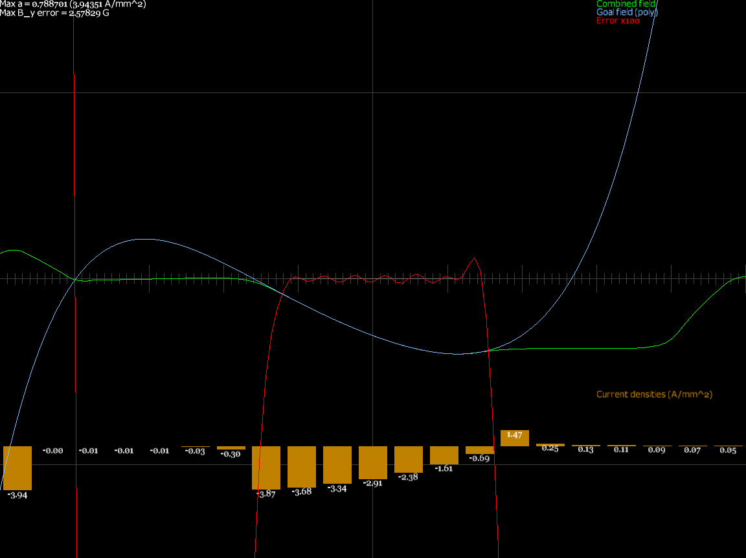
Q_{x}=0.2917, Q_{y}=0.2917 D magnet
SVD only activates coils in the region they have an effect

Slide 30
Magnets Summary Table
Cell Q_{x} | Cell Q_{y} | Magnet name | Max current density (A/mm²) | Max B_{y} error (G) | Max field (T) | Orbit range (m)
0.2083 | 0.2083 | F | 2.090 | 2.25 | 0.5201 | 0.641
 |  | D | 3.111 | 1.98 | 0.3921 | 0.460
0.2083 | 0.2917 | F | 3.056 | 3.31 | 0.6126 | 0.688
 |  | D | 2.955 | 2.31 | 0.4260 | 0.471
0.2917 | 0.2083 | F | 3.073 | 2.23 | 0.4418 | 0.389
 |  | D | 3.189 | 1.89 | 0.3370 | 0.247
0.2917 | 0.2917 | F | 3.480 | 2.50 | 0.3883 | 0.381
 |  | D | 3.944 | 2.58 | 0.4035 | 0.224
0.216 | 0.213 | F | 2.372 | 1.88 | 0.4224 | 0.573
 |  | D | 4.256 | 2.32 | 0.4270 | 0.400

Slide 31
Quick Dynamic Aperture Test
Started 8 particles at (x,y) = (±2.5/0,±2.5/0)cm
  Cell Q_{x}=0.216, Q_{y}=0.213 design
Tracked in ring for 60μs, all survived
Some particles at 3cm did not
Can use ε = x_{inj}²/β_{inj} to get apertures
Energy | Cells (in 60μs) | Turns | ε_{x} (geom.) | ε_{y} (geom.)
3MeV | 697 | 58 | 471 | 428 mm.mrad
6MeV | 954 | 79 | 408 | 374 mm.mrad
12MeV | 1266 | 105 | 381 | 365 mm.mrad

Slide 32
Dynamic Aperture Notes
FETS-FFA request was 100mm.mrad normalised at 3MeV (βγ=0.080)
  = 1250 mm.mrad geometric
β_{y} = 1.46m at 3MeV injection point
  Implies y = ±4.27cm (or ±5.31cm at maximum β_{y})
  Larger than the magnet aperture (±4cm)!
This DA is not the painted beam size, it is a stability margin (all beam ≤ 250 mm.mrad)

Slide 33
Analytic Method for 2 Thin Lenses
Assume small-angle (paraxial) approximation
  Weak focussing and edge focussing are negligible
  Not valid for the FETS-FFA example!
Fixed cell tunes with two lenses implies constant normalised focussing strength with momentum in each lens
  Q_{x}, Q_{y} are two constraints on linear optics and the focussing strengths (gradients) are two variables
For the case with 3 lenses and 2 constraints, see my IPAC’11 paper

Slide 34
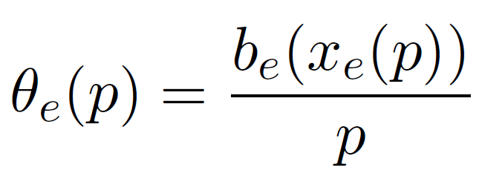
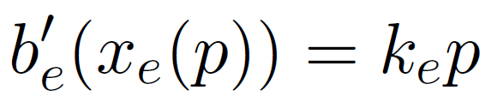
Function Variable Elimination
d₁
d₂
Ends at θ_{cell}, Δx_{cell} (constants)
F
D
x_{F}(p)
x’₁(p)
x_{D}(p)
x’₂(p)
Four constraints from linear tracking at each energy (and closure)
θ_{F}(p)
θ_{D}(p)
b_{F}(x)
b_{D}(x)
Two constraints from constant normalised gradient assumption
...becomes the differential equation
Two constraints from rigidity relation
Normalised b = q(Bℓ)

Slide 35
Change to Geometric Variables
Rigidity: pθ(p) = b(x(p))
Constant norm. gradient: b’(x(p)) = kp
dRigidity/dp: θ(p) + pθ’(p) = b’(x(p))x’(p)
Therefore: θ(p) + pθ’(p) = kpx’(p) [= kD_{x}(p)]
x dependency and b have been eliminated
The rest is easy
  Linear algebra
  Solving a 1-variable differential equation
See https://stephenbrooks.org/ap/report/2022-3/fixedtune2.pdf

Slide 36
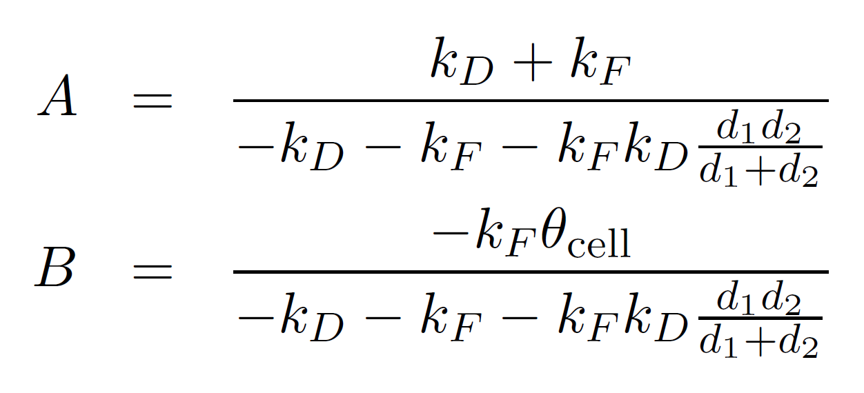
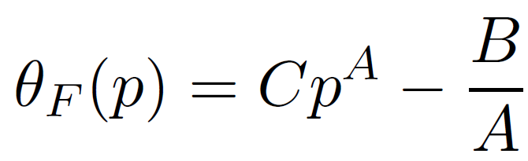
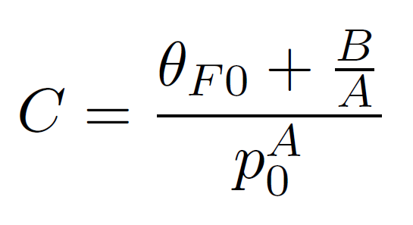
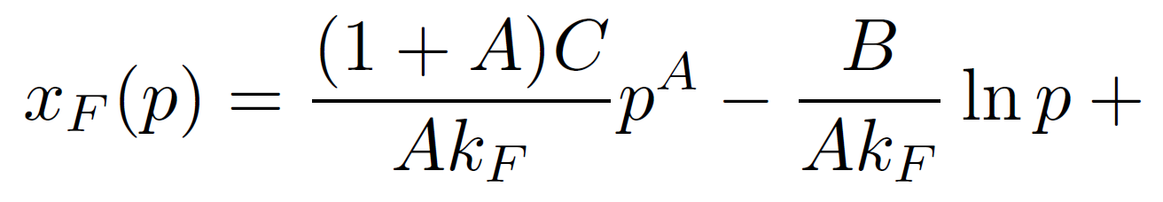
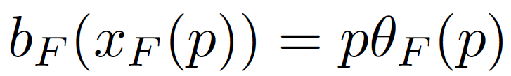
Two Thin Lenses Result
The general solution:
C=0 corresponds to straight scaling FFA
  Constant angle, logarithmic orbit position
Range of other solution families are possible
gives field profile implicitly
(arbitrary choice of x origin)

Slide 37
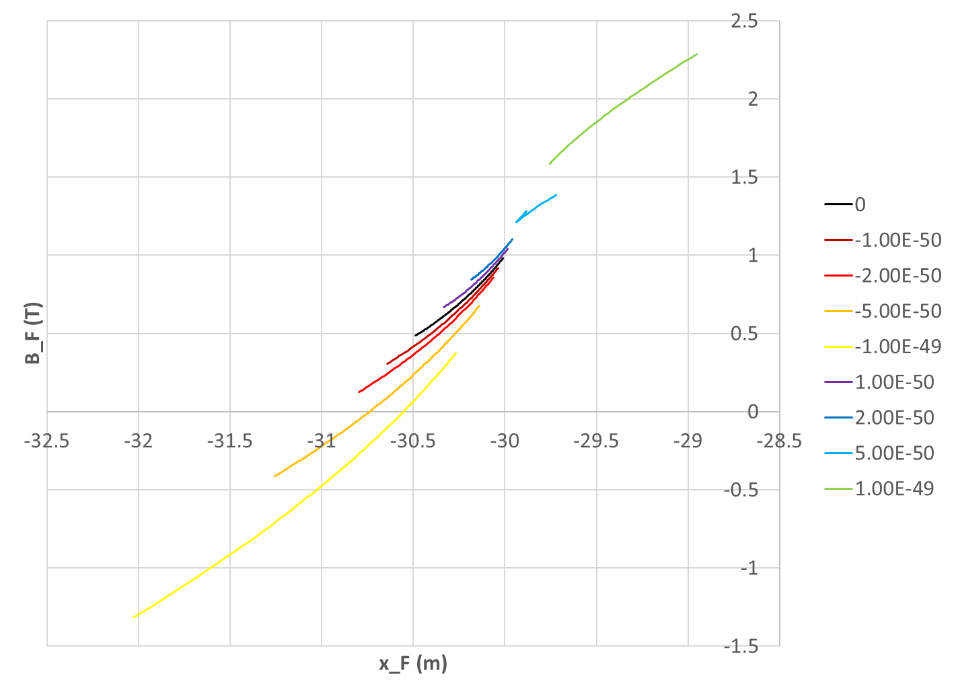
Example
Approximately the FETS-FFA parameters but not the same machine (not paraxial)
Negative values of C here produce fields that cross zero like non-scaling FFAs
C values:

Slide 38
Conclusion
Found fixed tune lattices to ~0.001 in cell tune
  And automated: eliminated most hand-tuning!
Dynamic aperture low by factor 2-3× in ε
  Not small by most standards: >400mm.mrad
  Haven’t explored the full tune plane yet
Magnetic efficiency about twice as good as (spiral) scaling FFA, magnets buildable
  ~0.6T max field on beam vs. ~1.2T
Very interesting machine type

Slide 39
Future Work
Dynamic aperture search of tune plane
  And maybe other parameters like fringe length or magnet edge angles (rect vs. sector etc.)
Try expressing transverse field as something better-conditioned than polynomials
  Like Fourier series, or Chebyshev polynomials
Maybe investigate low-level tune “noise” in Muon1 tracking/optics algorithm
  Could also be field model nonsmoothness

