Slide 1
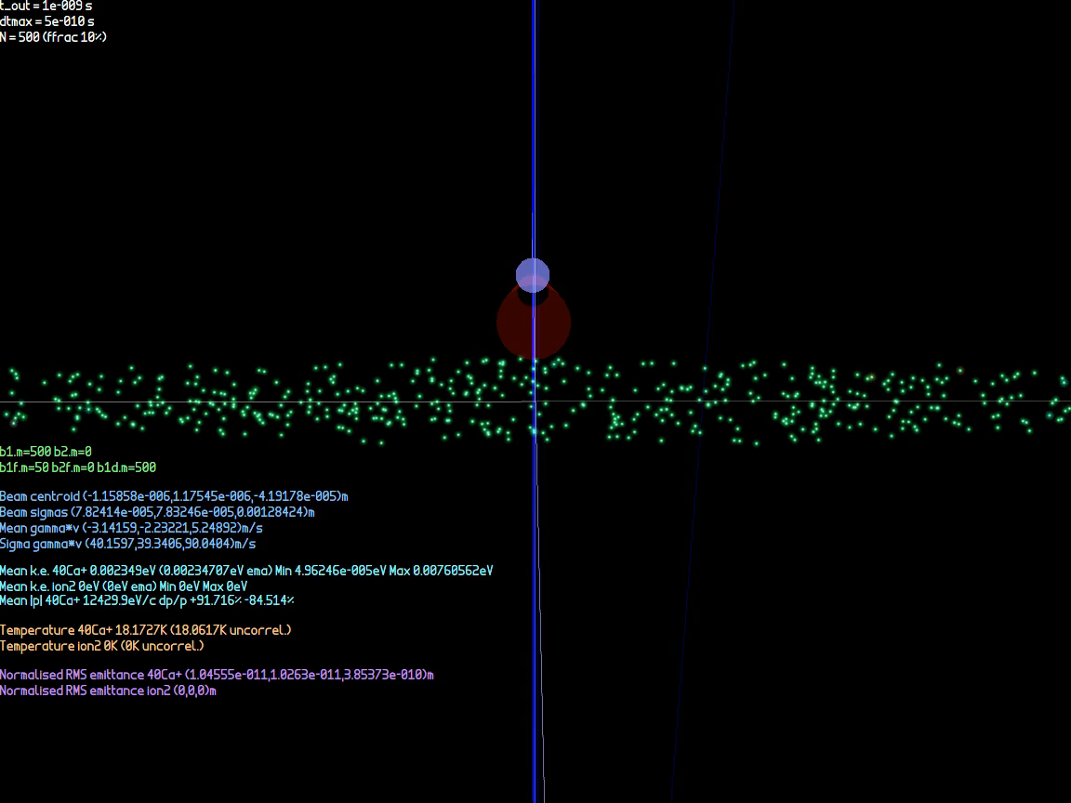
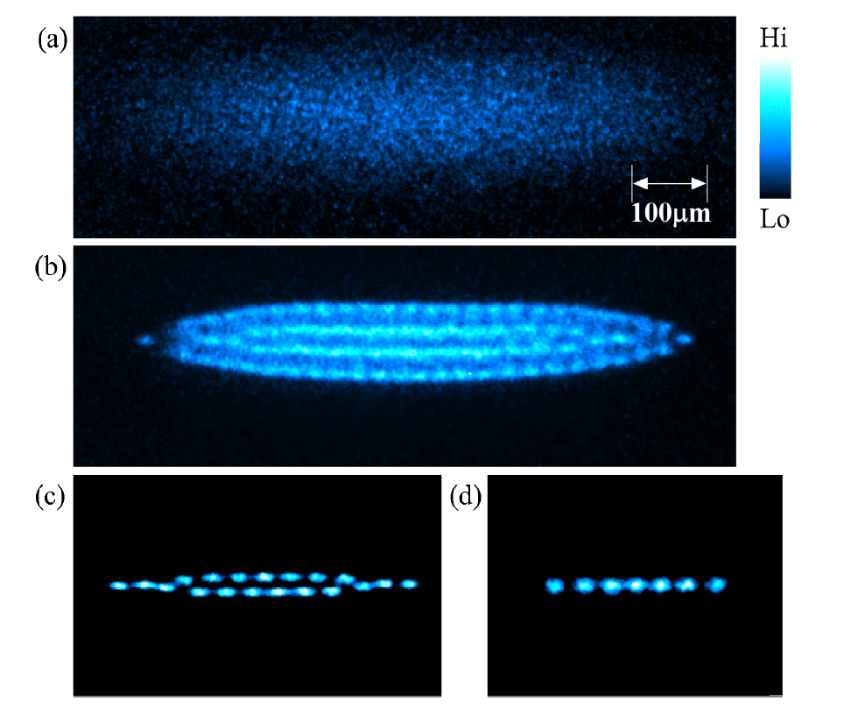
Ion Trap and Coulomb Crystals
Using laser Doppler cooling, can form ultra-low emittance bunches that are crystalline
  ~10⁵ times smaller than conventional beams
  Milli-Kelvin temperature range
Simulation studies on stability in transfer lines and rings
At high energy the beams produce very dense focal points
  Would approach nuclear density at TeV energies
  Perhaps a new kind of accelerator?
Cooling simulation
Paul trap configuration: four ~2MHz transverse electrodes (like alternating gradient focussing) and DC longitudinal end caps
Temperature limit T_{D} = ℏΓ/2k_{B} = 0.552mK
Experimental result example
Fluorescence of Coulomb crystal in S-POD trap, from K. Izawa et al., J. Phys. Soc. Jpn., Vol. 79, No. 12 (U.Hiroshima)
Longitudinal trap electrodes with injection / extraction hole
Emitted in random direction
Transverse trap electrodes
⁴⁰Ca⁺
397nm photon
Ions
Laser

Slide 2
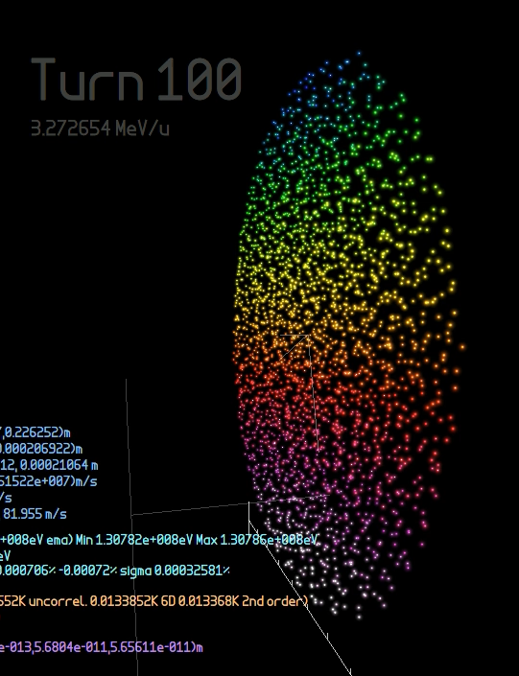
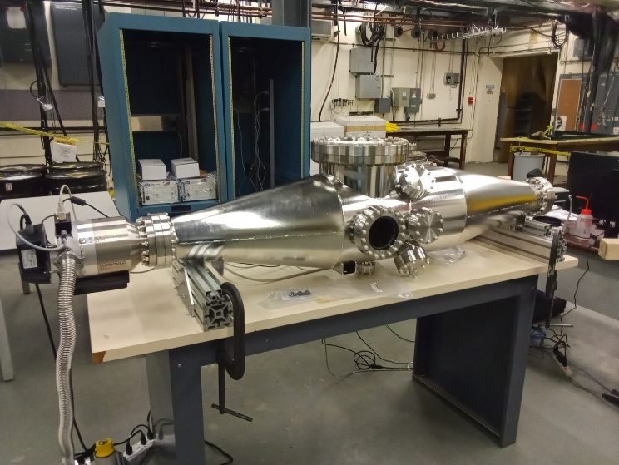
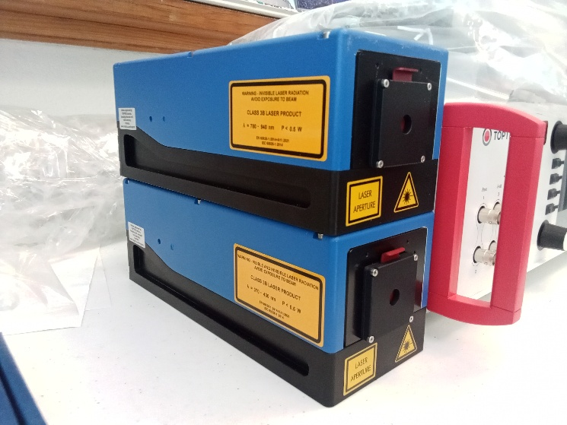
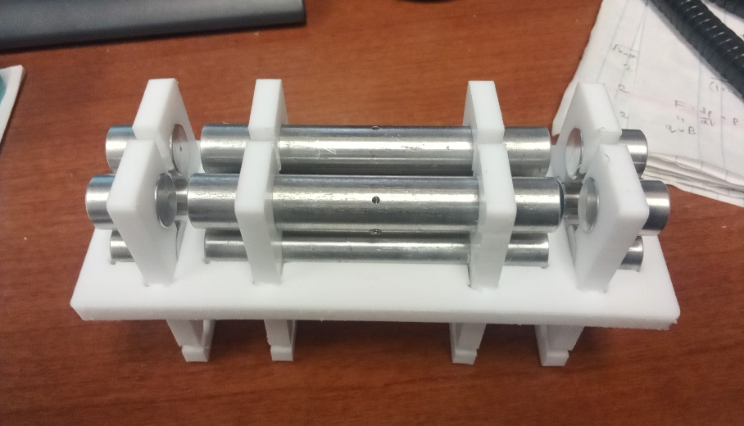
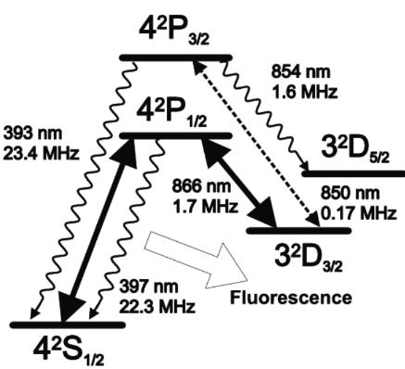
Experiment at BNL
Aiming to trap and cool ions
Later, extract into:
  Low energy test beamlines
    Beam transport tests
    Optics and stability
  BNL injectors?
    Stability in Booster ring →
Several experiments possible!
Booster simulation
Vacuum chamber and lab
Ion trap: insulator + aluminium rod electrodes
Cooling lasers at 397nm and 866nm

